Slide 1
Unit 5: GECONEU project and Evaluation of the Course
Lesson 5.1. Learn more about GECONEU project

Slide 2
Introduction and Learning Outcomes
Welcome to GECONEU course!
This lesson aims to give basic information about the GECONEU project. More specifically, the project background and outcomes as well as the main reached results will be presented.
At the end of this module the users will acquire a set of basic notions on the aim and the results of GECONEU project.

Slide 3
Table of contents
Chapter 1: Project background
Chapter 2: Project outcomes
Chapter 3: Main results

Slide 4
1
CHAPTER
Project background

Slide 5
Project Background
Over the last 20 years, genetic tests have gained importance in personalized medicine and disease prevention, especially to healthy individuals who have a family history of disease or patients who may have a disease resulting from a genetic mutation.
At risk relatives of the 30 million Europeans affected by genetic conditions may be neither recognized nor managed appropriately due to the lack of knowledge about genetics and the few trained health care professionals (HCPs).
This contravenes the EU’s aim and European Society of Human Genetics’s goals to create safe, efficient, patient-centered and sustainable health-care systems.
Klein., 2020; McAllister et al., 2015; European commission Innovation Union., 2011

Slide 6
Project Background
On the other hand, research has demonstrated that genetic testing for Neurodegenerative Disorders (ND) for asymptomatic relatives of people with neurodegenerative disorders (PwND) for specific genes and mutations can be valuable and safe in certain contexts.
However, individuals’ understandings about what genetic susceptibility tests can achieve, what they cannot achieve, and the risks they pose should be more realistic after testing than beforehand.
A lot of studies have shown that genetic testing increases risks for psychological harm, even among individuals who are at risk or positive for risk genes of ND, may elicit grief, distress, conflict, sadness, relief, guilt, uncertainty and ambivalence and that depends on the way that HCPs disclose the genetic information.
Nevertheless, when well informative and supported Genetic Counseling (GC) sessions take place, the genetic information can cause behavioral, day life changes (diet, vitamins/medications, physical activity) and enhance decision making that can work as predictive measures for the diseases.
Christensen et al., 2018; Rostamzadeh et al., 2019

Slide 7
Project Background
Nowadays, because of the lack of trainings on GC on ND, few HCPs are prepared to address the genetic risks and to manage the psychological impact of the disclosure to relatives.
Given the increased incidence of ND, the availability of Direct to Consumer Testing and the development of the precision medicine, an increased demand for high-quality information on ND genetics likely provided in the form of GC by well-trained HCPs, is anticipated.
All these global trends and challenges of genetic testing affect Higher Education Institutions (HEI)’s and their departments in the field of health as they aim to equip their students to become societal involved, well-educated HCPs.
There is a crucial need to use the existing knowledge and experiences from a variety of disciplines on the field of genetics to build an innovative learning method and course which will include the best practice guidelines on how future HCP need to implement GC, which is the most appropriate method to introduce genetic testing to patients and people at genetic risk.
Manrique de Lara et al., 2018

Slide 8
Project Background
The main aim and central impact of this project is to support people and society to better understand the aims of genetic testing and the usefulness of genetic counseling by involving students in an innovative learning and teaching setting.
This project will provide the opportunity to take all the factors of an appropriate training course to society into account by involving the families of PwND in the development of the learning and teaching outcomes consequently improving their visibility and enhancing their level of knowledge.

Slide 9
The consortium consists of 6 partners, covering all the necessary components of the ecosystem and of the innovation chain, to reach the project objectives. You can find more information for our team here http://www.genecounsel.eu/index.php/consortium
Aristotle University of Thessaloniki
(Greece)
Panhellenic Institute of Neurodegenerative Diseases
(Greece)
Ruprecht - Karls - Iniversitaet Heidelberg
(Germany)
Ace Alzheimer Center Barcelona
(Spain)
Vrije Universiteit Brussel
(Belgium)
Izmir Ekonomi Universitesi
(Turkey)

Slide 10
2
CHAPTER
Project outcomes

Slide 11
Project Outcomes
The project is divided in different Work Packages (WP) with different Project Results (PR). These PRs lead to the following main 4 outcomes:
1. ¨Best Genetic Counseling Protocol¨ in Europe (PR1)
Experts in the field of GC shared their existing GC protocols and partnership created the final European Guidelines. A needs analysis, involving a large variety of participants from care and patient organizations, diagnostic institutions and genetic laboratories was conducted in order to define their needs and the specifications of the protocol. The Methodological Guide is the final result.
2. An innovative creative course (PR2 and PR4)
The project developed an innovative interactive course that can be part of the curriculum of HEI’s in Europe. This has been done by involving care organizations, families, HCPs in the field of neurology, genetics and psychology in a co-design process, bringing theory and practice together, and taking the workplace as a starting point for new course material in education.

Slide 12
Project Outcomes
3. Service System for Universities' e-learning platforms (PR3)
The training material of the course is offered through a Software-as-a-Service (SaaS), which is able to integrate into any e-learning platforms, increasing the sustainability and impact of the results of the project, while promoting the competencies of students and giving them the possibility to exchange results internationally.
4. Guideline handbook (PR4)
Finally, the result is a guideline handbook, that helps HEIs across Europe to implement the training, the service system and the teaching material, supporting the impact, replicability and sustainability of GECONEU outcomes. This handbook has been set up based on extensive testing of the learning material and service system in pilots and experiences of 4 different faculties in 4 countries. The handbook facilitates the implementation in HEIs throughout Europe.

Slide 13
3
CHAPTER
Main reached results

Slide 14
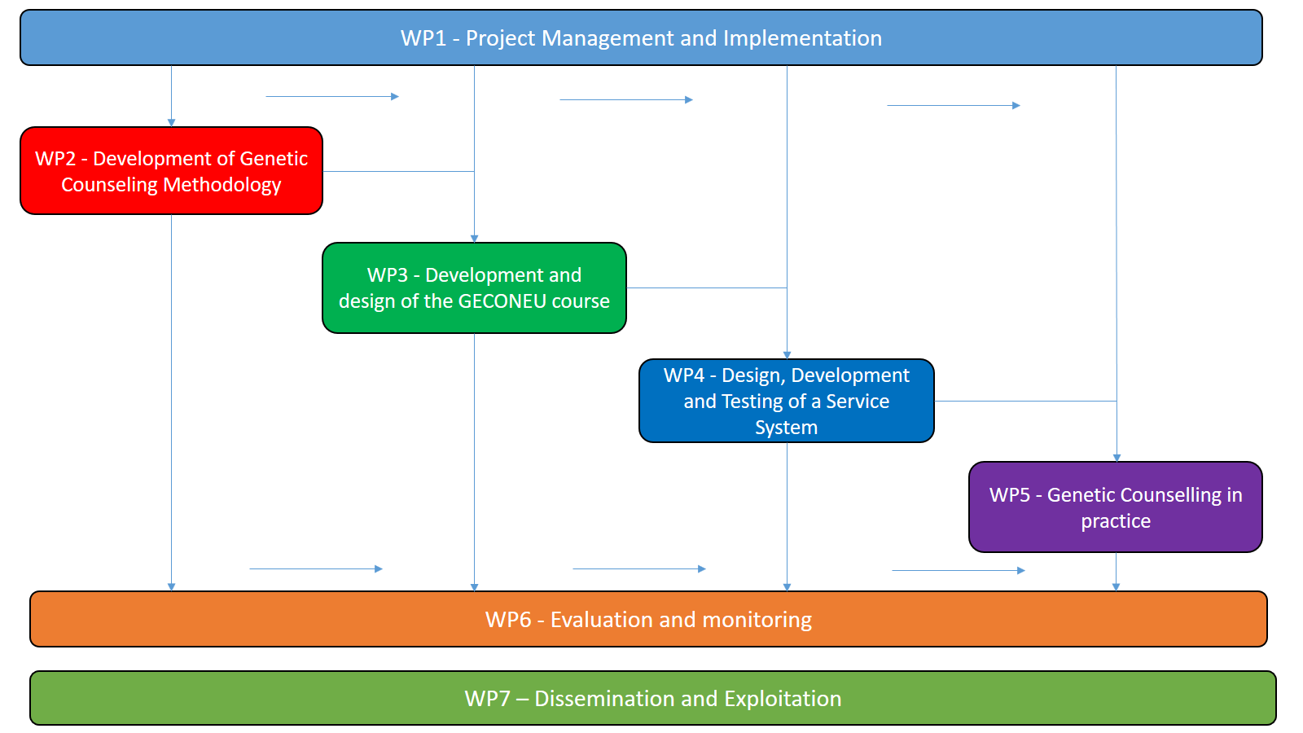
Workplan
We choose to split the different actions we are going to undertake in seven main WPs.

Slide 15
Main Results
At this moment, the project has entered the first operational phase, and some parts of the second project result. More specifically the following tasks have been completed:
PR1: Development of Genetic counseling intervention methodology
Task 1.1. Preparation of GC intervention
Task 1.1.1. Collection of recommendations and existing GC protocols.
Task 1.1.2. GC interventions.
Task 1.1.3. First Draft of the Methodological Guide of GC intervention
Task 1.2. Definition of the Needs of participants in GC
Task 1.2.1. Qualitative research with experts in the field.
Task 1.2.2. Quantitative research in families of PwND
Task 1.3. Development and design of the Transnational Implementation Guidelines

Slide 16
Main Results
PR 2: Development and design of the course and material
Task 2.1. Systematic research on existing innovative materials and courses
Task 2.1.1. Cross-country comparison of the courses in partnership countries
Task 2.1.2. Systematic research on existing innovative material and courses across EU
Task 2.1.3. Report on the similarities and differences in courses
Task 2.2. Development and design of material
Task 2.2.1. Definition of the structure of the course
Task 2.2.2. Definition of the content of the course
Task 2.2.3. Design and Development of each Lesson of the course
Task 2.2.4. Development of the final Lessons

Slide 17
Main Results
PR 3: Design, Development and Testing of a Service System for students' evaluation and learning
Task 3.1. Develop the functional requirements and Analyze the Stakeholder Requirements and Systems Requirements
Task 3.1.1. Collecting and allocating stakeholder requirements
Task 3.1.2. Analyze and validate Stakeholder and Systems Requirements
Task 3.1.3. Develop the functional requirements
Task 3.2. Develop Service System Designing
Task 3.2.1. Create a safe and effective Service System that meet the requirements
Task 3.3. Integrate Service Systems in ΗΕΙs' e-learning platforms
Task 3.3.1. Insert the new Service System in platforms
Task 3.4. Verify and Validate Service Systems
Task 3.4.1. Verify and Validate Service Systems

Slide 18
Main Results
PR 4: Genetic Counselling in practice
Task 4.1. Installation and pre-testing for the pilot in 2 or 3 iterative rounds
Task 4.2. Pilot running in 4 iterative rounds of 3 months
Task 4.3. Evaluation of outcomes
Task 4.4. Implementation of necessary adjustments and translation into guidelines
Task 4.5. Definition and drafting of the guidelines-Develop the final Handbook

Slide 19
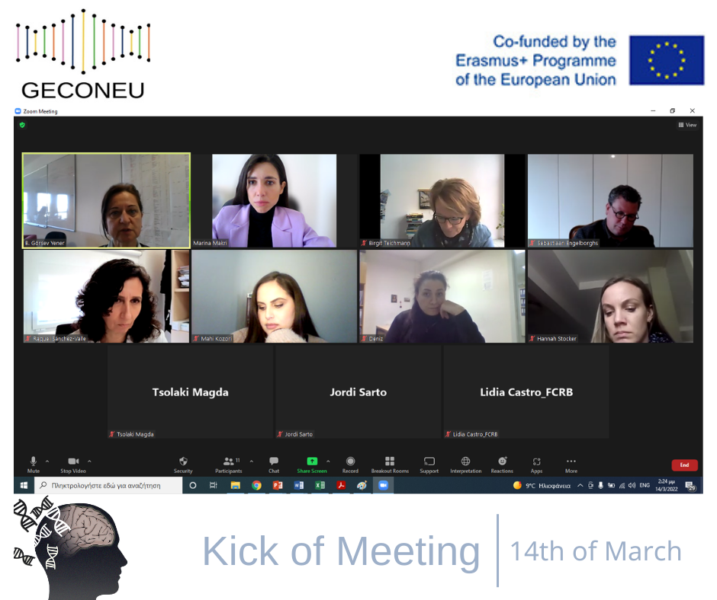
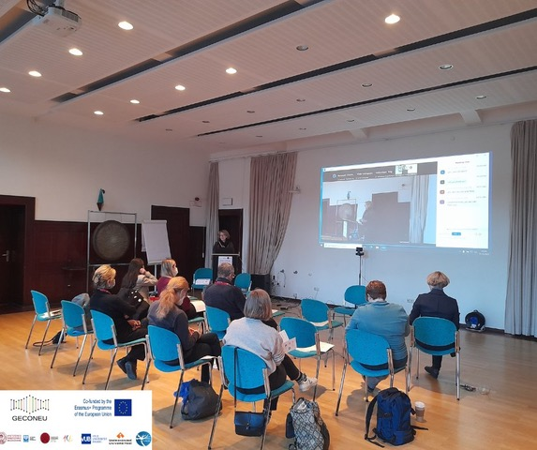
Meetings/Events
Kick off meeting was organized online on 14th of March 2022
2nd Transnational Project Meeting in Heidelberg & Symposium on 15th and 16th of December 2022

Slide 20
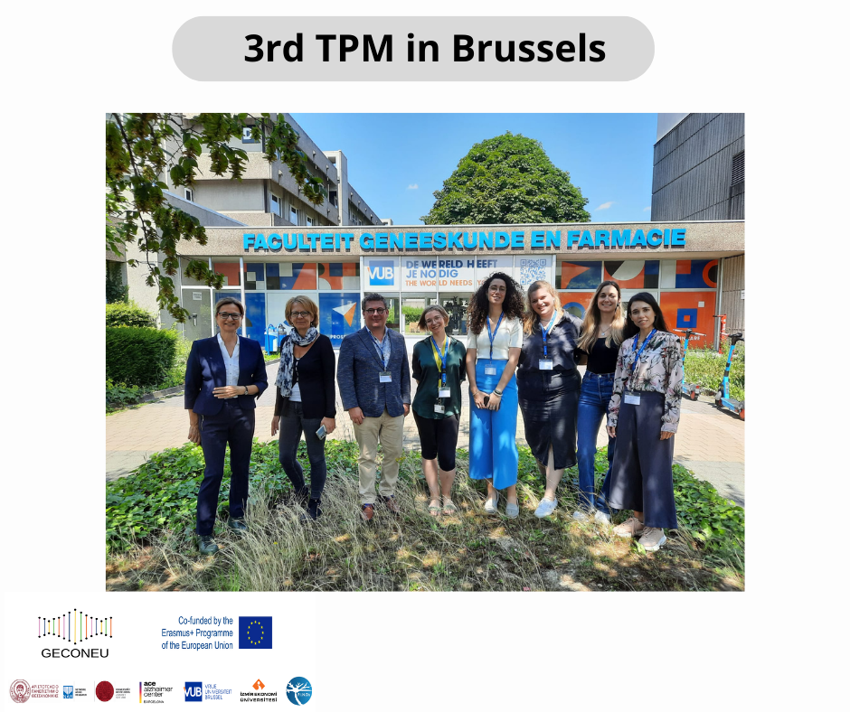
Meetings/Events

Slide 21
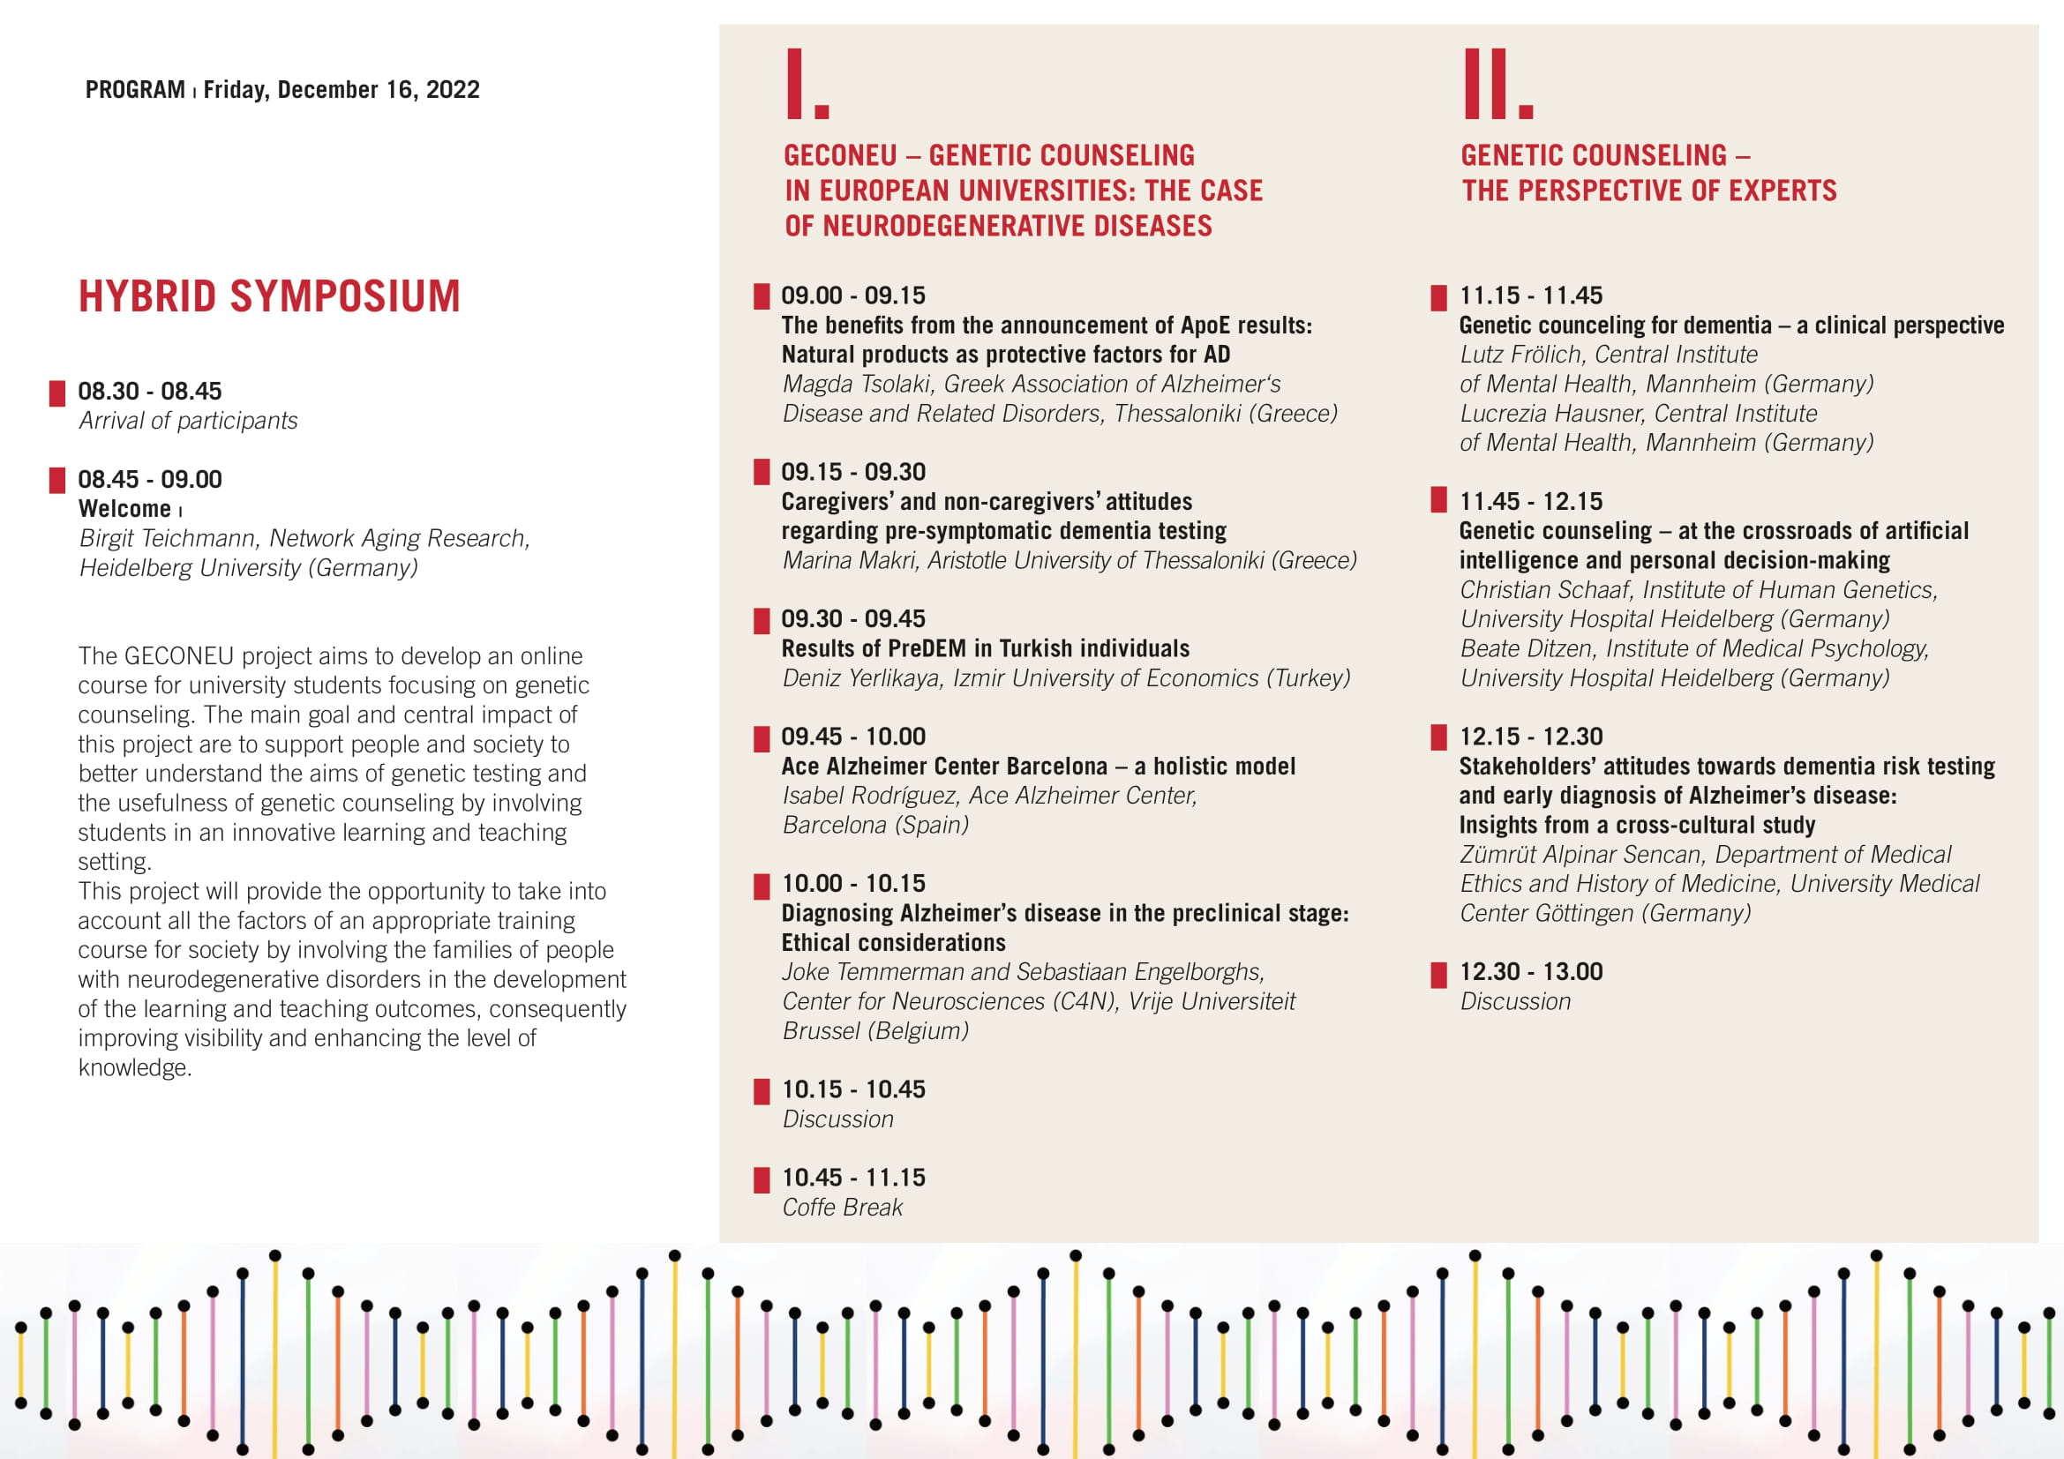
Hybrid Symposium

Slide 22
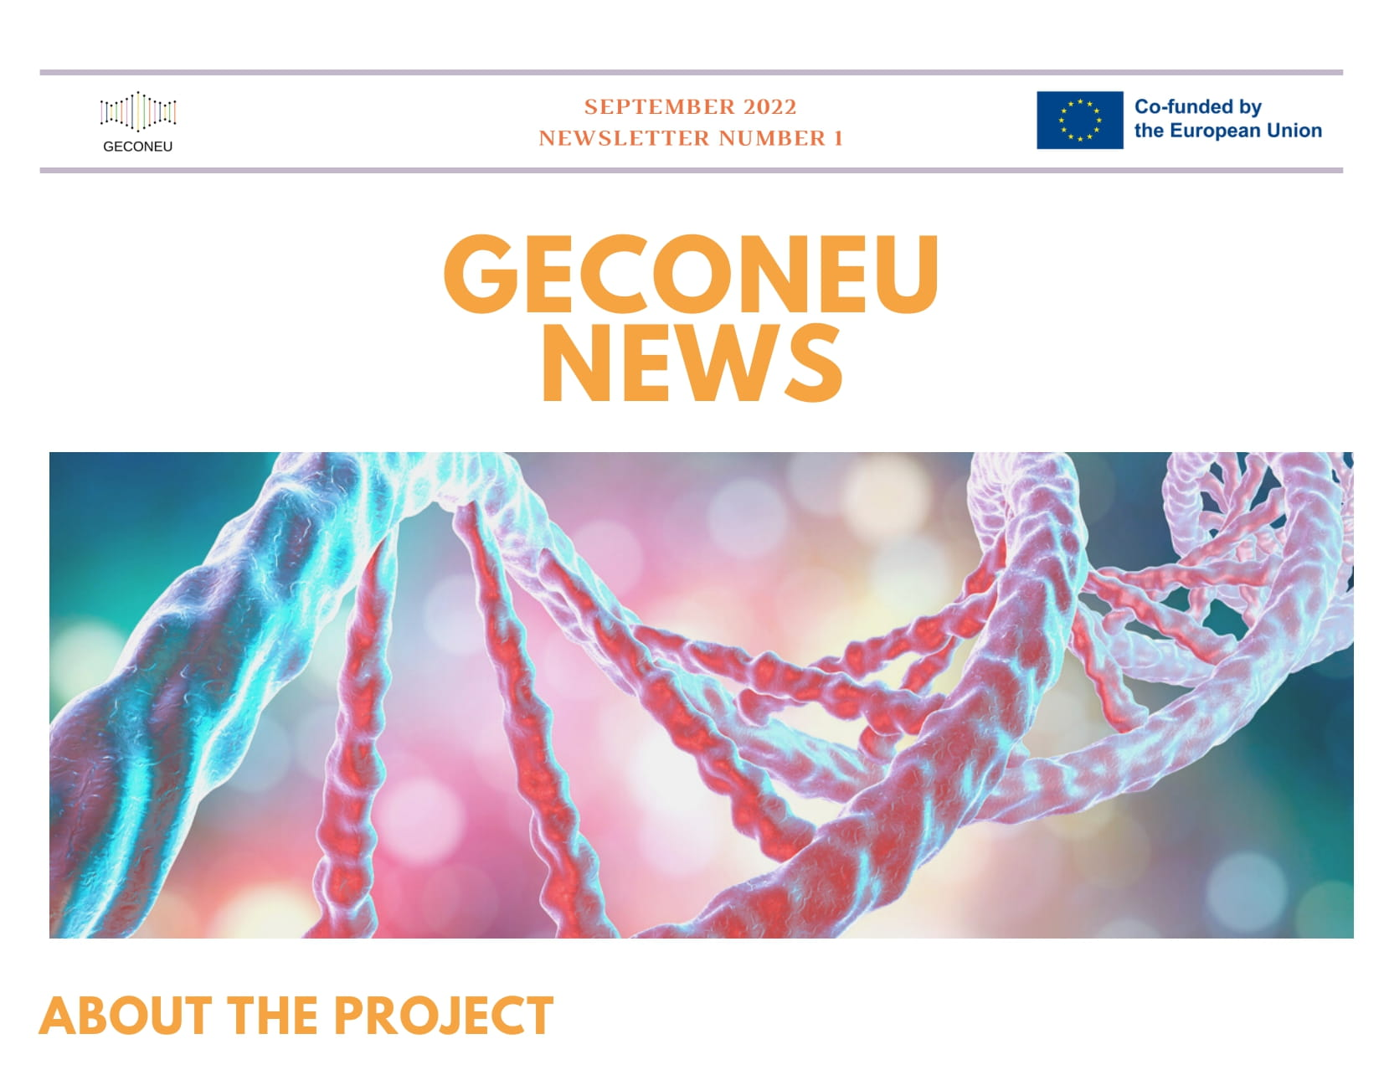
Newsletters & Press Release
You can find here all the published newsletters and press releases in English and in other 5 languages: Greek, German, Spanish, Turkish and Dutch. http://www.genecounsel.eu/index.php/dissemination/newsletters-press

Slide 23
Social Media
https://www.facebook.com/geconeuproject/
https://www.linkedin.com/company/geconeu-project/
https://twitter.com/GeconeuP

Slide 24
Website
You can visit our website for more information and content about GECONEU project…
http://www.genecounsel.eu/

Slide 25
Check your understanding!

Slide 26
Check your understanding!
The GECONEU is the acronym of the project “Genetic counseling in European universities: The case of neurodegenerative diseases”.
True
False
The consortium includes six institutions from Belgium, Germany, Greece, Spain and Turkey.
True
False

Slide 27
Check your understanding!
This project will involve the families of people with Neurodegenerative disease.
True
False
The Guideline handbook is the final project outcome.
True
False
There is total 4 lessons in the course.
True
False

Slide 28
References
Additional resources

Slide 29
References
Christensen, K. D., Vassy, J. L., Phillips, K. A., Blout, C. L., Azzariti, D. R., Lu, C. Y., Robinson, J. O., Lee, K., Douglas, M. P., Yeh, J. M., Machini, K., Stout, N. K., Rehm, H. L., McGuire, A. L., Green, R. C., Dukhovny, D., & MedSeq Project (2018). Short-term costs of integrating whole-genome sequencing into primary care and cardiology settings: a pilot randomized trial. Genetics in medicine : official journal of the American College of Medical Genetics, 20(12), 1544–1553. https://doi.org/10.1038/gim.2018.35
Lex - 52018SC0126 - en - EUR-lex. EUR. (n.d.). https://eur-lex.europa.eu/legal-content/EN/TXT/?uri=CELEX%3A52018SC0126
McAllister, M., Moldovan, R., Paneque, M., & Skirton, H. (2016). The need to develop an evidence base for genetic counselling in Europe. European journal of human genetics : EJHG, 24(4), 504–505. https://doi.org/10.1038/ejhg.2015.134
Rostamzadeh, A., Stapels, J., Genske, A., Haidl, T., Jünger, S., Seves, M., Woopen, C., & Jessen, F. (2020). Health Literacy in Individuals at Risk for Alzheimer's Dementia: A Systematic Review. The journal of prevention of Alzheimer's disease, 7(1), 47–55. https://doi.org/10.14283/jpad.2019.34
Von Vaupel-Klein, A. M., & Walsh, R. J. (2021). Considerations in genetic counseling of transgender patients: Cultural competencies and altered disease risk profiles. Journal of genetic counseling, 30(1), 98–109. https://doi.org/10.1002/jgc4.1372

Slide 30
Additional resources
Books and papers:
Handbook of Genetic Counseling
Paper: Goldman J. S. (2020). Predictive Genetic Counseling for Neurodegenerative Diseases: Past, Present, and Future. Cold Spring Harbor perspectives in medicine, 10(7), a036525. https://doi.org/10.1101/cshperspect.a036525
Paper: Yang, M., & Kim, J. W. (2018). Principles of Genetic Counseling in the Era of Next-Generation Sequencing. Annals of laboratory medicine, 38(4), 291–295. https://doi.org/10.3343/alm.2018.38.4.291
Websites:
YouTube: What is genetic counseling?
The European Society of Human Genetics

Slide 31
Thank you
Visit our website
http://www.genecounsel.eu/
This project has been funded with support from the European Commission. This presentation reflects the views only of the author, and the Commission cannot be held responsible for any use which may be made of the information contained therein.

