Slide 1
Unit 3. Counseling and practice
Lesson 3.2. Cultivating counseling and communication skills

Slide 2
Introduction and Learning Outcomes
Lesson 3.2 aims to give basic information about the main communication and counseling skills that are some of the critical skills that a counselor has to cultivate to effectively influence change in a client. It will include interactive materials and methods.
At the end of this module, the users will acquire a set of basic notions on
Why is communication important in genetic counseling and what are the main skills that a counselor needs to bring in a session with a client
The main communication skills that every counselor should cultivate
Exercises for practicing and cultivating effective communication skills and relationships with clients

Slide 3
Table of contents
Chapter 1: Introduction and the importance of counseling skills
Chapter 2: Verbal communication skills
Chapter 3: Non – Verbal communication skills
Chapter 4: Vocal communication skills
Chapter 5: Counseling in practice – Exercises

Slide 4
“What skills are needed when counseling a client?”

Slide 5
1
CHAPTER
Introduction and the importance of counseling skills

Slide 6
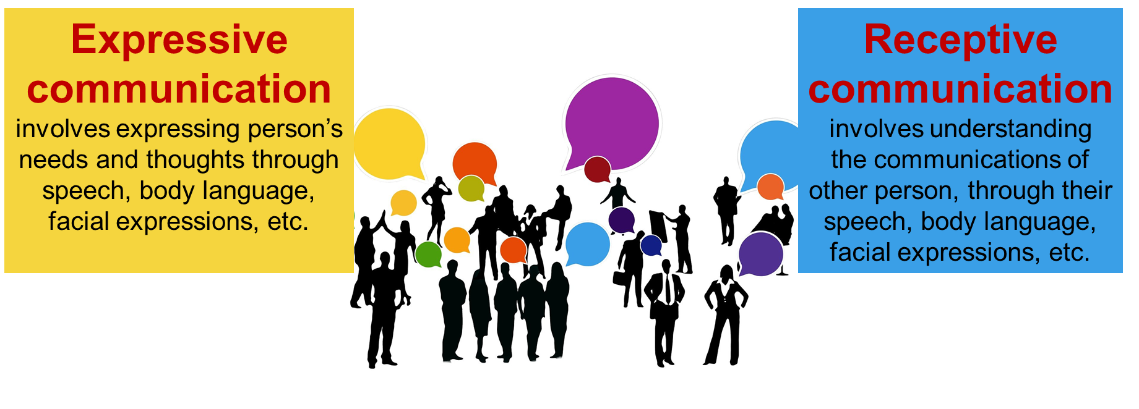
Involvement - communication
Communication (the expressive or receptive exchange of information) is vital to the functional success and emotional well-being of a person.

Slide 7
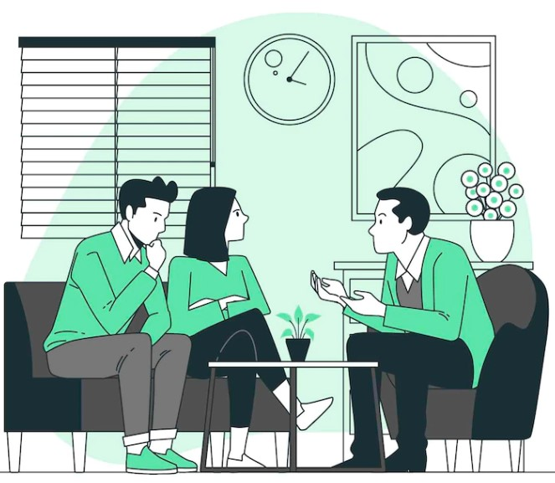
Why is communication important in counseling?
The words and phrases have the power to significantly impact the alliance and outcome of a counseling session.
Our communications are more than simple words; they shape “the climate of the relationship and the tenor of the alliance”. Even subtle changes in communication style and content can alter the client’s experience of the relationship, their progress, and how clients see themselves.
Paying close attention to and comprehending their client, it is therefore vital that counselors consider what they say based on the understanding received. Counselors need to use good communication skills to effectively and empathically put their observations into words, enabling the client to integrate new knowledge into an expanded sense of self without feeling shame
Wachtel., 2011

Slide 8
Why are communication skills important in Genetic Counseling?
An important aspect of the counseling profession is the relationship with the counselee. Therefore, the acquisition of good communication skills is an important part of the training of professionals in genetic counseling (GC), because he/she has to:
Establishment of a respectful relationship
Understand the needs of the counselee
Enable counselee to weigh the consequences and benefits in the context of his/her life (with relation to thoughts, values, beliefs, and feelings)
Facilitate decision-making, autonomous choice, and coping skills
Provide the opportunity for self-management
Address concerns
Support family communication
Manage the negative emotions of the counselee
Rantanen et al., 2008

Slide 9
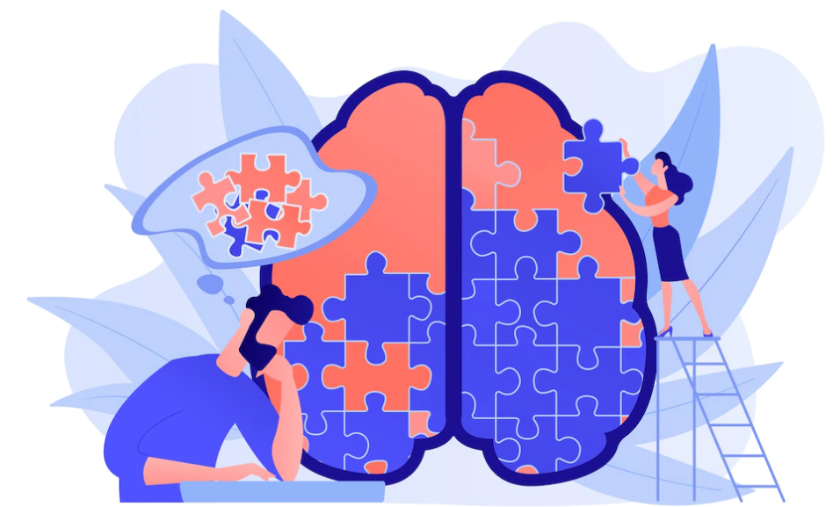
Effective communication can..
Enhance relationships and self-esteem.
Will be enhanced in a supportive and accepting environment.
Will encourage people to openly discuss sensitive issues with a counselor. People will become aware of a wider range of ideas and values relating to these issues, giving them access to many solutions to their problems. This in turn can help clients to build resilience and make informed decisions on their own.

Slide 10
Personal qualities of counselors
The counselor…
is characterized by self-awareness
respects the client’s individuality and dignity
is kind and sympathetic to clients’ problems and anxieties
is gentle, especially when sorting out corrective measures
is dignified and neat in his/her manners, speech and appearance
is in control of his/her emotions, especially of anger, impatience and frustrations
is able to use humor and laughter in counseling
Gladding S.T., 2006

Slide 11
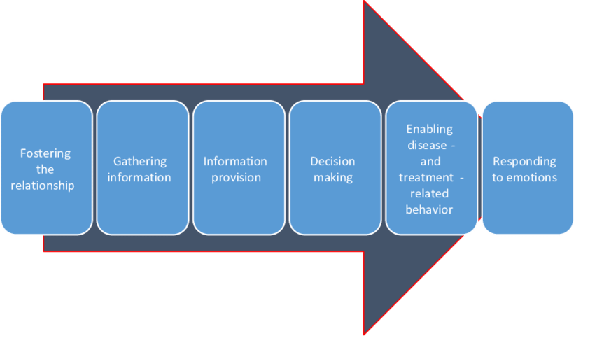
Communication skills in Genetic Counseling
According to Haus and Bensing (2008), the six-function model includes the main steps of medical communication in which a health care professionals needs to use the communication skills. The model distinguishes the following steps:
Haus & Bensing, 2008

Slide 12
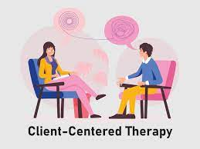
Person-centered approach in Genetic Counseling
The person-centered approach, which embraces genuineness, empathic understanding, and positive regard, is the main theoretical framework of the laboratory genetic counselor practice, as their role is to facilitate understanding and the meaningful use of genetic or familial information.
There are realities unique to the communication between a laboratory genetic counselor and the individual with whom he or she is speaking that often require adaptation of these counseling skills.
Biesecker B., 2020

Slide 13
2
CHAPTER
Verbal communication skills

Slide 14
What are the main verbal communication skills?
Active listening
Reflecting–Paraphrasing-Summarising
Building Rapport
Clarifying and the Use of Questions
Reassurance
Verbal communication skills
Silence
Immediacy
Self-Disclosure
Flexibility

Slide 15
1. Building Rapport
WHAT…
Rapport means a sense of having a connection with the person.
Rapport will be helped and facilitated by how the counselor manages their own feelings towards the client, and how they behave with the client.
Unless a client feels a sense of rapport, they will be unlikely to be able to work well with the counselor.
"Building rapport is as much about you as a person than any techniques or skills ... Clients are drawn to build relationships with people who are caring, trustful and show interest in them."
Griffin, 2006

Slide 16
1. Building Rapport
HOW…
Being well prepared for the session
Make a safe and trusting environment and use a friendly tone
Being aware of who the client is/Introduce oneself and acknowledge the other person by name
Having an accepting manner, including remaining unshocked, whatever the client brings; being non-judgemental
Being unrushed, allowing the client time
Being congruent
Be receptive and responsive to any questions the client might ask
Describe the GC process to clients, as well as modify the agenda as appropriate by continually contracting to address emerging concerns
Elicit client expectations, perceptions, knowledge, and concerns regarding the GC encounter and the reason for referral or contact
Apply client expectations, perceptions, knowledge, and concerns
Thank the person for his/her time
Griffin, 2006; Goodenberger, 2014; ACGC, 2015

Slide 17
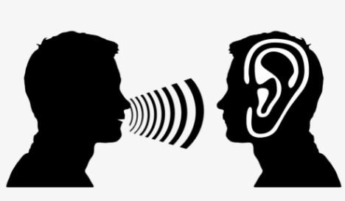
2. Active listening
WHAT…
Active listening is intentionally focusing on the one you are listening to in order to understand what he or she is saying. As the listener, you should then be able to repeat what he or she says in your own words to his or her satisfaction. This does not mean that you agree with what is being said, but that you understand it.
Counselors use this technique in order to collect the correct information, get a clear picture, affirm, acknowledge, and explore the problem.
Australian Institute of Professional Counsellors (AIPC), “AIPC’s Counsellor Skills Series”, Report 1

Slide 18
2. Active listening
HOW…
Attenting skills: Giving your physical attention to another person. Engaging by maintaining an open body posture. Maintaining eye contact, facial expressions, and other signs that show you are interested in what the person is saying.
Following skills: Do not interrupt or distract the speaker. Use minimal encouragers – simple answers that encourage the speaker to tell his or her story. Ask relevant questions that allow for more than a yes or no answer. Don't take on the role of inquisitor and ask too many questions. Maintain attentive silence.
Reflecting skills: Telling the other person what you think they are feeling. “Sounds like you are angry.” • “It seems to me that you feel annoyed.”
Paraphrasing skills: Putting in different words what the other person said and checking you have heard it correctly. • “If I understand you correctly...” • “So you’re saying that…” • “So you think that...” • “Sounds like you’re saying that…”
Focusing skills: You politely ask the other person to focus on their main concern. “I know that all these matters concern you greatly but is there one of these in particular that we can do something about?” “Of what you’ve mentioned, what concerns you the most?”

Slide 19
2. Active listening
Use the following questions in the Active Listening in a session worksheet to reflect on a recent session with a client and the vital factors of active listening.
Did you use open-ended questions?
Were you attentive?
Did you seek clarification?
Did you summarize what was said?
Did you observe nonverbal as well as verbal communication?
Did you use reflection (repeating back what you understood for confirmation)?
Reflect on the answers you gave to each question and consider where you could improve or add additional focus in the future.
https://positivepsychology.com/communication-in-therapy/

Slide 20
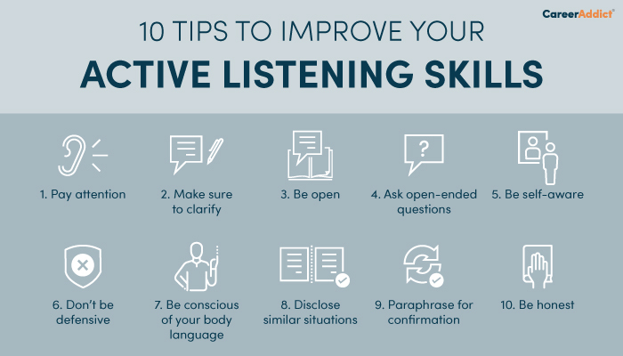
2. Active listening
https://www.careeraddict.com/active-listening-skills

Slide 21
3. Reflecting–Paraphrasing-Summarising
WHAT…
Reflecting in counseling is part of the ‘art of listening’. It is making sure that the client knows their story is being listened to by clarifying and verifying what the client has expressed.
Reflecting means showing the client that you have ‘not only "heard" what is being said, but also what feelings and emotions the client is experiencing as they share their story with you. It is like holding up a mirror to the client; repeating what is being said shows the client that they have your full attention. It also allows the client to make sure you have understood them correctly; if not, they can correct you.
Paraphrasing occurs when the counselor states what the client has just said, using fewer words but without changing the meaning of what the client said.
Summarising is particularly useful to help clients organise their thinking. Summaries are similar to paraphrasing, except they are used less frequently and encompass more information.
This is sometimes known in counseling ‘speak‘ as the music behind the words.
Australian Institute of Professional Counsellors (AIPC), “AIPC’s Counsellor Skills Series”, Report 1

Slide 22
3. Reflecting–Paraphrasing-Summarising
HOW…
When reflecting, you can reproduce the whole sentence or select a few words – or even a single word – from what the client has brought
We are looking to match the tone, the feeling of the words, and the client’s facial expression or body language as they spoke
In paraphrasing, you can repeat and feed a shorter version of their story back to the client.
In summarising, pay attention to the client's verbal and nonverbal expressions over a period of time, and then summarise the most important parts of the extended communication, reproducing them as accurately as possible for the client.

Slide 23
4. Clarifying and the Use of Questions
WHAT…
Questions during the consultation can help open up new areas for discussion. They can help identify a problem, and they can help clarify information that initially seems ambiguous to the counselor.
Asking too many questions sends a message to the client that the counselor is in control and may even set up a situation in which the client feels the counselor has all the answers.
Counselling questions may be open-ended, probing, or clarifying.
There are 3 types of questions
a) open questions (clarify his/her understanding of what the client is feeling; help the speaker to explore their own process; elicit a patient’s medical and/or social history; understand provider’s concerns; learn what information the person on the other end has available)
b) closed questions (focus on the client or gain very specific information)
c) clarifying questions (are open questions used by the counselor to make sure they fully understand what the client means)
Australian Institute of Professional Counsellors (AIPC), “AIPC’s Counsellor Skills Series”, Report 1

Slide 24
4. Clarifying and the Use of Questions
HOW…
Open questions
may begin with how, what, when, where or why
may be used to gain information (what happened as a result?); explore thoughts, feelings, attitudes and opinions (what were you hoping to achieve?); or consider hypothetical situations (how might you deal with. ..?)
When thinking about asking a client a question, first ask yourself whether the question is necessary.
Closed questions
lead to "yes" or "no" answers
Clarifying questions
When a clarifying question is asked, the client has the opportunity to either correct the counselor or reinforce that the counselor does understand.
Australian Institute of Professional Counsellors (AIPC), “AIPC’s Counsellor Skills Series”, Report 1
Notes:
• How? Most often enables talk about feelings and/or process. • What? Most often lead to facts and information. • When? Most often brings out the timing of the problem, including what preceded and followed it. • Where? Most often enables discussion about the environment and situations. • Why? Most often brings out reasons

Slide 25
5. Silence
For the client it can be:
gives the client control of the content, pace, and objectives
allows the client to speak about their issues without interruption (sometimes a new experience for him/her)
enables the client space to process their thoughts and feelings without distraction. Remember events, assess values, and reflect on feelings
helps them gain clarity on the difficulties they face and consider a possible way forward
allows time for the client to comprehend new information
"There can be just as much communication, power and meaning conveyed during silence as there can be during conversation."
Goodenberger., 2015

Slide 26
5. Silence
For the counselor it can be:
A deliberate use of silence to encourage the client’s self-exploration and “carry the burden” of the conversation
Provides the opportunity for the counselor to ask questions or reflect on his/her or the patient’s needs. For example, he/she can ask “These results are likely to be very upsetting to the patient.” [GC waits for provider response.]
An organisational use of silence enabling the counselor to collect her/his own thoughts
The counselor needs to listen to silences as well as words, sitting with them and recognising that the silences may facilitate the counseling process
The counselor can use silence as a natural ending to a discussion, or to some material that the client has brought. The client may have reached a natural end on that particular area, and wishes to move onto something different. In this case, silence serves as a type of punctuation, allowing the client the space to move to new material.
It requires full presence with the client within that silence – in other words, psychological contact must remain in place at all times.

Slide 27
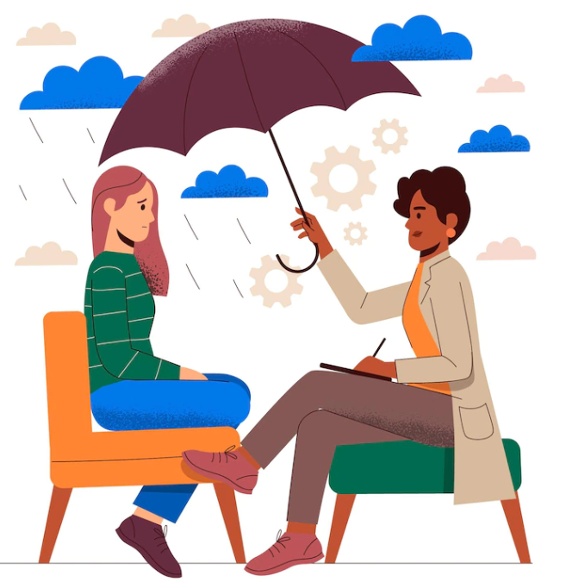
6. Flexibility
It is defined as the ability to adapt and change the way you respond to meet your clients’ needs
You don’t stay rigid and stick to a predetermined treatment path when your clients require a different approach
Being flexible is one of the most important attributes of a professional counselor
It is also an important skill in multicultural competency, This means trying to relate to and understand your client, regardless of their race, ethnicity, religious or political beliefs, or socioeconomic background.
A healthy person is someone who can manage themselves in the uncertain, unpredictable world around them, where novelty and change are the norm rather than the exception.”
(Kashdan and Rottenberg, 2010)
Wei et al., 2015

Slide 28
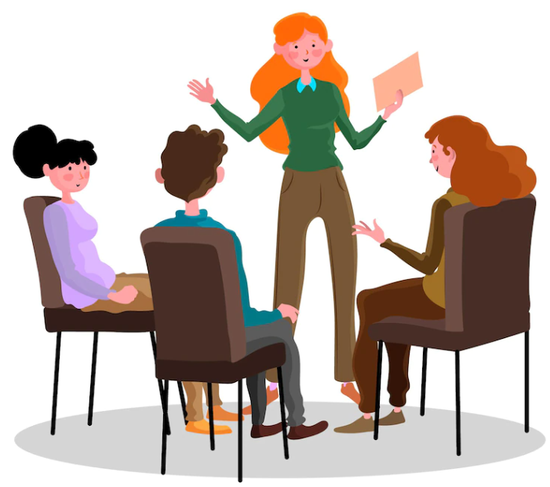
7. Self-Disclosure
It refers generally to a counselor’s sharing of personal information with clients during the session.
Types of self-disclosure by consultants can range from sharing information about the counselor’s personal life and experiences to sharing his or her personal opinions about specific issues and events.
There are 4 main types of counselor self-disclosures: accidental, unavoidable, client-initiated, and deliberate.
It can help the client to not feel alone, decrease the client’s anxiety, improve the client's awareness of different viewpoints, and increase counselor’s genuineness.
First and foremost, the counselor should be direct, brief, focused, and relevant. This will ensure that the self-disclosure process does not waste time and cause a loss of focus on the client's situation. Self-disclosure should also not be used frequently and should not add to the client's problems and negative outcomes in a situation.
In essence, the purpose of self-disclosure should be clear to both the counselor and the client, and the process should be used only after other options have been considered, taking into account the risk of miscommunication and disruption of the balance of power.
Gladding., 2006

Slide 29
8. Immediacy
It is ‘the key skill of focusing attention on the here and now relationship of counselor and client with helpful timing, to challenge defensiveness and/or heighten awareness’.
It is ‘not the same as simply saying whatever comes into one’s head, but a rapidly calculated disclosure of the counselor’s present experience in relation to the client’.
Using immediacy means that the therapist reveals how they themselves are feeling in response to the client.
Not only is it outside the client's frame of reference, but it's probably not even at the edge of the client's consciousness. It comes from your own frame of reference as a therapist – a gut feeling so strong that you feel drawn to share it.
Feltham & Dryden,1993

Slide 30
9. Reassurance
It may help clients, decreasing their stress and anxiety, and thus reducing inappropriate pain behavior and encouraging proactive healthy behavior.
By providing reassurance, counselors can create a sense of safety and trust for their clients, help clients feel more confident and supported in working through their challenges and achieving their goals, and help clients feel more connected and supported.
While it can be helpful, too much reassurance or reassurance that is not grounded in reality can actually be counterproductive.
It can be a significant predictor of genetic testing intentions.
Examples of helpful reassurance statements in therapy might include phrases like, “What you’re feeling is completely normal,” or “It’s okay to feel anxious or overwhelmed.” These types of statements acknowledge the client’s experience and help them feel heard and understood. Other useful reassurance statements could include things like, “I believe in your ability to overcome this challenge.” which gives motivation and support.
https://publications.iom.int/system/files/pdf/pandemic_manual_aug09.pdf

Slide 31
Barriers to effective communication
1. Judging
Judging is imposing your values on another person and giving them solutions to their problems. When you judge, you don’t fully listen to what someone is saying because you are too busy judging their appearance, the tone of their voice, and the words they use.
2. Offer solutions
Interrupting the speaker before they have finished speaking, or offering your proposed solutions before you are asked, can irritate the speaker and prevent them from delivering their original message. It can also cause people to become dependent on us to solve problems for them and deprive them of the opportunity to exercise their decision-making skills. This kind of communication can make them feel that their feelings, values and problems are not important.
3. Avoiding the concerns of the other person
This is where the problem is never addressed by the counselor. The person’s feelings and concerns are not addressed. The listener does not want to deal with the person's fears, anxieties, and concerns.
https://publications.iom.int/system/files/pdf/pandemic_manual_aug09.pdf

Slide 32
3
CHAPTER
Non-verbal communication skills

Slide 33
1. Empathy
WHAT…
It is the ability to feel what another person is feeling. It means that you are truly able to imagine what it’s like to stand in someone’s shoes.
Establishing empathy with client requires a high degree of insight and a strong sense of shared understanding.
It ensures that you listen to the client and address their concerns when they raise them, and you can convey that you accept (not that you necessarily understand) the client's experiences and feelings.
By using empathy in your interactions with clients you will:
Build the relationship
Stimulate self-exploration
Check understanding
Provide support
Assist communication
Focus attention on the client
It is the most important aspect in building a relationship
..."Empathy [is] the ability to ‘perceive the internal frame of reference of another with accuracy and with the emotional components and meanings which pertain there to as if one were the person, but without ever losing the 'as if' conditions.“ Carl Rogers (1959, pp. 210–211)
Silver., 2018; Moudatsou et al., 2020

Slide 34
1. Empathy
How…
Ask yourself questions like: “How would I feel in this situation?”
You are deliberately choosing to look at things from client’s perspective NOT yours.
Talking at a slower pace with periodic check-ins
Actively listening to the client and reflecting back to them for their consideration
Closely following the moving focus of the conversation as the therapy progresses
Using empathic affirmation, such as, “Yes, it must be hard being pulled in all directions”
Individualizing responses to clients so that they are relevant and personal
Using evocative language to bring clients’ experiences alive
Elliott et al., 2011

Slide 35
1. Empathy
How…
Some issues for you to remember when considering the issue of empathy
Intensity - responding to the feelings expressed at the appropriate level of intensity
Context - Consider all aspects, not just words and nonverbal behaviour. Many people we come in contact with have multiple issues in their lives. They may behave in ways that we feel are inappropriate, but are understandable in the context of their experiences.
Selective responding - sometimes it may be appropriate to respond only to feelings or behaviours. Some clients do not respond well to discussion of their feelings, and in these cases it is useful to focus on more concrete elements such as experiences and behaviours.
When your empathic responses have been successful, it is evident from the client’s response, a nod of the head, or a positive verbal response. If your empathic responses have not been accurate, the client will indicate this non-verbally by stopping, fumbling or becoming frustrated.

Slide 36
Breaking bad news in GC—communication tools
Another tool that can be helpful during GC is the EMPATHY which is an acronym of a protocol and a tool containing principles essential for proper transmission of unsuccessful results of diagnostic tests.
E—Emotions - Both in the context of reporting research results and demonstrating emotional support needed by the client.
M—Meeting - For the quality of the meeting with the client, its place is important, not only in the physical sense but also regarding the absence of any disturbing factors and the time intended for it.
P—Patient’s perspective - If the patient hears even a few introductory sentences on the subject, the conversation can be conducted more effectively, as more opportunities are created to adapt it to the competence of the counselee.
A—Adequate language - Use language that is unambiguous and understandable to the person to whom the genetic test results are communicated; any deviation from this rule will result in decreased compliance and an increase in client anxiety.
T and H—Truth and hope - two letters, one phone - Respecting the client’s right to the truth about his illness/or increased risk, but this truth should be conveyed in a way that does not take away hope
Y—Yes for patient empowerment - The purpose of the proper form of conversation is to maintain the client’s autonomy, build his sense of influence, faith in his own strength, and responsibility for the course of treatment.
Witt & Jankowska., 2018

Slide 37
2. Body Language
Sometimes we forget to consider our whole body when we communicate, yet it can significantly affect communication, adding to or distracting from what we are saying.
According to 2010 research published in Psychiatry, experts estimate around 60% of communication happens nonverbally.
Body language is used to build rapport. By observing the client's body movements and adjusting them appropriately, one can improve communication. On a subconscious level, mirroring the client’s movements can help them feel more comfortable with you.
The counselor observes the client’s body language at all times and notices any discomfort as this may indicate difficulty verbalising something, and further exploration can be done to connect to the client's deeper feelings.
Types of body language in counseling:
Posture
Hands
Facial expression
Eye contact
Arms and legs
Tone of voice
Foley & Gentile, 2010

Slide 38
3. Being present
Presence in counseling, considered the fundamental quality of an effective therapeutic relationship, is essentially the state of being fully with oneself in the encounter with a client, being fully in the moment on a variety of levels: physical, emotional, cognitive, and spiritual.
It is not a substitute for technique, but a basic attitude that supports deep listening and understanding of the client in the moment.
It is a framework for counseling that fosters a deep connection between client and therapist through various aspects such as awareness of body sensations, emotions, and perception.
Being fully present allows for an attuned responsiveness based on a kinesthetic and emotional awareness of the other's experience as well as one's own intuition and abilities and the relationship between the two.
Westland., 2015

Slide 39
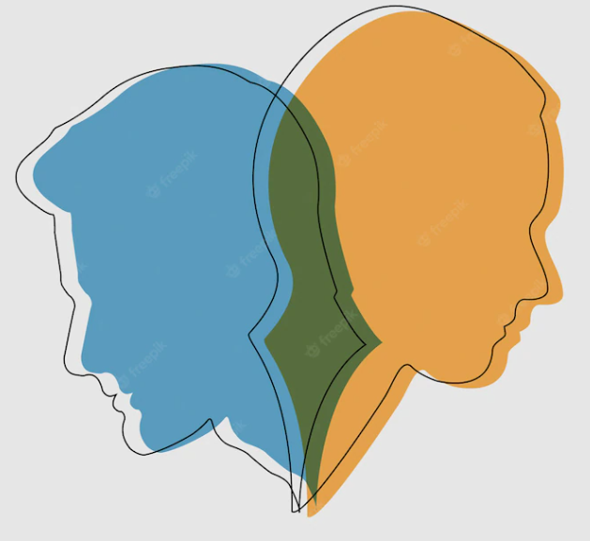
4. Self-awareness
Self-awareness is the ability to look within and identify your own unmet psychological
needs and desires, such as need for intimacy or the desire to be professionally competent
This ability prevents your issues from affecting or conflicting with those of your clients
Counselors must be knowledgeable about subjects with which they are familiar, and they must be willing to admit their own limits as well as those of others.
Self-awareness allows one to realise the restrictions within the situation and requires one to remain non-judgemental. This helps develop a relationship based on respect
Clients would rather hear the honesty of ‘I don’t know, but I will find out for you’, than for someone to provide incorrect information [that if discovered by the client] would lead to loss of trust.
Training in self-awareness practices such as self-care, reflection, and mindfulness could have lasting effects on genetic counselors, their patients, and the profession as a whole.
Bulmer et al., 2022

Slide 40
Under- and over-involvement in communicating in counseling
Two kinds of reactions in therapy can significantly affect and even harm communication:
The under-involved counselor is aloof, cool, and insufficiently responsive.
The over-involved counselor has lost touch with boundaries and becomes submerged in the client’s world”.
In order to become more aware of what being too much, and too little, engaged with a client looks like, you can follow the exercise in Chapter 5.
under-involvement and over-involvement
Westland, 2015

Slide 41
4
CHAPTER
Vocal communication skills

Slide 42
Vocal communication skills
How we talk can signify what we are really thinking and how we truly feel.
Messages sent through the voice are influenced by the speaker’s:
Volume
Articulation
Pitch
Emphasis
Speech rate
Each factor must be considered, tuned to the situation and subject, and modified to add variety to the conversation.
In GC, counselors need to ensure the use of the appropriate tone, rhythm, and volume of voice.

Slide 43
Lack of Nonverbal Cues and Visual Aids
The vast majority of the communication between a genetic counselor and a client occurs over the phone.
Thus, counselors do not have the benefit of reading body language to assess understanding or responses. Likewise, the counselor is not able to use nonverbal attending skills such as mirroring a client’s body posture or using gestures to guide an encounter.
Visual aids may not be as easily used to facilitate education about technology or explanation of genetic test results. One of the ways a genetic counselor adapts to these limitations is by increasing his or her sensitivity to vocal cues, such as listening carefully for keywords or phrases that can be used to assess understanding or needs.
Genetic counselor often chooses language, such as person-first language, with the intent that he or she will be a model for the client to follow when interacting with patients.

Slide 44
5
CHAPTER
Exercises

Slide 45
Exercise 1: Under- and over-involvement in communication
Use the Under- and Over-Involvement in Communication worksheet https://positive.b-cdn.net/wp-content/uploads/2022/01/Under-and-Over-Involvement-in-Communication.pdf
to become more aware of what being too much and too little engaged with a client can be like.
Consider each of the following reactions:
Neutral – remaining present without any particular type of reaction or engagement.
Over-involved – over-engaging yourself with the client; feeling fully and emotionally involved in everything they have to say.
Under-involved – disengaging yourself from what the client is sharing; physically and mentally distancing yourself from what the client shares; gazing out the window or thinking about a recent event.
Westland, 2015

Slide 46
Exercise 2: Assess Vocal Communication Skills
Often, we are either unaware of our verbal skills or fail to reflect on them.
Use this worksheet https://positive.b-cdn.net/wp-content/uploads/2022/01/Assess-Vocal-Communication-Skills.pdf to both self-assess and receive feedback from others regarding key factors in vocal communication.
Consider what went well, not so well, and what you could do differently next time.

Slide 47
Exercise 3: Exercise for “being present”
Use the following questions to increase awareness of what is happening inside your mind and body and what you are aware of in the environment:
Describe your subjective awareness at that time.
What physical sensations did you experience (e.g., tension, tingles, pressure)?
Describe your outer awareness at that time.
What did you sense in the environment (e.g., noises, smells, touches, tastes)?
Describe your awareness of fantasy at that time.
What mental processes took you out of the present moment into planning, explaining, and thinking?
Reflecting on each answer will help you increase understanding and awareness of your inner and outer world and improve your communication and understanding of the client.
Westland, 2015

Slide 48
Exercise 4: Exercise your knowledge of communication skills
What type of communication technique is the following?
Client (Mohammed): My ex-wife phoned me yesterday; she told me that our daughter Nafiza (who is only 9) is very ill after a car accident. I am feeling very scared for her. They live in France, so I am going to have to travel to see her, and now I have been made redundant, I don’t know how I can afford to go.
Counselor: So, Mohammed, you have had some bad news about your little girl, who has been involved in an accident. You are frightened for her and also have worries over money now you have lost your job.
Client: Yes, yes ... that’s right.
Answer:
Reflation
Notice that the counselor does not offer advice or start asking how long Mohammed and his wife have been separated, but reflects the emotion of what is said: ‘frightened' and ‘worried'.
Notes:
Notice that the counsellor does not offer advice or start asking how long Mohammed and his wife have been separated, but reflects the emotion of what is said: ‘frightened' and 'worries'.
Reflecting and paraphrasing are the first skills we learn as helpers, and they remain the most useful.
To build a trusting relationship with a helper, the client needs not only to be ‘listened to' but also to be heard and valued as a person.

Slide 49
Check your understanding!

Slide 50
Check your understanding!
In communication process, it is vital that counselors consider
What they say based on the understanding received
To use good communication skills to effectively and empathically put their observations into words
Enabling the client to integrate new knowledge into an expanded sense of self without feeling shame
All the above
2. An appropriate communication with a counselor
Can enhance relationships and self-esteem
Will be enhanced in a supportive and accepting environment
Will encourage people to openly discuss sensitive issues
All the above

Slide 51
Check your understanding!
3. In the technique of reflecting and paraphrasing, counselor can
Repeat and feed exactly what client said
Summarise the most important parts of the extended communication
Reproduce the whole sentence or select a few words from what the client has brought
Make a comment on the facial expression or body language of client
4. Self-awareness is the ability to look within and identify your own unmet psychological needs and desires.
True
False
5. Genetic counselor needs to offer reassurance to all clients and it does not depend on the case.
True
False

Slide 52
Lesson overview What’s next?

Slide 53
Lesson Overview – What’s next?
This lesson focused on the main communication and counseling skills that are some of the critical skills that a counselor has to cultivate to effectively influence change in a client. It also included exercises for practicing and cultivating effective communication skills and relationships with clients.
The next lesson 4.1. Genetic Counseling sessions – an overview, will explain exactly what the GC sessions for people with a family history of neurodegenerative disorders are, what are the main objectives and what are the pros and cons of this process.

Slide 54
References
Additional resources

Slide 55
References
Accreditation Council for Genetic Counseling (2015) “Practice-Based Competencies for Genetic Counselors” https://www.nsgc.org/Portals/0/Docs/Education/ACGC-Core-Competencies-Brochure_15_Web.pdf?ver=cvdeod3i-hMx0Hy1h9l0ww%3D%3D
Australian Institute of Professional Counsellors (AIPC), “AIPC’s Counsellor Skills Series”, Report 1
Biesecker, B. (2020). Genetic Counseling and the Central Tenets of Practice. Cold Spring Harb Perspect Med. 10(3):a038968. doi: 10.1101/cshperspect.a038968
Bulmer, L., Stanley, C., Loffredo, L., Mills, R., Doyle, L. (2022). Building a foundation in self-awareness: Genetic counseling students' experiences with self-care, reflection, and mindfulness. J Genet Couns. 31(3):722-734. doi: 10.1002/jgc4.1539.
de Haes, H., Bensing, J. (2009). Endpoints in medical communication research, proposing a framework of functions and outcomes. Patient Educ Couns. 74(3):287-94. doi: 10.1016/j.pec.2008.12.006.
Ellington, L., Kelly, KM., Reblin, M., Latimer, S., Roter, D. (2011). Communication in genetic counseling: cognitive and emotional processing. Health Commun. 26(7):667-75. doi: 10.1080/10410236.2011.561921
Elliott, R., Bohart, A. C., Watson, J. C., & Greenberg, L. (2011). Empathy. In J. C. Norcross (Ed.), Psychotherapy relationships that work: Therapist contributions and responsiveness to patients (pp. 132–152). Oxford University Press.
Feltham, C. & Dryden, W. (1993). Dictionary of Counselling, Whurr Publishers
Foley, G. N., & Gentile, J. P. (2010). Nonverbal communication in psychotherapy. Psychotherapy (Edgmont), 7(6), 38-44. Retrieved from https://www.ncbi.nlm.nih.gov/pmc/articles/PMC2898840

Slide 56
References
Gladding, S.T. (2006). Counseling: A Comprehensive Profession. Upper Saddle River, NJ: Prentice Hall.
Goodenberger, ML., Thomas, BC., Wain, KE. (2015). The utilization of counseling skills by the laboratory genetic counselor. J Genet Couns. 24(1):6-17. doi: 10.1007/s10897-014-9749-9
Griffin, J. (2006). Client-centered exercise prescription. Illinois: Human Kinetics, p.6.
Moudatsou, M., Stavropoulou, A., Philalithis, A., Koukouli, S. (2020). The Role of Empathy in Health and Social Care Professionals. Healthcare (Basel). 8(1):26. doi: 10.3390/healthcare8010026
Rantanen, E., Hietala, M., Kristoffersson, U., Nippert, I., Schmidtke, J., Sequeiros, J., Kääriäinen, H. (2008). What is ideal genetic counselling? A survey of current international guidelines. Eur J Hum Genet. 16(4):445-52. doi: 10.1038/sj.ejhg.5201983.
Silver, J., Caleshu, C., Casson-Parkin, S. et al. (2018). Mindfulness Among Genetic Counselors Is Associated with Increased Empathy and Work Engagement and Decreased Burnout and Compassion Fatigue. J Genet Counsel. 27, 1175–1186. doi:10.1007/s10897-018-0236-6
Wachtel, P. L. (2011). Therapeutic communication: Knowing what to say when. Guilford Press.
Wei, M., Tsai, P., Lannin, D.G., Du, Y., & Tucker, J.R. (2015). Mindfulness, Psychological Flexibility, and Counseling Self-Efficacy. The Counseling Psychologist, 43, 39 - 63.
Westland, G. (2015). Verbal and non-verbal communication in psychotherapy. W.W. Norton & Company.
Witt, MM., & Jankowska, KA. (2018). Breaking bad news in genetic counseling-problems and communication tools. J Appl Genet. 59(4):449-452. doi: 10.1007/s13353-018-0469-y.

Slide 57
Additional Resources
Books and papers:
“Introduction to Basic Counselling and Communication Skills: IOM Training Manual For Migrant Community Leaders and Community Workers” by IOM and USAID https://publications.iom.int/system/files/pdf/pandemic_manual_aug09.pdf
Cragun D, Zierhut H. Development of FOCUS-GC: Framework for Outcomes of Clinical Communication Services in Genetic Counseling. J Genet Couns. 2018 Feb;27(1):33-58. doi: 10.1007/s10897-017-0145-0
https://www.nsgc.org/Portals/0/Docs/Education/ACGC-Core-Competencies-Brochure_15_Web.pdf?ver=cvdeod3i-hMx0Hy1h9l0ww%3D%3D
Medendorp NM, van den Heuvel LM, Han PKJ, Hillen MA, Smets EMA. Communication skills training for healthcare professionals in providing genetic counseling: A scoping literature review. Patient Educ Couns. 2021 Jan;104(1):20-32. doi: 10.1016/j.pec.2020.07.018.
Websites:
A video for empathy https://www.youtube.com/watch?v=PeuPLVlhAiM&t=2s
https://counsellingtutor.com/basic-counselling-skills/

Slide 58
Thank you
Visit our website
http://www.genecounsel.eu/
This project has been funded with support from the European Commission. This presentation reflects the views only of the author, and the Commission cannot be held responsible for any use which may be made of the information contained therein.

