Slide 1
Unit 2. Theory-basic scientific information
Lesson 2.2. Neurodegenerative inherited diseases

Slide 2
Introduction and Learning Outcomes
Lesson 2.2 aims to give basic information about the most common neurodegenerative inherited diseases.
At the end of this module the users will acquire a set of basic notions on the role of genetics in neurodegenerative disorders that can cause dementia, such as Alzheimer’s disease (AD), Vascular dementia (VaD), Parkinson’s disease (PD), Lewy bodies dementia (LBD), Frontotemporal lobar degeneration (FTLD), Huntington’s disease (HD), and Creutzfeldt-Jakob disease (CJD).
Furthermore, the different types of genetic testing and the current technologies will be briefly discussed.

Slide 3
Table of contents
Chapter 1: Inheritable neurodegenerative diseases: clinical overview
Chapter 2: Genetics of neurodegenerative diseases
Chapter 3: Genetic testing for neurodegenerative diseases
Chapter 4: Technologies for testing

Slide 4
1
CHAPTER
Inheritable neurodegenerative diseases: clinical overview

Slide 5
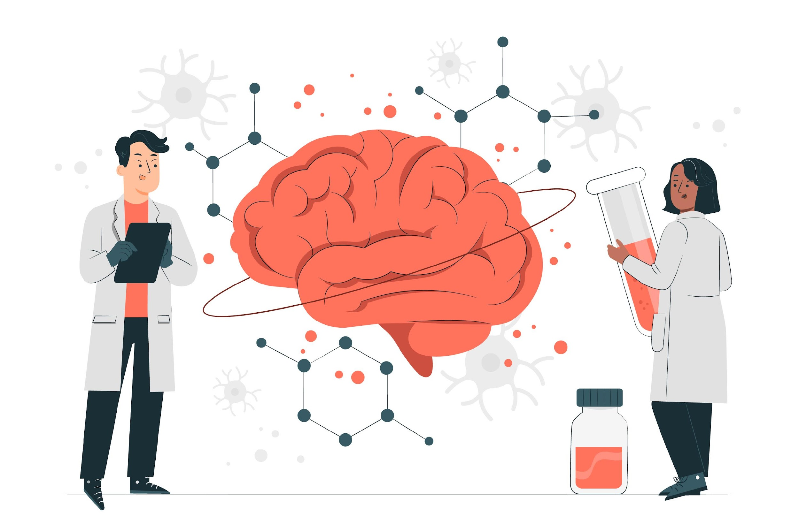
Neurodegeneration
The irreversible damage of brain cells over time, resulting in neurodegenerative diseases
Neurodegenerative and cerebrovascular brain diseases lead to irreversible damage to neurons and the cortical network, which can cause dementia.
The symptoms depend on the areas of the brain that are affected
https://www.alz.org/alzheimers-dementia/what-is-dementia

Slide 6
Dementia
Dementia is an umbrella term for loss of memory and / or other cognitive functions severe enough to interfere with daily life, caused by many neurodegenerative and vascular brain diseases
Alzheimer’s
Lewy body
Vascular
Frontotemporal
Others:
Parkinson Huntington
Creutzfeldt- Jakob
Mixed dementia
https://www.alz.org/alzheimers-dementia/what-is-dementia

Slide 7
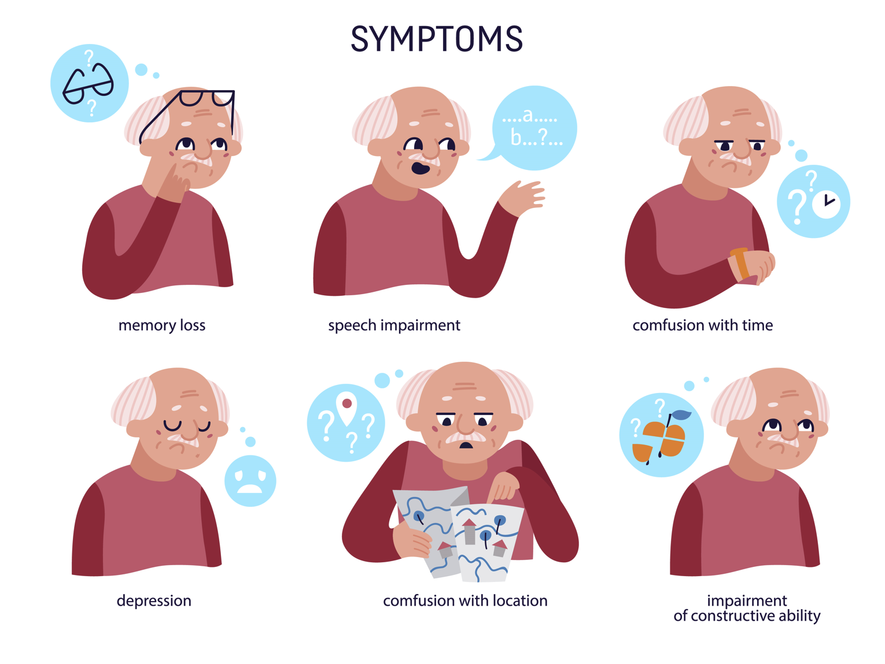
Alzheimer’s disease (AD)
AD is the most common cause of dementia (60-70%).
confusion with time
confusion with location
https://www.alz.org/alzheimers-dementia/what-is-alzheimers

Slide 8
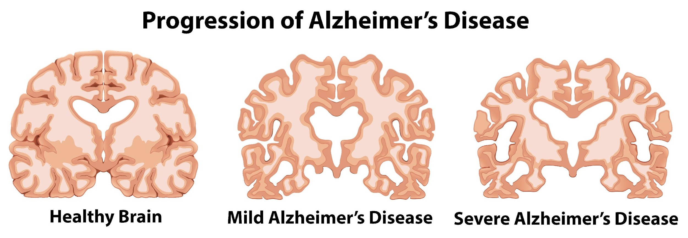
Alzheimer’s disease (AD)
AD is characterized by abnormal protein deposits in the brain
as well as neurodegeneration
Neurons are damaged by
Amyloid plaques: deposits of the beta-amyloid protein that are cast out between the neurons
Neurofibrillary tangles: fibers from hyperphosphorylated tau protein that build up within the neurons
Resulting in brain volume loss over time
Alzheimer’s association 2023: https://doi.org/10.1002/alz.13016

Slide 9
Alzheimer’s disease (AD)
AD pathological changes are already happening inside the brain
one to two decades before the first symptoms are visible
Alzheimer’s association 2023: https://doi.org/10.1002/alz.13016

Slide 10
Alzheimer’s disease (AD)
AD cannot be cured
Three anti-amyloid drugs have shown some positive results in clinical results
Aducanumab: https://www.alz.org/alzheimers-dementia/treatments/aducanumab
Lecanemab: https://www.alz.org/alzheimers-dementia/treatments/lecanemab-leqembi
Donanemab: https://www.alzheimers.org.uk/blog/what-is-donanemab-alzheimers-drug
The likelihood exists that disease modifying drugs against AD will be approved by the European Medicines Agency (EMA) soon.
Alzheimer’s association 2023: https://doi.org/10.1002/alz.13016

Slide 11
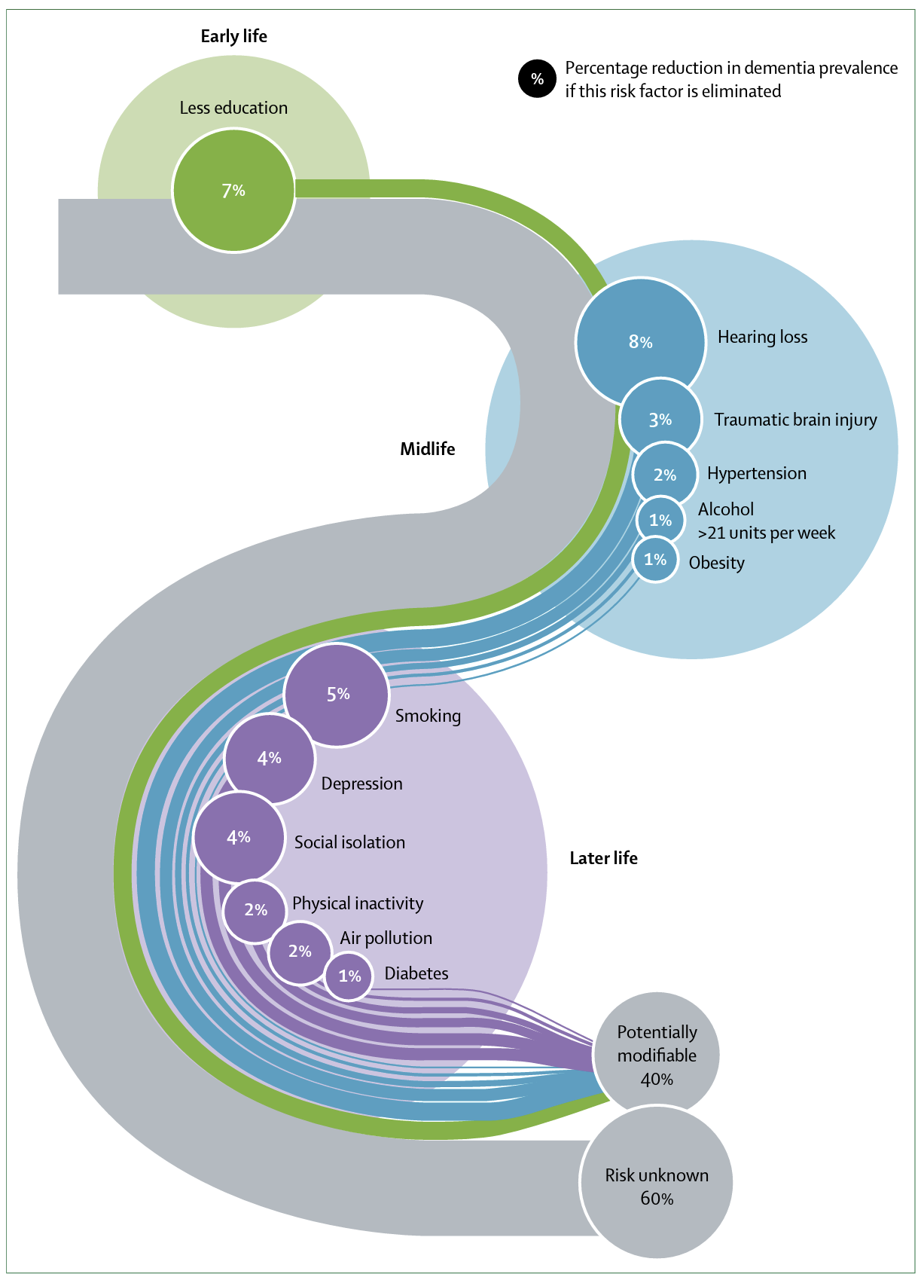
Alzheimer’s disease (AD)
Modifiable risk factors
Less education
Hearing loss
Traumatic brain injury (TBI)
Hypertension
Alcohol >21 units per week
Obesity
Smoking
Depression
Social isolation
Physical inactivity
Air pollution
Diabetes
40% of the total risk can potentially be altered through eliminating these factors!
Three other risk factors for which a percentage reduction could not be determined:
Lack of sleep or poor sleep quality
Elevated serum cholesterol
Unhealthy diet
Livingston et al., 2020

Slide 12
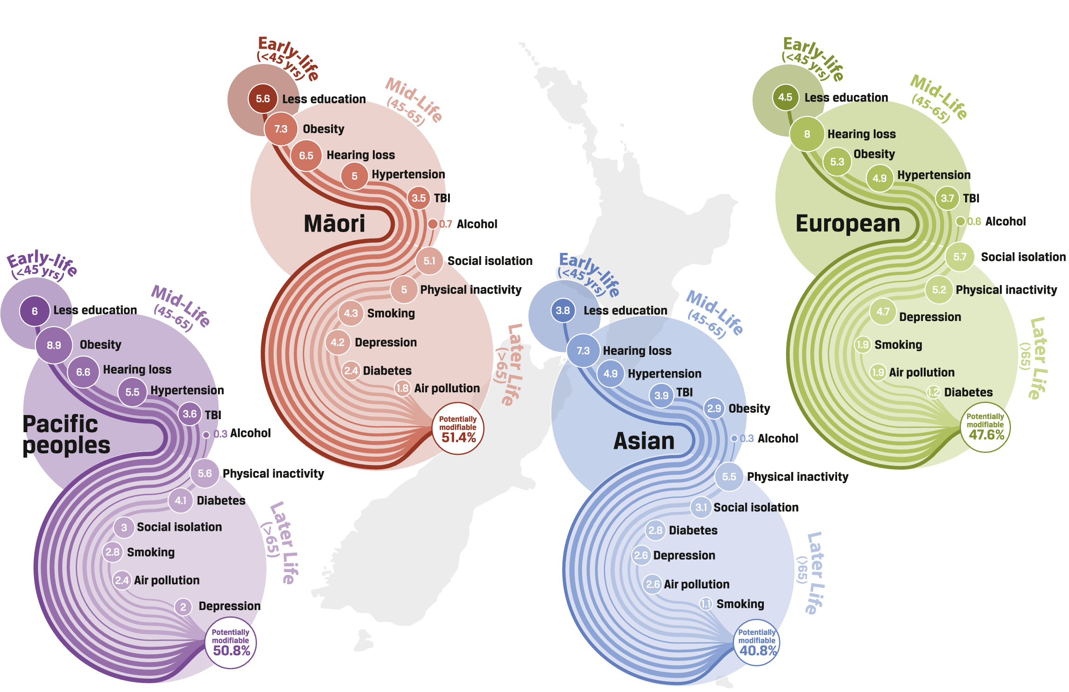
Alzheimer’s disease (AD)
Differences in modifiable risk factors between major ethnic groups from New-Zealand
Ma’u et al., 2021

Slide 13
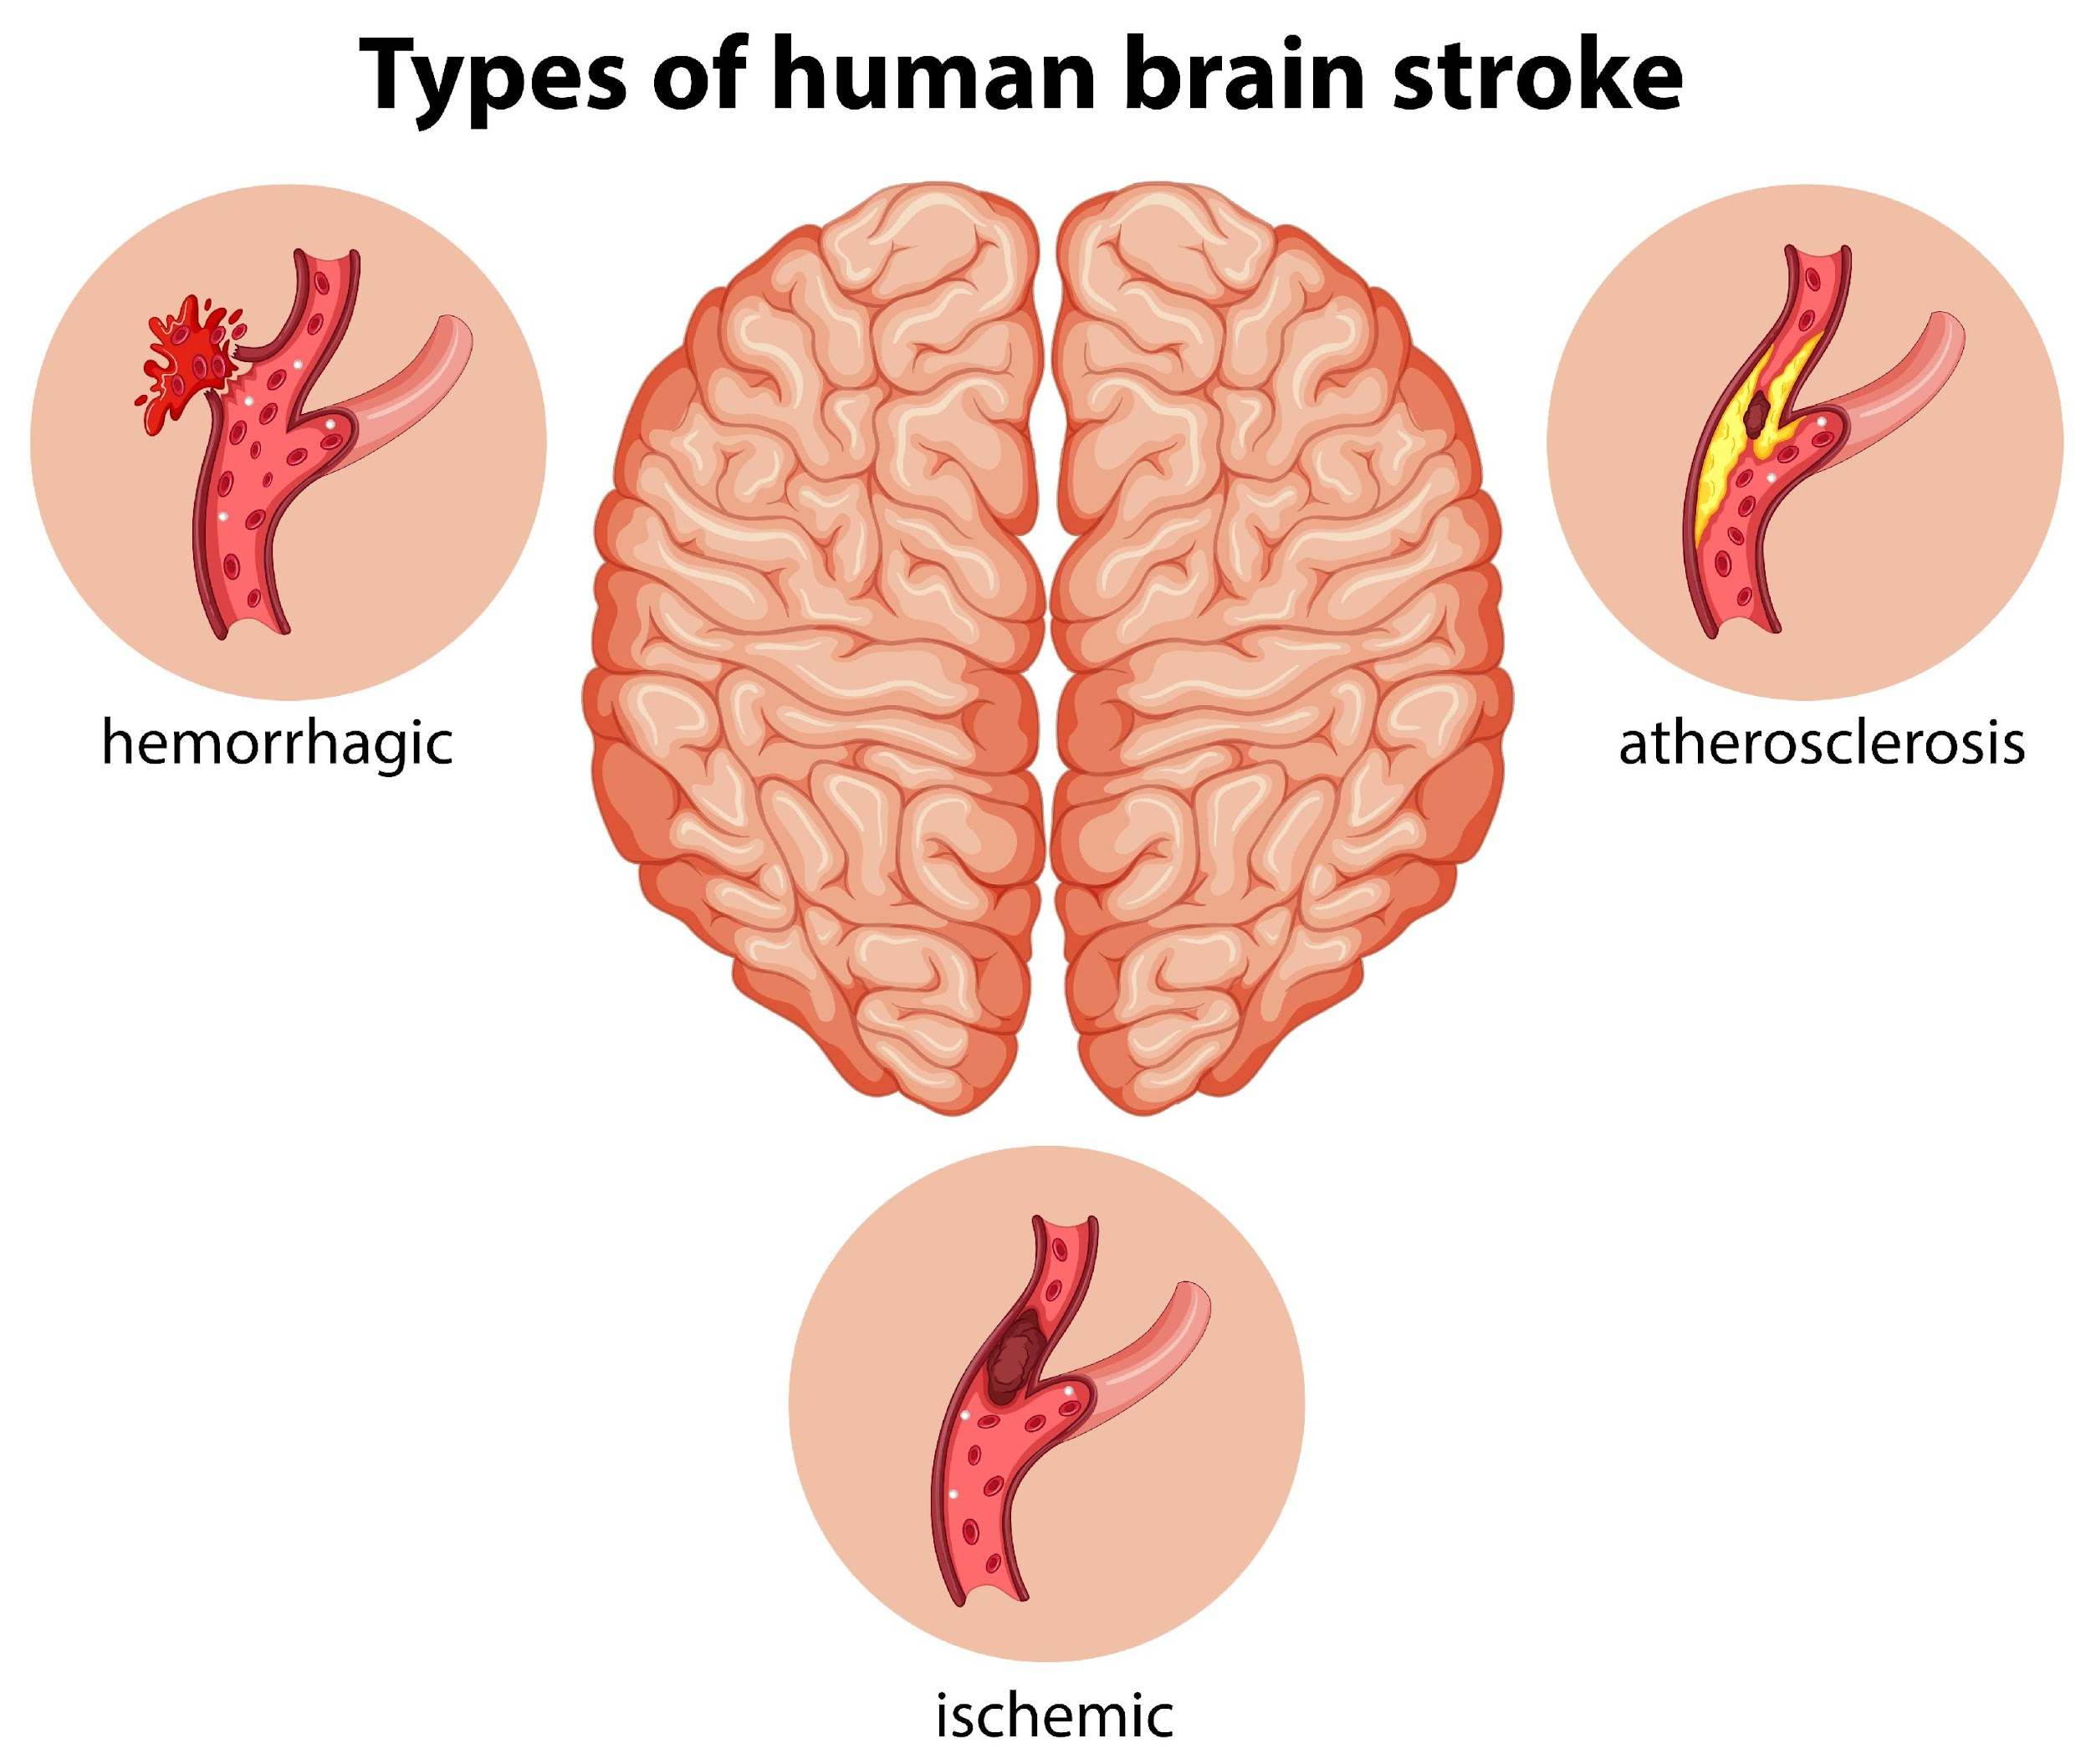
Vascular dementia (VaD)
VaD is the second most common cause of dementia
First symptoms can occur after:
Stroke: thrombosis or burst of main vessels in the brain 🡺 Sudden changes
Small vessel disease: widespread damage across the brain 🡺 Gradual changes
Only 5-10% has VaD alone, it often occurs together with other causes of dementia (= mixed dementia) 🡺 the more so as age is a risk factor for both AD and stroke
https://www.alz.org/alzheimers-dementia/what-is-dementia/types-of-dementia/vascular-dementia

Slide 14
Vascular dementia (VaD)
Brain damage in VaD due to complications with blood flow
POSSIBLE SYMPTOMS AFTER STROKE
Confusion and disorientation
Trouble speaking or understanding speech
Difficulty walking and poor balance
Numbness or paralysis on a specific side of the body
POSSIBLE SYMPTOMS AFTER SMALL VESSEL DISEASE
Impaired planning and judgment
Uncontrollable laughter or crying
Impaired functioning in social settings
Declining ability to pay attention
Difficulty finding words
https://www.alz.org/alzheimers-dementia/what-is-dementia/types-of-dementia/vascular-dementia

Slide 15
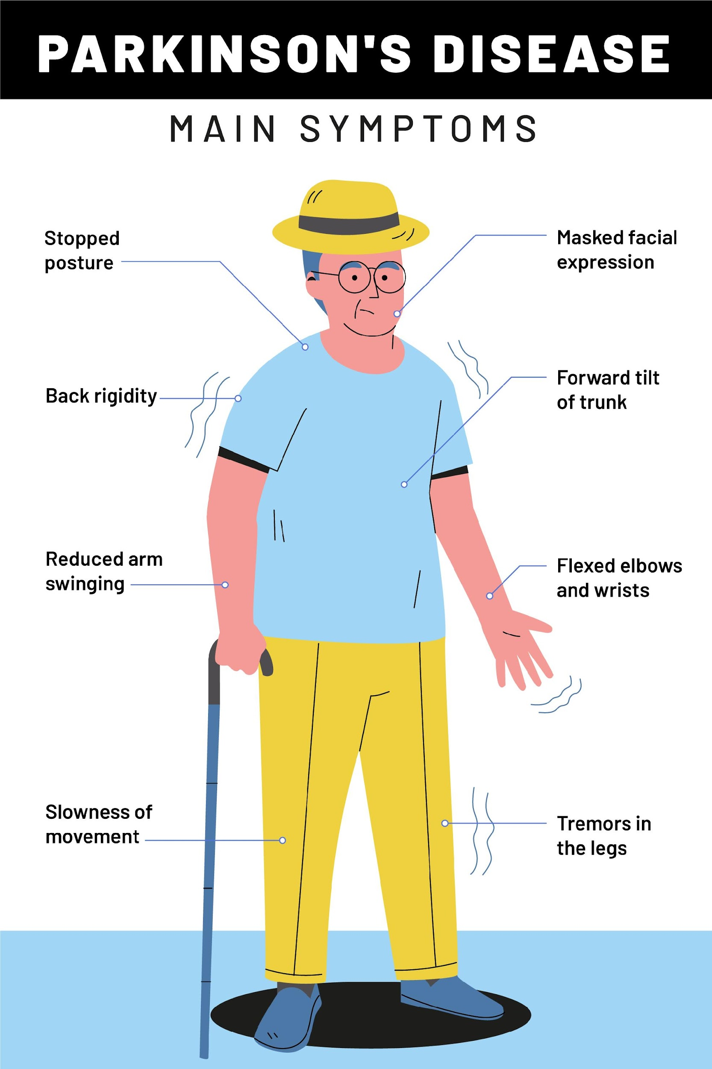
Parkinson’s disease (PD) Dementia with Lewy Bodies (DLB)
Dementia occurring in patients who have PD for at least one year
Brain damage located in region responsible for movement = substantia nigra
🡺 PD is a motor disease with increased risk of developing dementia
Characterized by abnormal deposition of alpha-synuclein = Lewy body
SYMPTOMS PD DEMENTIA
Memory, concentration and judgment changes
Trouble interpreting visual information
Speech impairment (e.g., muffled)
Visual hallucinations
Delusion (i.e., paranoia)
Depression, irritability, anxiety
Sleep disturbances
https://www.alz.org/alzheimers-dementia/what-is-dementia/types-of-dementia/parkinson-s-disease-dementia

Slide 16
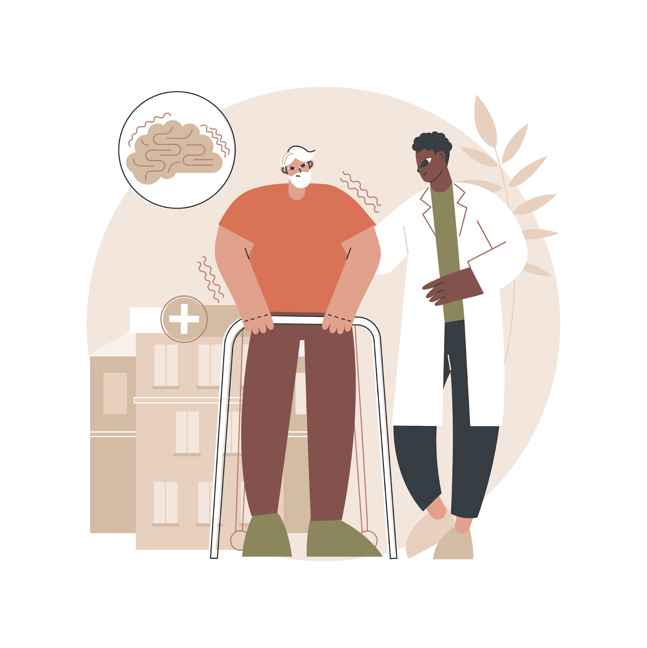
Parkinson’s disease (PD) Dementia with Lewy Bodies (DLB)
DLB is (also) characterized by “Lewy bodies”
Lewy body: abnormal deposition of alpha-synuclein in nuclei of neurons 🡺 Affects brain functioning
SYMPTOMS
Parkinsonism (i.e., slow movement, rigidity, tremor)
Dementia
Fluctuating cognition
Visual hallucinations
REM sleep behavior disorder
https://www.alz.org/alzheimers-dementia/what-is-dementia/types-of-dementia/dementia-with-lewy-bodies

Slide 17
Parkinson’s disease (PD) Dementia with Lewy Bodies (DLB)
How to make the difference?
PD Dementia: When dementia changes occur at least one year after the onset of PD symptoms
Often several years after
DLB: When dementia changes occur before, during or within a year of the onset of PD symptoms
This is an arbitrary rule and may not be a true representation of how the diseases differ in reality
https://www.alz.org/alzheimers-dementia/what-is-dementia/types-of-dementia/dementia-with-lewy-bodies
Notes:
Arbitraire grens!!

Slide 18
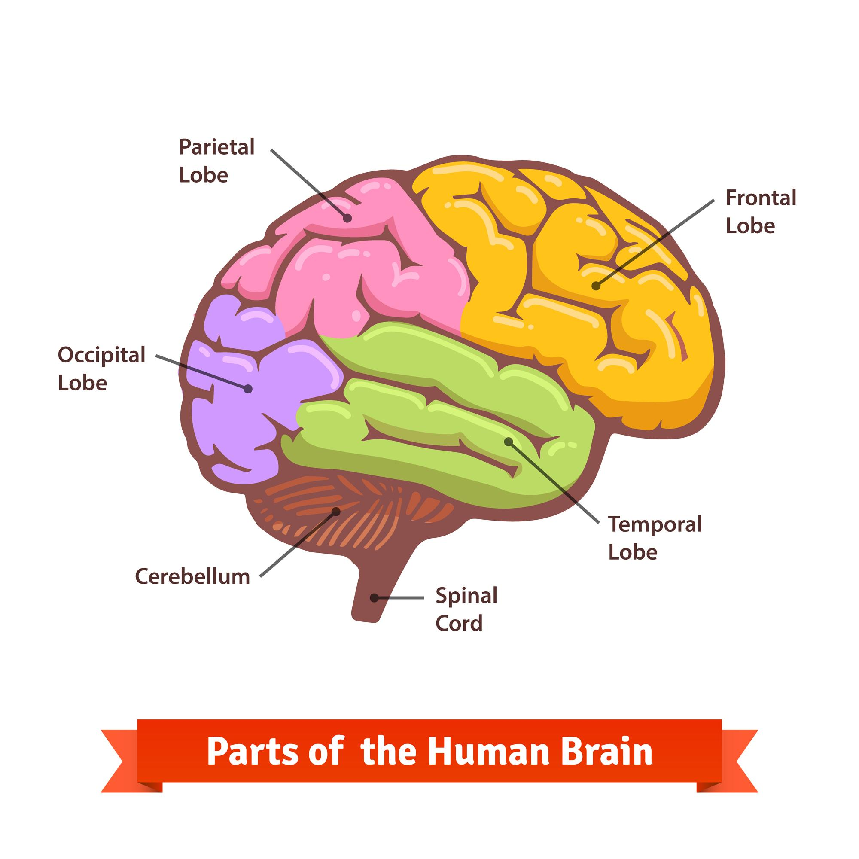
Frontotemporal lobar degeneration (FTLD)
Brain cells damage in frontal and temporal lobe of the brain leads to loss of function in these areas
Accumulation of tau protein and TDP-43
SYMPTOMS
Language problems
Personality and behavioral changes
Cognitive deficits regarding attention, planning and organization
https://www.nia.nih.gov/research/alzheimers-dementia-outreach-recruitment-engagement-resources/frontotemporal-disorders

Slide 19
Frontotemporal lobar degeneration (FTLD)
Three subtypes of FTLD
Behavioral variant Frontotemporal Dementia (bvFTD)
Changes in personality and behavior
Usually people aged 50-60y
Brain damage in areas responsible for conduct, judgment, empathy and foresight
Primary progressive aphasia (PPA)
Affected language ability (speaking, reading, writing and comprehension)
Before people turn 65y
Semantic variant: no longer able to understand or say words in a sentence
Nonfluent/agrammatic variant: no longer using linking words (from, to, such as, …)
Logopenic variant: no longer finding the right words, hesitation
Motor variant
Amyotrophic lateral sclerosis (ALS): muscle weakness or wasting
Corticobasal syndrome: uncoordinated or stiff arms
Progressive supranuclear palsy (PSP): Parkinsonism, but tremor less common and earlier language disability
https://www.nia.nih.gov/research/alzheimers-dementia-outreach-recruitment-engagement-resources/frontotemporal-disorders

Slide 20
Huntington’s disease (HD)
HD is a rare monogenic neurodegenerative disease
A genetic mutation leads to abnormal protein “huntingtin”, which causes HD
The role of huntingtin is not yet understood
SYMPTOMS
Uncontrolled movement
Decline in thinking and reasoning
Depression, anxiety, anger, irritability
Obsessive compulsive behavior
Symptoms develop between 30 and 50 years old
https://www.alz.org/alzheimers-dementia/what-is-dementia/types-of-dementia/huntington-s-disease

Slide 21
Huntington’s disease (HD)
Important considerations regarding HD
FAMILY PLANNING: available reproductive options to help people make an informed decision
Deciding to get tested
Not having children
Adoption
Natural conception
Sperm or egg donation / surrogate mother
Preimplantation genetic diagnosis
Prenatal diagnosis
The final decision may be difficult and may be influenced by personal beliefs and opinions of loved ones.
Appropriate counseling is of vital importance!
https://hopes.stanford.edu/family-planning/

Slide 22
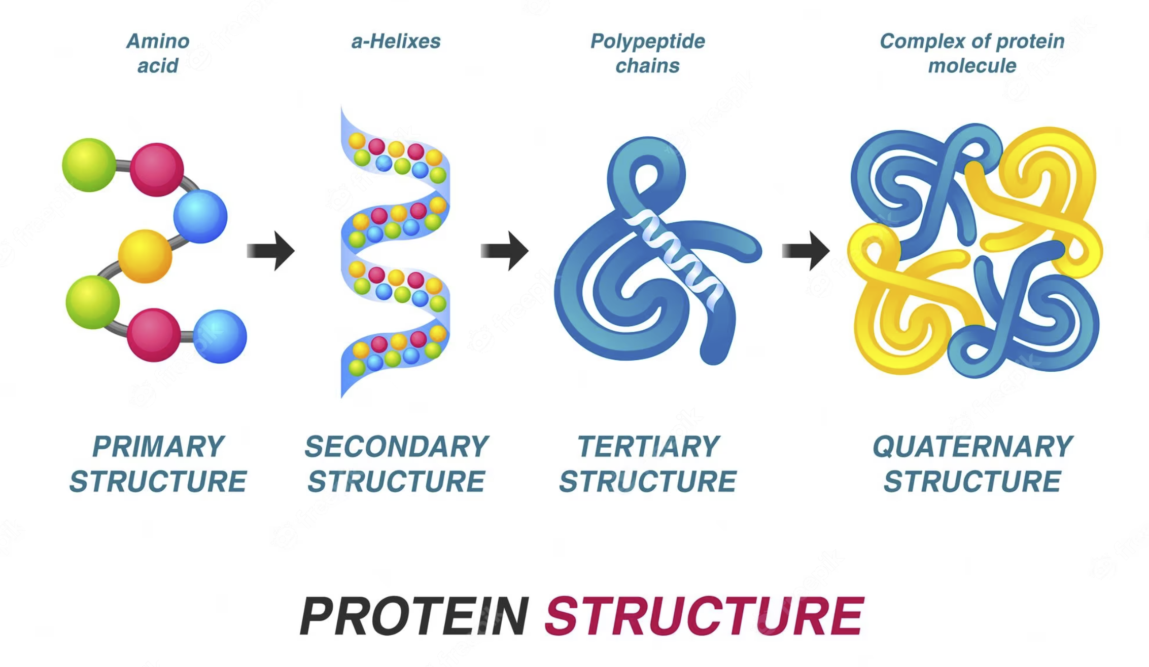
Creutzfeldt-Jakob Disease (CJD)
The most common form of a group of diseases called “prion diseases”
Prion diseases occur when a “prion protein”
Starts folding in an abnormal 3D shape (abnormal quaternary structure)
“Infects” other prion proteins in having the same abnormal structure 🡺 The process behind this is still not clear
SYMPTOMS PROGRESS RAPIDLY
Depression
Agitation, apathy, mood swings
Rapidly worsening confusion
Disorientation
Problems with thinking, memory, planning and judgement
Muscle stiffness, difficulty walking
Vision problems
https://www.alz.org/alzheimers-dementia/what-is-dementia/types-of-dementia/creutzfeldt-jakob-disease

Slide 23
2
CHAPTER
Genetics of neurodegenerative diseases

Slide 24
Inheritance patterns
Monogenic inheritance = Deterministic genes
Directly causes a disease and when one inherits the gene mutation, one will develop the disease
Heterogeneous inheritance = Risk genes
Increases the chance of developing the disease
Autosomal dominant
Abnormal gene from one parent can cause the disease
Autosomal recessive
Abnormal genes from both parents can cause the disease

Slide 25
Alzheimer’s disease (AD)
Genetics of AD
Risk genes increase the chance of developing AD
“Sporadic” or “Late-onset” AD
APOE- ε4 🡺 40-65% of people with AD have one or two copies of APOE- ε4
Deterministic genes directly cause a disease and when one inherits the gene mutation, one will develop AD
“Familial” or “Early-onset” AD
Symptoms tend to develop before age of 65
APP1, PSEN1, PSEN2 🡺 1% of AD cases is caused by a genetic mutation in one of these three genes
Alzheimer’s association 2023: https://doi.org/10.1002/alz.13016

Slide 26
Vascular dementia (VaD)
Genetics of VaD
Risk genes: increase the chance of developing VaD
Research is still ongoing
Deterministic genes: directly cause a disease and when one inherits the gene mutation, one will develop VaD
“Familial” VaD: cerebral autosomal dominant arteriopathy with subcortical infarcts and leukoencephalopathy (CADASIL)
Symptoms tend to develop earlier than VaD, age of diagnosis at 50 years old
NOTCH3 gene
Ikram et al., 2017

Slide 27
Parkinson’s disease (PD) Dementia with Lewy Bodies (DLB)
Genetics of PD dementia
Risk genes: increase the chance of developing PD
GBA
Deterministic genes: directly cause a disease and when one inherits the gene mutation, one will develop PD
Majority of PD is sporadic 🡺 Only 10% of patients report family history
Autosomal dominant: SNCA (PARK1/PARK4) LRRK2 (PARK8) VPS35 (PARK17)
Autosomal recessive: PRKN (PARK2) PINK1 (PARK6) DJ-1 (PARK7) ATP13A1 (PARK9)
Klein & Westenberger. 2012

Slide 28
Parkinson’s disease (PD) Dementia with Lewy Bodies (DLB)
Genetics of DLB
Risk genes: increase the chance of developing DLB
DLB shares overlap with AD and PD genes
SNCA, GBA, APOE
Deterministic genes: directly cause a disease and when one inherits the gene mutation, one will develop DLB
Research is ongoing
Orme, Guerreiro, & Bras. 2018

Slide 29
Frontotemporal lobar degeneration (FTLD)
Genetics of FTLD
Risk genes: increase the chance of developing FTLD
Research ongoing
Deterministic genes: directly cause a disease and when one inherits the gene mutation, one will develop FTLD
Tau (MAPT), GRN, C9ORF72
C9ORF72 🡺 ALS
VCP, CHMP2B 🡺 rare variants FTLD
TARDBP & FUS 🡺 ALS
https://www.nia.nih.gov/research/alzheimers-dementia-outreach-recruitment-engagement-resources/frontotemporal-disorders

Slide 30
Huntington disease (HD)
Genetics of HD
Risk genes: increase the chance of developing HD
Not applicable
Deterministic genes: directly cause a disease and when one inherits the gene mutation, one will develop HD
CAG repeat on chromosome 4 🡺 Normal number of repeats at 17 – 20 (normal huntingtin protein) 🡺 People with HD have 40 or more repeats (abnormal huntingtin protein) 🡺 The longer the repeat, the earlier symptoms will first present themselves
McColgan & Tabrizi. 2018

Slide 31
Creutzfeldt Jakob Disease (CJD)
Genetics of CJD
Risk genes: increase the chance of developing CJD
PRNP polymorphisms codon 129 and 219, STX6F and GAL3ST1 🡺 Homozygosity at codon 129: “Sporadic” CJD (85%) 🡺 Heterozygosity at codon 219: “Acquired” CJD (1%)
Deterministic genes: directly cause a disease and when one inherits the gene mutation, one will develop CJD
PRNP mutation: E200K 🡺 “Genetic” CJD (10-15%)
Appleby et al., 2022

Slide 32
3
CHAPTER
Genetic testing for neurodegenerative diseases

Slide 33
Genetic screening
Evaluate an individual’s risk of developing a genetic condition, usually in people who do not have signs or symptoms of a disorder.
Estimate whether an individual’s risk of having a certain condition is increased (positive result) compared with the risk in other people of a similar population.
Possibility of false positives or false negatives!
Having a positive result does not mean the individual has the condition. These tests do not give a conclusive answer but can help guide the next steps such as deciding whether additional diagnostic testing is needed.
Examples: noninvasive prenatal testing (NIPT)
https://medlineplus.gov/genetics/understanding/testing/differenttests/

Slide 34
Diagnostic testing
Used to confirm or rule out a certain suspected diagnosis based on physical signs and symptoms.
Can be performed before birth or at any time during a person’s life, but is not available for all genes or genetic conditions
Can also provide insight on person’s chance of developing or passing on said disease.
The results of this test can heavily influence a person’s choice about health care and the management of the disorder
Examples: molecular gene tests, chromosomal tests
https://medlineplus.gov/genetics/understanding/testing/differenttests/

Slide 35
Predictive and Presymptomatic testing
Used to detect genetic mutations associated with diseases that often appear at older age and can be helpful for those who have affected family members but do not show any symptoms (yet) themselves.
Predictive: Can identify genetic mutations that increase a person’s risk of developing a certain disease (risk genes)
Example: APOE gene AD
Presymptomatic: Can find out whether a person will develop a genetic disease before any signs of symptoms appear (deterministic genes).
Example: PSEN1 gene AD
https://medlineplus.gov/genetics/understanding/testing/uses/

Slide 36
Susceptibility testing
A type of genetic test that uses methods, such as polygenic risk scores (PRS), to estimate the relative genetic susceptibility of someone to develop a certain disease.
PRS can identify persons at-risk and estimate their risk for developing a certain disease by considering effects of genome-wide common variants.
Difficult to interpret results for complex diseases (such as neurodegenerative diseases, including AD and PD)
Susceptibility testing is mostly probabilistic!
Their accuracy is not yet sufficient for routine clinical practice.
De Lara et al., 2019

Slide 37
Pharmacogenetic testing
Is not the same as genetic testing, but rather a type of precision medicine, that provides information about your genes to help your health care provider choose the medicine and dosage that are the “best fit” for you.
These tests use a sample of your saliva, blood or cells swabbed from your cheek.
The results will describe gene variants that can show how a certain medicine is likely to affect you.
The results cannot diagnose or disclose what risk you may pose to develop a certain disease.
https://medlineplus.gov/lab-tests/pharmacogenetic-tests/

Slide 38
Carrier testing
Test to see if someone “carries” a genetic mutation associated with a certain disease or trait
In case of recessively inherited diseases
The test can provide information for couples in context of family planning
https://www.genome.gov/genetics-glossary/Carrier-Screening

Slide 39
4
CHAPTER
Technologies for
genetic testing

Slide 40
Three major types
Cytogenetic To examine whole chromosomes
Biochemical To measure protein produced by genes
Molecular To look for small DNA mutations
https://www.ncbi.nlm.nih.gov/books/NBK115555/#ch2.I24_Types_of_Genetic_Testing

Slide 41
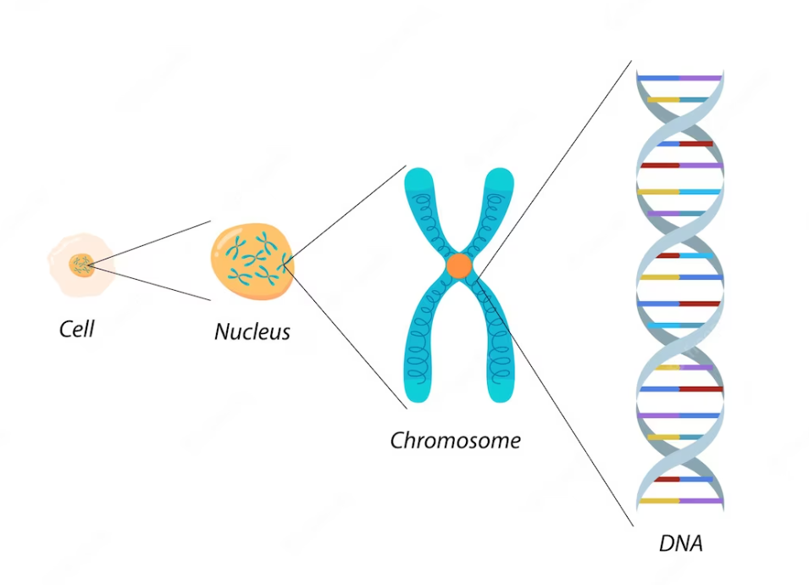
Cytogenetic testing
Chromosomes of a human cell can be analyzed under a microscope.
White blood cells (T lymphocytes)
Fixation, spreading and staining allows for visualization of distinct bands on each chromosome
Fluorescent in situ hybridization (FISH)
https://www.ncbi.nlm.nih.gov/books/NBK115548/

Slide 42
Biochemical testing
Different types of protein and possible malfunction due to genetic mutation.
Test can measure
Protein activity: enzymes
Indirect measurement of protein activity: Level of metabolites
Protein structure: Size / quantity of protein
Malfunctions can include:
None / too much / too little protein
Misfolded / incorrectly modified / incorrectly assembled protein
Altered active site or other critical region for biochemical reactions
High performance liquid chromatography (HPLC) Gas chromatography / mass spectrometry (GC/MS)
Tandem mass spectrometry (MS/MS)
https://www.ncbi.nlm.nih.gov/books/NBK115548/

Slide 43
Molecular testing
DNA analysis when gene sequence is known and may contain small DNA mutations
Any tissue sample, only requires small amount of sample
Methodologies
Polymerase chain reaction (PCR) assay
Comparative genomic hybridization (CGH) or chromosomal microarray analysis (CMA)
DNA microarray analysis
Protein microarray analysis
https://www.ncbi.nlm.nih.gov/books/NBK115548/

Slide 44
Check your understanding!

Slide 45
Check your understanding!
Vascular dementia is the most common cause of dementia.
True
False
Huntington’s disease has no risk genes.
True
False
Predictive testing can determine whether a person will develop a genetic disorder before any signs of symptoms appear based on deterministic genes
True
False
Notes:
False
True
False
False
True

Slide 46
Check your understanding!
PSEN1 is a deterministic gene for FTLD
True
False
Having a positive result at genetic screening does not mean the individual has the condition.
True
False
Notes:
False
True
False
False
True

Slide 47
Check your understanding!
Homozygosity means that ...
There are two different copies / alleles of a gene
There are no copies / alleles of a gene
There are three copies / alleles of a gene
There are two exact copies / alleles of a gene
None of the above
Huntington's disease (HD) is the only neurodegenerative disease characterized by ...
Abnormal protein formation or deposition
Monogenic and fully penetrant inheritance of one genetic mutation and no risk genes
Deterministic genes and risk genes
Cognitive problems
None of the above

Slide 48
Check your understanding!
Susceptibility testing ....
Estimates the relative risk for developing a disease
Is based on GWAS results
Uses polygenic risk scores (PRS) as a tool
Is not yet implemented in the clinical routine due to hard to interpret results in complex diseases
All of the above
Alzheimer's disease (AD) and other causes of dementia have 15 modifiable risk factors. These include:
Lower education, hearing loss, obesity, smoking and social isolation
Higher education, hearing loss, smoking, social isolation and physical inactivity
Smoking, social isolation, being female, depression and exposure to air pollution
Not smoking, lack of sleep, unhealthy diet, depression and social isolation
Lack of sleep, unhealthy diet, depression, hearing loss and getting older

Slide 49
Check your understanding!
Polymerase chain reaction (PCR) assay is a technique used for
Cytogenetic testing: chromosomes
Biochemical testing: proteins
Molecular testing: DNA
All of the above
None of the above

Slide 50
Lesson overview What’s next?

Slide 51
Lesson Overview – What’s next?
You are familiar with the most common inheritable neurodegenerative diseases, their clinical presentation and genetic predisposition.
You know the difference between deterministic and risk genes.
You know which genetic testing modality is appropriate for a certain setting.
You are up to date with the latest technologies for genetic testing.
The next lesson will cover ethical aspects of genetic counseling (GC). This will provide knowledge on ethical principles for healthcare practice, components of informed consent, genetic law and guidelines. More specifically, it will cover:
Legal background
Ethical frameworks / recommendations
🡺 With a focus on consent and date / sample sharing in international contexts
Effective implementation of GC
🡺 Including all General Data Protection Regulations (GDPR).

Slide 52
References
Additional resources

Slide 53
References
2023 Alzheimer’s disease facts and figures. (2023) Alzheimers & Dementia, 19(4), 1598-1695. https://doi.org/10.1002/alz.13016
Livingston, G., Huntley, J. M., Sommerlad, A., Ames, D., Ballard, C., Banerjee, S., Brayne, C., Burns, A., Cohen-Mansfield, J., Cooper, C., Costafreda, S. G., Dias, A., Fox, N. C., Gitlin, L. N., Howard, R., Kales, H. C., Kivimäki, M., Larson, E. B., Ogunniyi, A., . . . Mukadam, N. (2020). Dementia prevention, intervention, and care: 2020 report of the Lancet Commission. The Lancet, 396(10248), 413–446. https://doi.org/10.1016/s0140-6736(20)30367-6
Ma’u, E., Cullum, S., Cheung, G., Livingston, G., & Mukadam, N. (2021). Differences in the potential for dementia prevention between major ethnic groups within one country: A cross sectional analysis of population attributable fraction of potentially modifiable risk factors in New Zealand. The Lancet Regional Health - Western Pacific, 13, 100191. https://doi.org/10.1016/j.lanwpc.2021.100191
Ikram, M. A., Worrall, B. B., Manso-Calderón, R., Jia, J., Schmidt, H., Middleton, L. T., Nacmias, B., Siddiqi, S., & Adams, H. H. (2017). Genetics of vascular dementia – review from the ICVD working group. BMC Medicine, 15(1). https://doi.org/10.1186/s12916-017-0813-9
Orme, T., Guerreiro, R., & Bras, J. (2018). The Genetics of Dementia with Lewy Bodies: Current Understanding and Future Directions. Current Neurology and Neuroscience Reports. https://doi.org/10.1007/s11910-018-0874-y
Klein, C., & Westenberger, A. (2012). Genetics of Parkinson’s Disease. Cold Spring Harbor Perspectives in Medicine. https://doi.org/10.1101/cshperspect.a008888
Frontotemporal Disorders Information for Patients, Families, and Caregivers. (2019, January 14). National Institute on Aging. https://www.nia.nih.gov/research/alzheimers-dementia-outreach-recruitment-engagement-resources/frontotemporal-disorders
McColgan, P., & Tabrizi, S. J. (2018). Huntington’s disease: a clinical review. European Journal of Neurology, 25(1), 24–34. https://doi.org/10.1111/ene.13413
Appleby, B. S., Shetty, S., & Elkasaby, M. (2022). Genetic aspects of human prion diseases. Frontiers in Neurology, 13. https://doi.org/10.3389/fneur.2022.1003056
De Lara, A. M., Soto-Gómez, L., Núñez-Acosta, E., Saruwatari-Zavala, G., & Rentería, M. E. (2019). Ethical issues in susceptibility genetic testing for late-onset neurodegenerative diseases. American Journal of Medical Genetics - Neuropsychiatric Genetics, 180(8), 609–621. https://doi.org/10.1002/ajmg.b.32699

Slide 54
Additional Resources
Websites:
Alzheimer’s Association: https://www.alz.org/
Medline Genetics: https://medlineplus.gov/genetics/
NIH – Understanding Genetics: https://www.ncbi.nlm.nih.gov/books/NBK115563/
National Human Genome Research Institute: https://www.genome.gov/

Slide 55
Thank you
Visit our website
http://www.genecounsel.eu/
This project has been funded with support from the European Commission. This presentation reflects the views only of the author, and the Commission cannot be held responsible for any use which may be made of the information contained therein.

