Slide 1
Unit 4. How to implement Genetic Counseling sessions
Lesson 4.1. Genetic Counseling sessions
An overview

Slide 2
Introduction and Learning Outcomes
Lesson 4.1 aims to explain exactly what the Genetic Counseling (GC) sessions for people with a family history of Neurodegenerative Disorders (ND) are and the main objectives of these sessions.
At the end of this module, the users will acquire a set of basic notions on
GC and the main goals, who can be a Genetic Counselor, the multidisciplinary team and the difficulties in this job. This Unit will focus on the benefits of the potential negative implications of GC as well as the motivations and barriers to taking part in GC sessions.

Slide 3
Table of contents
Chapter 1: Definition of Genetic Counseling and the main objectives
Chapter 2: The profession of Genetic Counselor
Chapter 3: Benefits of Genetic Counseling
Chapter 4: Risks of Genetic Counseling
Chapter 5: Motivations and Barriers to taking part in GC sessions

Slide 4
“What is genetic counseling and what are the benefits and implications?”

Slide 5
1
CHAPTER
Definition of Genetic Counseling and its main aims

Slide 6
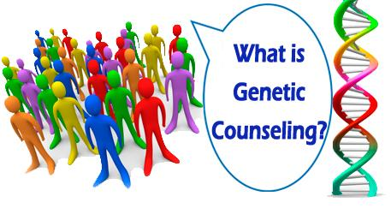
What is genetic counseling?
Counseling is a process of communicating between two or more persons who meet to solve a problem, resource a cure, or make a decision on various matters. It is not a one-way process where in the counselor tells the client what to do or it is a forum for presentation of the counselor’s values.
According to the National Society of Genetic Counselors (2006) and the EuroGentest Network of Excellence, Genetic Counseling (GC) is:
a communication process that deals with the occurrence, or risk of occurrence, of a (possibly) genetic disorder in the family and helping people understand and adapt to the medical, psychological and familial implications of genetic contributions to disease.
National Society of Genetic Counselors, 2006

Slide 7
What is genetic counseling?
This process integrates the following:
• Interpretation of family and medical histories to assess the chance of disease occurrence or recurrence.
• Education about inheritance, testing, management, prevention, resources and research.
• Counseling to promote informed choices and adaptation to the risk or condition.
National Society of Genetic Counselors, 2006

Slide 8
What is genetic counseling?
The process helps the individual or the family to:
understand the medical facts of the disorder;
appreciate how heredity contributes to the disorder and the risk of recurrence in specified relatives;
understand the options for dealing with the risk of recurrence;
use this genetic information in a personally meaningful way that promotes health, minimizes psychological distress and increases personal control;
choose the course of action that seems appropriate to them in view of their risk and their family goals, and act in accordance with that decision;
make the best possible adjustment to the disorder in an affected family member and/or to the risk of recurrence of that disorder.
National Society of Genetic Counselors, 2006

Slide 9
Objectives of genetic counseling
Provide concrete, accurate information about inherited disorders. Explaining the cause and course of the disease or the high-risk and treatment options available
Make a precise diagnosis (if possible), based on detailed family history, construction of a pedigree, clinical examination and investigations
Provide risk figures for the future of spring/ relatives based on genetic facts
Calculation of the risk of recurrence based on inheritance pattern
Offer support to people who are affected by genetic disorders
Allow people who are affected by inherited diseases to make informed choices and make decisions about future reproduction by non-directive counseling principals
Reduce anxiety and guilt of clients
Rantanen et al., 2008; “CHAPTER 4. GENETIC COUNSELING” Genetic Alliance. 2010

Slide 10
Important issues in genetic counseling
According to international guidelines and policies, the most important issues related to GC are the following:
Appropriate training for the counselors
Content of the information
Counselors' understanding of the information
Psychological support
Problems related to disclosure to the relatives
Need for consent
Autonomy
Confidentiality
Fear of discrimination
https://sfmg.se/download/externadokument/publikationer/guidelines_of_GC_final.pdf; Rantanen et al., 2008

Slide 11
Risk factors that require genetic counseling
Either a parent or a close relative has an inherited disease or birth defect.
Either parent already has children with birth defects or genetic disorders.
The mother-to-be had two or more miscarriages or babies that died in infancy.
The mother-to-be will be 35 or older when the baby is born. The chances of having a child with Down syndrome increase with the mother’s age.
A standard prenatal screening test yields an abnormal result.
An amniocentesis yields unexpected results.
Regarding the risk factors on neurodegenerative disorders, look at Unit 2.2.
https://www.cdc.gov/genomics/gtesting/genetic_counseling.htm

Slide 12
Persons involved in the GC process
Counselor
Profession | Person who gives GC should be a professional specialist, as he/she needs to convey complex information. Local providers of GC must be qualified per local laws and regulations governing GC and associated licensure requirements of providers. In areas where no regulations exist, it is recommended that providers of GC and disclosure be trained clinical professionals with an advanced understanding of genetics and experience with providing potentially sensitive medical results.
Training | Genetic counselors should receive appropriate and on-going training in genetic conditions, risk assessment, psychosocial issues, bioethics, service system, communication and patient perspective. Guidelines for the training of clinical geneticists and genetic counselors can be found on the following websites: https://www.nsgc.org/; www.hgsa.org.au; https://www.ebmg.eu/. It is also acknowledged that different clinical genetics units and/or services may function differently and are administered by various public and private health facilities.
Co-operation within healthcare system | GC team consists of a team of professionals. Particularly complex genetic conditions requires a multidisciplinary focus. It comprises physicians, gentisists, social science researchers, health educators, legal experts, and genetic counselors, medical ethics, and disclosure of genetic risk factors.
Family
Asymptomatic people | A protocol based on specific steps on implementing GC is recommended, e.g. International Huntington Association and World Federation of Neurology Research Group on Huntington’s Chorea Guidelines.
Symptomatic people | GC for symptomatic people should be performed in the presence of the individual’s legal guardian or family member.
Vulnerable people / Not able to consent | Tests should be done in the best interest of the people that cannot give informed consent, or sometimes in the health interest of their family. Authorisation of the representative is required, but the persons need to participate according to their capacity.
Rantanen et al (2008)

Slide 13
2
CHAPTER
The Genetic counselor

Slide 14
Genetic counselors help people understand how their family history and DNA influence their health.
https://www.aboutgeneticcounselors.org/

Slide 15
Who can provide genetic counseling?
Genetic counselors are health professionals with specialized graduate degrees and experience in the areas of medical genetics and counseling.
Most enter the field from a variety of disciplines, including medicine, biology, genetics, nursing, psychology, public health and social work.
They have passed a certification exam administered by the American Board of Genetic Counseling or European Board of Medical Genetics
Abacan et al., 2018

Slide 16
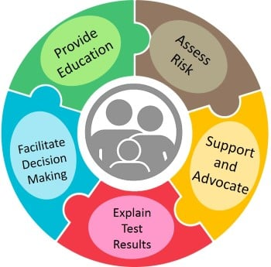
Who are the genetic counselors?
Genetic counselors help translate genomic science to improve the lives of people with
common and rare genetic conditions.
They can meet with individuals or families before or after genetic testing.
Genetic counselors specialize in prenatal, pediatric, oncology, neurology, ophthalmology, psychiatry, and many other areas.
Genetic counselors work in countless healthcare settings to improve the lives of people with known or suspected genetic conditions in many ways.
As our understanding of DNA improves, the settings, jobs, and roles of genetic counselors will continue to increase.
https://www.aboutgeneticcounselors.org/

Slide 17
Who are the genetic counselors?
Some Genetic Counselors work directly with patients
Most genetic counselors work in a clinic or hospital and often work in partnership with other doctors and members of your healthcare team. Genetic counselors may provide general care, or specialize in one or more areas including prenatal/family planning, pediatrics, cancer, or neurology.
Some Genetic Counselors work in other areas outside of seeing patients
like work in research, education, industry, marketing, and other roles across the healthcare and genetics fields:
- Reading, interpreting, and writing reports for genetic testing companies or guiding and managing business decisions
- Conduct or assist with research, including collecting information such as detailed family histories and pregnancy information
- As teachers in medical or graduate school programs
- With policymakers and lawyers on policy and legal statutes specific to genetics or GC
https://www.aboutgeneticcounselors.org/

Slide 18
Important qualities of genetic counselors
Communication skills. Genetic counselors must be able to explain complex information in a way that their clients understand.
Compassion. They must be sensitive and empathetic when discussing clients’ options regarding potentially upsetting test results.
Critical-thinking skills. They recommend the proper test and analyze findings for each client.
Interpersonal skills. They must be able to relate well with clients and their families, as well as to work with other healthcare providers offering services to clients.
Organizational skills. They manage multiple clients and must keep accurate, complete records on each of them.
https://www.bls.gov/ooh/healthcare/genetic-counselors.htm

Slide 19
Genetic counselor profession
The profession of genetic counselor is established or developing in more than 11 European countries.
In some countries, it has a long history and is becoming more and more respected as a significant provider of allied health services, whilst in others it is just getting started.
There is a lack of GC training programs - Most genetic counselors are trained in other countries (mainly the USA).
Few healthcare professionals are prepared to address the genetic risks and manage the disclosure's psychological impact on relatives.
Abacan et al., 2018; Ormond et al., 2018

Slide 20
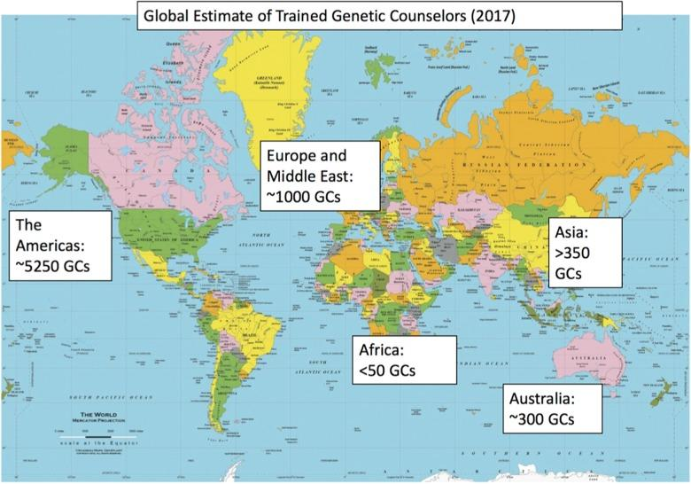
Abacan et al., 2018

Slide 21
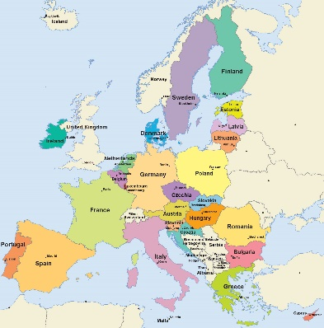
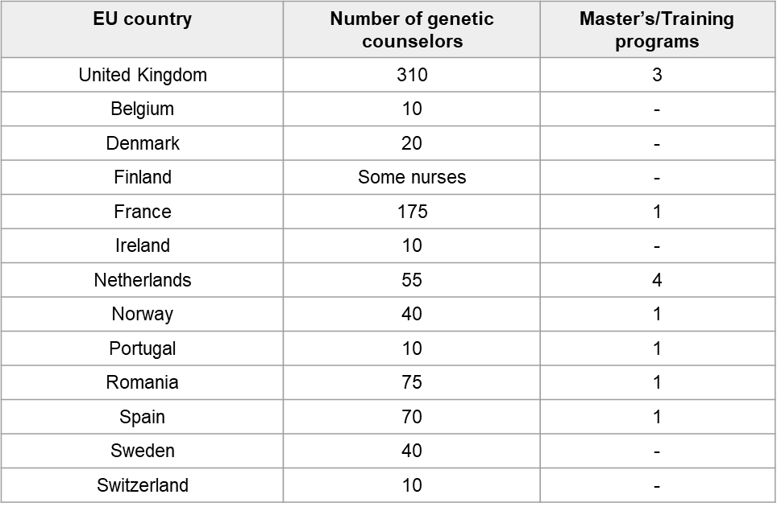
Genetic counselors in Europe
Abacan et al., 2018

Slide 22
Multidisciplinary team
In the last years, it seems clear that genetic counselors are essential for in-patient care and in the multidisciplinary team of the health care system.
Multidisciplinary team approach involving coordinated care among various specialties with a patient-centric outlook ensures efficient resource utilization and cost-effective management.
The establishment of multidisciplinary specialized clinics providing comprehensive care is expected to improve the quality of patient care and reduce the overall burden on the family.
“Genetic Counselors are increasingly playing a pivotal role in a multidisciplinary team, which is a great way of mainstreaming genomic knowledge from genetic counselors into the wider healthcare team”
Catapano et al., 2022; Endrakanti et al., 2023

Slide 23
3
CHAPTER
Benefits of Genetic Counseling

Slide 24
Advantages
A greater understanding of health and individual risk
Information to help make informed medical and lifestyle decisions
A sense of relief from uncertainty
Opportunity to help educate other family members about the potential risk

Slide 25
1. Health literacy
Health literacy refers to the capacity to access, understand, appraise and apply information for decision-making and acting in health-related matters.
Education about inheritance, testing, management, prevention, resources, and research. Understand the possibilities and limitations of the tests. A greater understanding of health and individual risk.
Health literacy can promote a healthier lifestyle, change behaviors (physical exercise, diet, vitamins, cognitive stimulation, stop smoking, etc.), and improve quality of life as well as the sense that there is more time for future planning.
It can decrease fear and stigma of the disease and the testing.
Counselors should consider providing additional resources to aid accurate genetic risk communication, such as written information and online resources, at various stages before and after genetic testing.
Rostamzadeh et al., 2019

Slide 26
1. Health literacy
Nowadays, there is a greater use of multimedia decision-aids and e-learning tools in GC. As a result, knowledge acquisition is equivalent to or greater than GC alone and tools with integrated decision support appeared effective in minimizing decisional conflict.
Information is consistent and can be accessed by patients in their own time, at their own pace, and on multiple occasions if required.
Such tools can also be layered in the amount of information available, thereby allowing individuals to tailor their information-seeking according to their own needs and preferences.
Studies measuring informed decision-making showed that uninformed decisions were due to a lack of knowledge and/or value inconsistency.
These tools can provide a greater opportunity for the counselor to focus on patient-centered counseling.
Birch, 2015

Slide 27
2. Decision-making
Intentions/motivation to get tested/ to undergo genetic or biomarker testing.
People tend to consider genetic tests as valid information to make important preventive decisions like changing health behavior, participating in a hypothetical trial with a disease-modifying treatment, etc.
Encourage long-term health insurance, which is particularly relevant for the long-term nature of neurodegenerative disorders (ND).
Genetic testing is estimated valuable information to improve personal control of health and guide future decisions.
Oliveri et al., 2018

Slide 28
3. Emotional benefits
A sense of relief from uncertainty.
Receiving a lower-risk estimate may reduce client’s anxiety about developing the disease.
Distress reduction among those who learned that they were negative.
It may satisfy clients’ curiosity about their chances of developing the disease.
The disclosure of thoughts and feelings has been shown to have therapeutic benefits through the conversion of a stressful event (e.g. AD risk disclosure) into a linguistic structure which in itself may promote understanding of a stressor and a reduction of associated negative emotion.
This interpretation is supported by studies linking emotional disclosure to positive patient outcomes, including improved reported physical health and psychological well-being.
Christensen et al., 2011; Guan et al., 2018; Oliveri et al., 2018

Slide 29
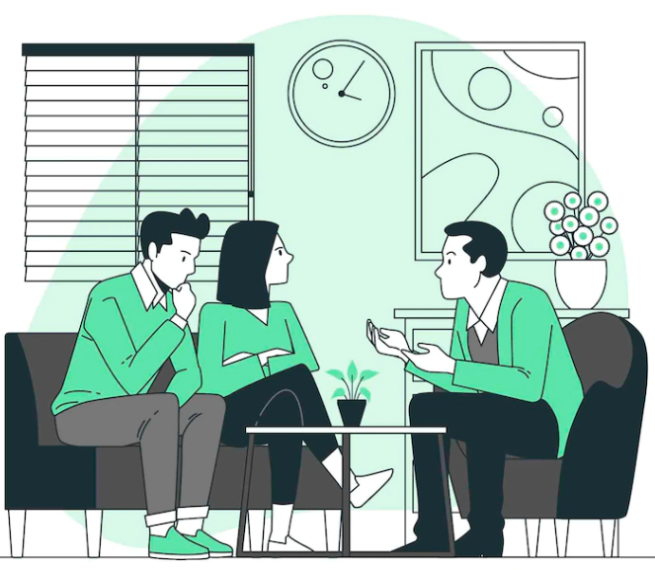
4. Impact on the family
Testing may give details about a risk for kids, siblings, and other members of the family.
Increase the family’s understanding of a genetic disease, the risks and benefits of genetic testing and disease management, and available options.
Identify with the family the psychosocial tools required to adjust to potential outcomes and to cope (coping skills) with the consequences of a genetic disorder, which subsequently reduces stress and anxiety on the burden associated with the disorder.
Through GC, people could be better prepared to support and care for their loved ones.
Families can be better prepared to support and care for their loved ones and make plans for the future.
CHAPTER 4, GENETIC COUNSELING, “Understanding Genetics: A District of Columbia Guide for Patients and Health Professionals”; District of Columbia Department of Health. Washington (DC): Genetic Alliance; 2010

Slide 30
4
CHAPTER
Risks of Genetic Counseling

Slide 31
Disadvantages
Testing may increase individual’s stress and anxiety
Results in some cases may return inconclusive or uncertainty
Negative impact on family and personal relationships

Slide 32
1. Emotional implications
Family members may have concerns and fears about receiving a testing result,
and perceive negative societal attitudes toward it.
They may worry about the potential loss of "normal" life or experience a sense of grief.
Genetic tests may generate anxiety and distress. These effects may depend on people's perception of risk, severity, and controllability of the disease; and the availability of treatments.
Some people experience depressive symptoms, suicidal ideations, aggressive reactions and hopelessness in gene carriers such as in Huntington’s disease.
Higher psychological suffering and negative impact on quality of life.
Binetti et al., 2006; Oliveri, et al, 2018

Slide 33
2. Increase uncertainty
A non-well-informed GC session and the lack of knowledge or misconceptions about the genetics and the clinical characteristics of the illness can increase uncertainty.
Differently from other chronic diseases, a negative genetic result for a ND does not reassure, but it causes negative emotions. This reaction can be due to the uncertainty of results and a lack of “response” for the etiology of cognitive symptoms, when present, or a sense of guilt toward family members that have the disease.
Prevention behavioral changes are not always positive: for example, an increasing assumption of dietary supplements harmless, such as vitamin E, could give people a false perception of control over their health without any significant scientific evidence
Blasco & Roberts, 2023

Slide 34
3. Negative impact on the family
Increased the presence of adverse relational/family situations like conflicts.
Put carriers at risk of social discrimination.
Embarrassment and social withdrawal.
Proceed with insufficient decisions about health insurance that often result in increased costs.
Genetic testing should be encouraged only when there is effective therapy available to prevent or treat the condition tested for. There is little value in genetic tests that do not allow clients to take action to reduce or change their risk for a particular disease. In other words, genetic testing is a good idea only when the pros of genetic testing outweigh the cons of your situation. It shouldn’t be a one-size-fits-all approach.
Blasco & Roberts, 2023

Slide 35
Genetic tests should be proposed along with proper psychological support and counseling focused on users' genetic health literacy; perception of risk, and beliefs about disease controllability, in order to foster fruitful medical decisions.

Slide 36
5
CHAPTER
Motivations and Barriers to taking part in GC sessions

Slide 37
Motivations to taking a genetic counseling session
Family is a motivational factor in a variety of aspects and concerned about other family members being at risk. The ability to provide information to family members.
Family care planning.
Affordability (over the last several years the cost of genetic testing has decreased, which may influence some patients finding it affordable).
Emotional concerns.
Easing Worry (the worry about the unknown being worse than taking the steps to get an answer).
General curiosity.
Christensen et al., 2011; Shen et al., 2022

Slide 38
Motivations to taking a genetic counseling session
Gaining information and learning that GC and/or testing were available.
Informing risk-specific prevention and the potential to encourage health improvements through means such as behavioral changes, and the use of results for future diagnostic purposes.
Informing about treatment strategies and facilitating appropriate participation in early detection. The potential for medical intervention and/or monitoring.
Shen et al., 2022

Slide 39
Barriers to taking a genetic counseling session
Interpersonal Barriers
Lack of knowledge and/or awareness of the medical history of family members.
Anxiety, fear, and worry about testing, dislike of blood, and potential negative psychological and emotional impacts.
Mistrust, disinterest, the possibility of receiving unwanted information, and the belief that a low-risk result may not give reassurance.
Uncertainty of results and perceived limited clinical utility.
Unaffordable cost/lack of insurance coverage and their belief that it would lead to unnecessary future testing.
Delikurt, et al, 2015; Shen et al., 2022

Slide 40
Barriers to taking a genetic counseling session
Community Barriers
Lack of awareness of personal risk.
Lack of awareness and knowledge of genetic services.
Concerns related to confidentiality, privacy and data security.
Potential impact of results on insurance and the potential increased cost to the health system.
Scheduling or other priorities (for some people, the idea of adding another appointment mid-treatment or quickly after spending so much time at the hospital was too overwhelming).
Fear of discrimination (mainly by employers)
Moral and ethical reasons, such as the fear of eugenics and the question of human mortality.
Shen et al., 2022

Slide 41
Check your understanding!

Slide 42
Check your understanding!
The process of Genetic Counseling includes:
Interpretation of family and medical histories to assess the chance of disease occurrence or recurrence.
Education about inheritance, testing, management, prevention, resources and research.
Counseling to promote informed choices and adaptation to the risk or condition.
All the above
Some of the objectives of Genetic Counseling are to:
Provide just a diagnosis and information
Provide mainly information about the genetic results and the increased risk of the family
Focus mainly on the psychological aspects of clients
Offer information, discussion on the results, the risk, support family and their choices
3. In Genetic Cousneling, counselors need to pay attention to
Mainly to have the appropriate education
Just share the correct information
Solve problems in the family
Be updated for appropriate information, support family, take into account all ethical issues

Slide 43
Check your understanding!
Some people lack knowledge of their family history for a disease, which could prevent them from asking for GC.
True
False
5. Some of the motivations for deciding to participate in Genetic Counseling could be
Risk in the family
Family care planning
Curiosity and emotional concerns
All the above

Slide 44
Lesson overview What’s next?

Slide 45
Lesson Overview – What’s next?
In this lesson, we acquired a set of basic notions on GC, the main goals, the profession of a genetic counselor, and who can be a genetic counselor working in a multidisciplinary team. This lesson also focused on the benefits of the potential negative implications of GC and the motivations and barriers to participating in GC sessions.
Lesson 4.2 will share all the resources, and materials, protocols of GC sessions, giving step-by-step the implementation process of GC. It will also provide an adequate opportunity to develop the ability to draw and interpret pedigrees, calculate genetic risk, communicate risk, and facilitate decision-making as well as the common tools to assess a patient’s psychological state regarding the process of genetic testing.

Slide 46
References
Additional resources

Slide 47
References
Abacan, M., Alsubaie, L., Barlow-Stewart, K., Caanen, B., Cordier, C., Courtney, E., Davoine, E., Edwardsm J., Elackatt, NJ., Gardinerm K., Guan, Y., Huang, LH., Malmgren, CI,. Kejriwal, S., Kim, HJ., Lambert, D., Lantigua-Cruz, PA., Lee, JMH., Lodahl, M., Lunde, Å., Macaulay, S., Macciocca, I., Margarit, S., Middleton, A., Moldovan, R., Ngeow, J., Obregon-Tito, AJ., Ormond, KE., Paneque, M., Powell, K., Sanghavi, K., Scotcher, D., Scott, J., Juhé, CS., Shkedi-Rafid, S., Wessels, TM., Yoon, SY., Wicklund, C. (2019). The Global State of the Genetic Counseling Profession. Eur J Hum Genet. 27(2):183-197. doi: 10.1038/s41431-018-0252-x.
Binetti, G., Benussi, L., Roberts, S., Villa, A., Pasqualetti, P., Sheu, CF., Gigola ,L., Lussignoli, G., Dal Forno, G., Barbiero, L., Corbellini, G., Green, RC., Rossini, PM., Ghidoni, R. (2006) Areas of intervention for genetic counselling of dementia: Cross-cultural comparison between Italians and Americans. Patient Education and Counseling 64, 285–293. https://doi.org/10.1016/j.pec.2006.03.008
Birch, P.H. (2015). Interactive e-counselling for genetics pre-test decisions: where are we now? Clin Genet;87:209e17
Blasco, D., Roberts, J.S. (2023). Editorial: Implications of Emerging Uses of Genetic Testing for Alzheimer's Disease. J Prev Alzheimers Dis.;10(3):359-361. doi: 10.14283/jpad.2023.46
Catapano, F., El Hachmi, M., Ketterer-Heng, N., Renieri, A., Mari, F., Morris, M., Cordier, C. (2022). The role of the Genetic Counsellor in the multidisciplinary team: the perception of geneticists in Europe. Eur J Hum Genet. 30(12):1432-1438. doi: 10.1038/s41431-022-01189-5.
Christensen, KD., Roberts, JS., Uhlmann, WR., Green, RC. (2011). Changes to perceptions of the pros and cons of genetic susceptibility testing after APOE genotyping for Alzheimer disease risk. Genet Med. 13(5):409-14. doi: 10.1097/GIM.0b013e3182076bf1.

Slide 48
References
Delikurt, T., Williamson, G., Anastasiadou, V. et al. (2015). A systematic review of factors that act as barriers to patient referral to genetic services. Eur J Hum Genet. 23, 739–745 https://doi.org/10.1038/ejhg.2014.180
Dusic, EJ., Theoryn, T., Wang, C., Swisher, EM., Bowen, DJ. (2022). EDGE Study Team. Barriers, interventions, and recommendations: Improving the genetic testing landscape. Front Digit Health. 4:961128. doi: 10.3389/fdgth.2022.961128.
Endrakanti, Mounika & Gupta, Neerja. (2023). Multidisciplinary Team for Genetic Disorders – Integration with Clinicians and Health-care Professionals. Apollo Medicine. 20(2):p 144-147. DOI: 10.4103/am.am_82_23
Guan, Y., Roter, DL., Wolff, JL., Gitlin, LN., Christensen, KD., Roberts, JS., Green, RC., Erby, LH. (2018). The impact of genetic counselors' use of facilitative strategies on cognitive and emotional processing of genetic risk disclosure for Alzheimer's disease. Patient Educ Couns.101(5):817-823. doi: 10.1016/j.pec.2017.11.019
Megan, M. (2021). Exploring Motivational Factors to Pursue Genetic Counseling and Testing in Adolescent and Young Adult Cancer Patients. The University of Texas MD Anderson Cancer Center UTHealth Graduate School of Biomedical Sciences Dissertations and Theses (Open Access). 1072.
National Society of Genetic Counselors' Definition Task Force, Resta R, Biesecker BB, Bennett RL, Blum S, Hahn SE, Strecker MN, Williams JL. (2006). A new definition of Genetic Counseling: National Society of Genetic Counselors' Task Force report. J Genet Couns. 15(2):77-83. doi: 10.1007/s10897-005-9014-3.

Slide 49
References
Rantanen, E., Hietala, M., Kristoffersson, U., Nippert, I., Schmidtke, J., Sequeiros, J., Kääriäinen, H. (2008). What is ideal genetic counselling? A survey of current international guidelines. Eur J Hum Genet.16(4):445-52. doi: 10.1038/sj.ejhg.5201983.ar
Shen, EC., Srinivasan, S., Passero, LE., Allen, CG., Dixon, M., Foss, K., Halliburton, B., Milko, LV., Smit, AK., Carlson, R., Roberts, MC. (2022) Barriers and Facilitators for Population Genetic Screening in Healthy Populations: A Systematic Review. Front Genet. 13:865384. doi: 10.3389/fgene.2022.865384
Oliveri, S., Ferrari, F., Manfrinati, A., Pravettoni, G. A. (2018). Systematic Review of the Psychological Implications of Genetic Testing: A Comparative Analysis Among Cardiovascular, Neurodegenerative and Cancer Diseases. Front Genet. 9:624. doi: 10.3389/fgene.2018.00624.
Ormond, KE., Laurino, MY., Barlow-Stewart, K., Wessels, TM., Macaulay, S., Austin, J., Middleton, A. (2018). Genetic counseling globally: Where are we now? Am J Med Genet C Semin Med Genet.178(1):98-107. doi: 10.1002/ajmg.c.31607
Poulton, A., Curnow, L., Eratne, D., Sexton, A. (2023). Family Communication about Diagnostic Genetic Testing for Younger-Onset Dementia. J Pers Med.13(4):621. doi: 10.3390/jpm13040621.

Slide 50
Additional Resources
Books and papers:
CHAPTER 4, GENETIC COUNSELING, “Understanding Genetics: A District of Columbia Guide for Patients and Health Professionals”; District of Columbia Department of Health. Washington (DC): Genetic Alliance; 2010 Feb 17.
Websites:
https://www.aboutgeneticcounselors.org/
https://www.youtube.com/watch?v=mhwVlCDgk84&t=5s
https://www.bls.gov/ooh/healthcare/genetic-counselors.htm

Slide 51
Thank you
Visit our website
http://www.genecounsel.eu/
This project has been funded with support from the European Commission. This presentation reflects the views only of the author, and the Commission cannot be held responsible for any use which may be made of the information contained therein.

