Slide 1
Unit 2. Theory-basic scientific information
Lesson 2.1. Basic Principles and Methods of Genetics and Inheritance

Slide 2
Introduction and Learning Outcomes
Lesson 2.1 aims to give basic information about inheritance, human genomic variation, genetic disorders & genomic research
At the end of this module the users will acquire a set of basic notions on heredity, genomic variation, and emerging research in the field of genetics

Slide 3
Table of contents
Chapter 1: Inheritance
Chapter 2: Basic definitions of genetics
Chapter 3: Human genomic variation
Chapter 4: Genetic disorders
Chapter 5: Emerging areas

Slide 4
Prior knowledge
On a scale from 1-5, (1- no previous knowledge, 2-very little previous knowledge, 3- some previous knowledge, 4-moderate previous knowledge, 5-extensive previous knowledge)
How would you describe your knowledge regarding:
Basic principles of inheritance
Human genomic variation
Genetic disorders
Genomic research

Slide 5
1
CHAPTER
Inheritance

Slide 6
Inheritance - Mendel
All living things (animals, plants, microbes, etc.) have a set of characteristics inherited from its parents
The way in which traits are passed from one generation to the next was first described by Gregor Mendel
Through pea plant breeding, Mendel developed three principles of inheritance:
Law of Dominance
Law of Segregation
Law of Independent Assortment
These laws do not apply to non-mendelian inheritance situations such as incomplete dominance, sex-linked genes, polygenic traits etc.
Miko, I. (2008) Gregor Mendel and the principles of inheritance. Nature Education 1(1):134
Notes:
Law of Independent Assortment
The law of independent assortment says that genes for different traits segregate independently of each other. It means that separate traits are separately inherited. This is because during meiosis the chromosomes line up randomly before the cell divides, allowing for gamete formation.
Law of Dominance
The law of dominance says that there are dominant and recessive traits. Dominant traits are defined as whichever phenotype is expressed in an organism that is heterozygous for the trait.
Law of Segregation
The law of segregation says that everyone has two versions (called alleles) for each trait—one from each parent—and that these alleles segregate randomly (see independent assortment) during meiosis.

Slide 7
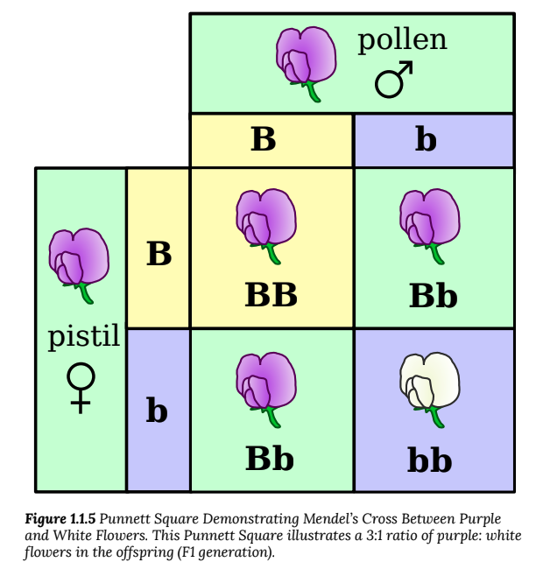
Inheritance
Phenotype - The observable characteristics in an individual resulting from the expression of genes
Singh, N., (2009) Introduction to Genetics.
Notes:
Law of Dominance
The law of dominance says that there are dominant and recessive traits. Dominant traits are defined as whichever phenotype is expressed in an organism that is heterozygous for the trait.
Law of Segregation
The law of segregation says that everyone has two versions (called alleles) for each trait—one from each parent—and that these alleles segregate randomly (see independent assortment) during meiosis.
Here Phenotype should be discussed

Slide 8
2
CHAPTER
Basic definitions
of genetics

Slide 9
Basic Definitions
Genetics: the study of genes and heredity
Gene: Physical unit of inheritance – arranged in a linear order on chromosomes
Heredity: Handing down of traits from parents to offspring – occurs through genes
Allele: Alternative form of a genetic locus; a single allele for each locus is inherited separately from each parent
Chromosome: Each chromosome is made of protein and a single molecule of deoxyribonucleic acid (DNA). Passed from parents to offspring, DNA contains the specific instructions that make each type of living creature unique.
Chromosome behavior and interaction during meiosis explain inheritance patterns
https://www.genome.gov/about-genomics/fact-sheets/

Slide 10
3
CHAPTER
Human Genomic
Variation

Slide 11
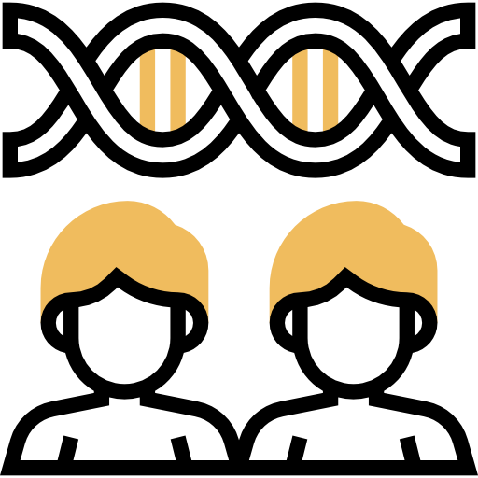
Human Genomic Variation
Genome: the complete set of DNA instructions found in every cell – made out of four different nucleotides: adenine (A), thymine (T), cytosine (C), and guanine (G).
DNA – deoxyribonucleic acid is the chemical compound that contains instructions to develop and direct the activities of living organisms
Genomic variation is the difference in one person‘s DNA compared to others
A very small subset of genomic variants contributes to human health and disease
Human genomes are ~99.6% identical with only ~0.4% of variation accounting for all differences
https://www.genome.gov/about-genomics/fact-sheets/

Slide 12
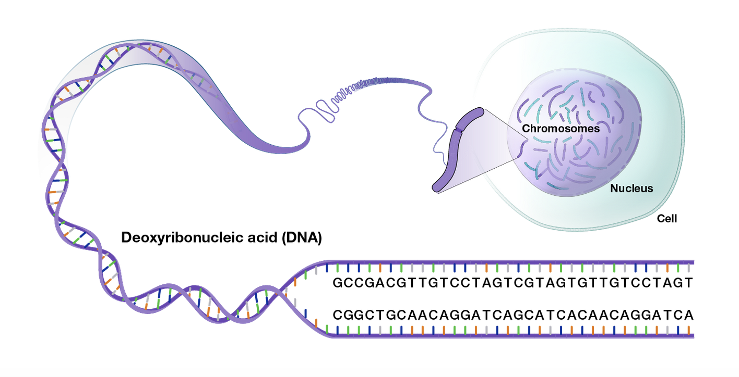
Human Genomic Variation
https://www.genome.gov/about-genomics/fact-sheets/

Slide 13
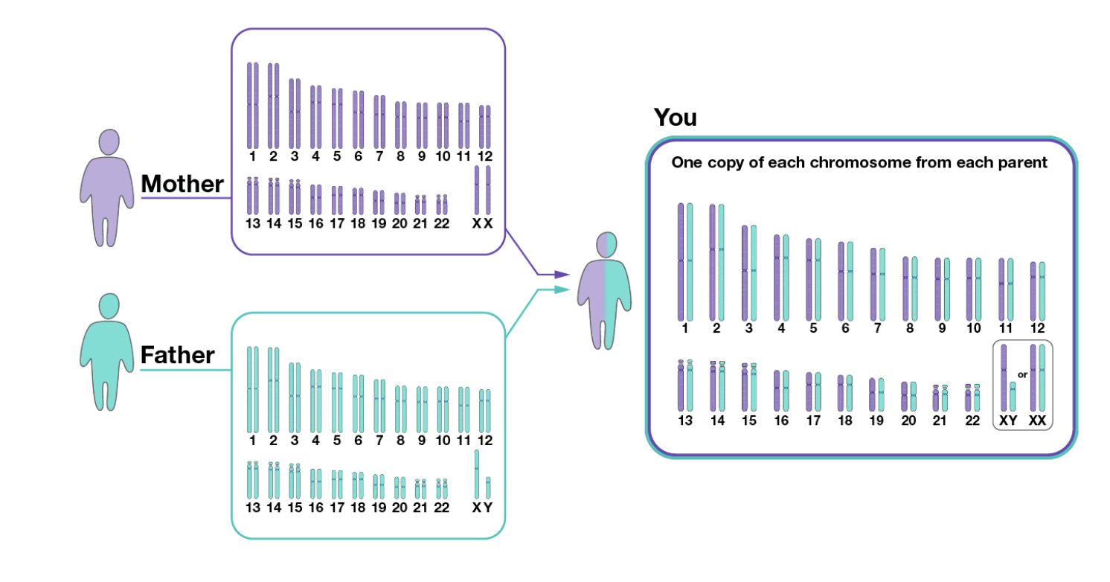
Human Genomic Variation
https://www.genome.gov/about-genomics/fact-sheets/

Slide 14
4
CHAPTER
Genetic disorders

Slide 15
Monogenic genetic disorders
Monogenic genetic disorders are caused by a mutation in one gene
Examples include sickle cell anemia, cystic fibrosis, and Huntington‘s disease
Three types of monogenic disorders:
Autosomal Dominant
Autosomal Recessive
X-Linked
https://www.genome.gov/about-genomics/fact-sheets/

Slide 16
Multifactorial inheritance disorders
Multifactorial inheritance refers to disorders or traits caused by multiple genes, with or without the interplay of environmental factors.
Examples include a broad range of medical diseases such as diabetes, cardiac disease, congenital conditions, and neuropsychiatric diseases
https://www.genome.gov/about-genomics/fact-sheets/

Slide 17
Mitochondrial genetic disorders
Mitochondrial genetic disorders can be caused by changes in either the mitochondrial DNA or nuclear DNA that lead to dysfunction of the mitochondria and inadequate production of energy.
Mitochondrial diseases affect how mitochondria in your cells produce energy
https://rarediseases.info.nih.gov/diseases/7048/mitochondrial-genetic-disorders

Slide 18
5
CHAPTER
Emerging areas

Slide 19
Emerging areas of genomic research Genome-wide association studies
A genome-wide association study (abbreviated GWAS) is a research approach used to identify genomic variants that are statistically associated with a risk for a disease or a particular trait.
The genomes of many people are used to identify variants that occur more frequently in those with a specific disease or train than those without the disease or trait
https://www.genome.gov/genetics-glossary/

Slide 20
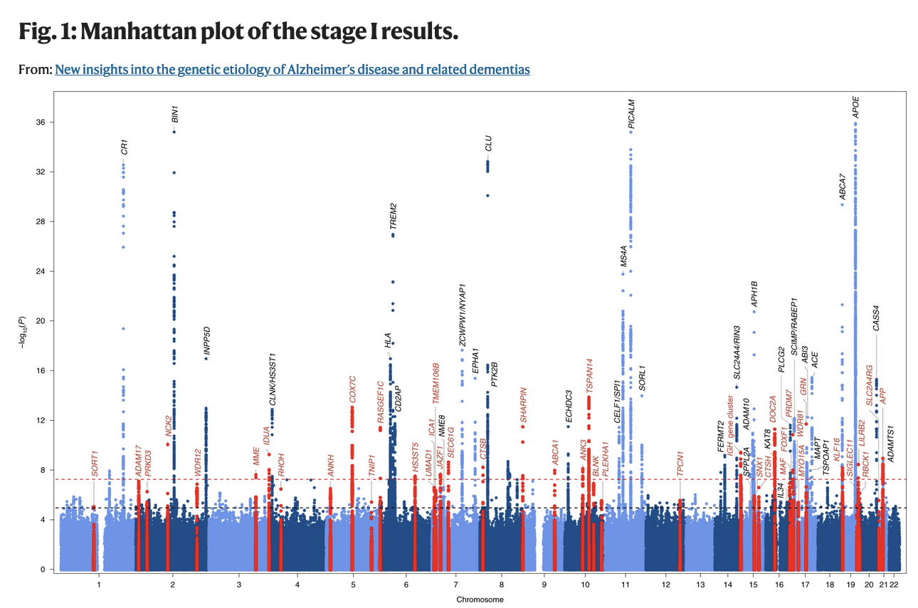
Genome-wide association studies
Bellenguez, C., Küçükali, F., Jansen, I.E. et al. (2022) New insights into the genetic etiology of Alzheimer’s disease and related dementias. Nat Genet 54, 412–436 https://doi.org/10.1038/s41588-022-01024-z

Slide 21
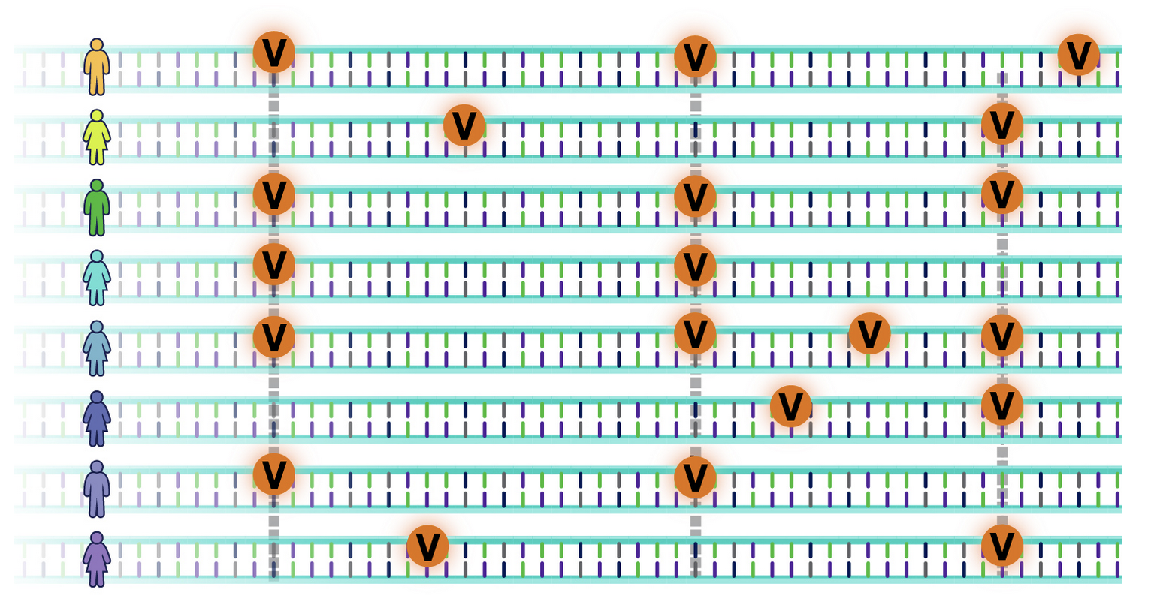
Polygenic risk scores
Polygenic risk scores provide a measure of genetic risk for complex diseases
Polygenic risk scores are a relative cumulative measure of genetic risk for a disease determined through evaluating information (risk alleles and effect sizes) of multiple genetic variants
Polygenic risk scores are not yet routinely used by health professionals because there are no guidelines for practice and researchers are still improving how these scores are generated
https://www.genome.gov/Health/Genomics-and-Medicine/Polygenic-risk-scores

Slide 22
Check your understanding!

Slide 23
Check your understanding!
The three principles of inheritance defined by Gregor Mendel are the: (1) Law of Dominance, (2) Law of Segregation, and (2) Law of Codependency.
True
False
What are the four nucleotides that make up DNA?
What percentage of DNA is identical among all humans?
>99%
96%
80%
98%

Slide 24
Check your understanding!
What is(are) an example(s) of a monogenic disorder?
Diabetes
Cardiac disease
Huntington’s disease
Cystic Fibrosis
Polygenic risk scores are routinely used in clinical care.
True
False

Slide 25
Lesson overview What’s next?

Slide 26
Lesson Overview – What’s next?
In this lesson, we acquired a set of basic notions on basic information about inheritance, human genomic variation, genetic disorders and genomic research.
The next lesson 2.2 will focus on basic information about the most common neurodegenerative inherited diseases, the role of genetics in neurodegenerative disorders that can cause dementia, the different types of genetic testing and the current technologies on genetics.

Slide 27
References
Additional resources

Slide 28
References
Miko, I. (2008) Gregor Mendel and the principles of inheritance. Nature Education 1(1):134
Singh, N., (2009) Introduction to Genetics
NIH: National Human Genome Research Institute. (2023 February). https://www.genome.gov/about-genomics/fact-sheets
NIH: National Human Genome Research Institute. (2023 February). https://www.genome.gov/Health/Genomics-and-Medicine/Polygenic-risk-scores
NIH: National Center for Advancing Translational Sciences. (2023 February). https://rarediseases.info.nih.gov/diseases/7048/mitochondrial-genetic-disorders
Bellenguez, C., Küçükali, F., Jansen, I.E. et al. (2022) New insights into the genetic etiology of Alzheimer’s disease and related dementias. Nat Genet 54, 412–436 https://doi.org/10.1038/s41588-022-01024-z

Slide 29
Additional resources
Books and papers:
Introduction to Genetics, Natasha Ramroop Singh https://open.umn.edu/opentextbooks/textbooks/1279
Websites:
https://www.nature.com/scitable/topicpage/gregor-mendel-and-the-principles-of-inheritance-593/#
https://www.genome.gov/genetics-glossary
https://www.genome.gov/For-Patients-and-Families/Genetic-Disorders

Slide 30
Thank you
Visit our website
http://www.genecounsel.eu/
This project has been funded with support from the European Commission. This presentation reflects the views only of the author, and the Commission cannot be held responsible for any use which may be made of the information contained therein.

