Slide 1
Unit 4. How to implement Genetic Counseling sessions
Lesson 4.2. Genetic Counseling sessions in practice

Slide 2
Introduction and Learning Outcomes
The objective of lesson 4.2 is to present the transnational guidelines aimed at professionals performing genetic counselling (GC) and created by the GECONEU project.
At the end of this module, the users will acquire a set of basic notions on the proposed protocols to conduct GC, the common tools to assess a patient’s psychological state regarding the process of genetic testing, how to produce the patient’s pedigree and family tree, the basics of risk calculation and the steps of result disclosure and follow-up sessions.

Slide 3
Table of contents
Chapter 1: Genetic Counseling: Pre-existing Protocols
Chapter 2: GECONEU+ Transnational Implementation Guidelines
Chapter 3: Assessment of the patient’s/family’s psychological state
Chapter 4: Creating families’ pedigree.
Chapter 5: Risk Determination: Population Genetics
Chapter 6: Communicating risk and how to facilitate decision-making

Slide 4
1
CHAPTER
Genetic Counseling: Pre-existing Protocols

Slide 5
Existing Protocols for Genetic Counseling:
Due to the lack of standardization in the counseling practice across countries, including the counceling practice directed to ND, we find a variety of protocols:
Guideline of the Genetic Diagnostics Commission (GEKO) – Germany
PICOGEN program – a GC intervention for dementia in Spain.
Italian Dominantly Inherited Alzheimer’s and Frontotemporal Network IT-DIAfN
Joint practice guidelines of American College of Medical Genetics and the National Society of genetic counselors.
Gold standard for genetic testing for adult-onset conditions by the Huntington Disease Society of America.
Alzheimer's Prevention Initiative Generation Program: Development of an APOE genetic counseling and disclosure process in the context of clinical trials.
The NSW Genetic Counselling Workforce produced by the Sax Institute for the NSW Ministry of Health of Australasia.

Slide 6
Existing Protocols for Genetic Counseling:
An example protocol by the Italian Dominantly Inherited Alzheimer’s Frontotemporal Network
Designed to guide affected individuals and healthy at-risk relatives, the protocol involved a multidisciplinary team, comprising a geneticist, a specialized neurologist or geriatrician, and a psychologist or psychiatrist experienced in counseling. Steps:
Pretest Consultations: the team explores the individual's motivations and expectations regarding genetic testing, discusses the potential benefits and risks, and addresses any concerns or questions they may have.
Psychological Assessment: to evaluate personality traits, anxious and depressive symptoms, quality of life, coping strategies, resilience, and health-related beliefs.
Blood Sampling: to identify the presence of pathogenic mutations in genes associated with AD (PSEN1, PSEN2, and APP) or FTD (MAPT, GRN, and C9orf72).
Genetic Test Result Disclosure: to ensure the patient fully understands the results and their implications.
Follow-up Visits: visits at 1, 6, and 12 months after the disclosure aimed at monitoring the psychological well-being of the at-risk relatives.
Mega et al., 2020

Slide 7
Existing Protocols for Genetic Counseling:
An example protocol by the Huntington Disease Society of America
Recommended Components of HD Predictive Testing Process:
Telephone Contact (to help the Individual at risk understand the genetic testing process)
Visit 1
Genetic Counseling: The genetic counselor reviews the family history, explains the risks, benefits, and limitations of the test and the potential impact of test results on the individual and their family.
Sign Informed Consent Document
Mental Health Assessment of the individual's emotional state and support system helps identify psychological issues, life stressors, and the need for emotional support. Counseling may extend to companions and family members affected by the test results.
Neurological Exam
Draw Blood
Visit 2: Disclosure of results in person and arrangement of a post-result follow-up.
Follow-Up
Huntington's Disease Society of America, 2016

Slide 8
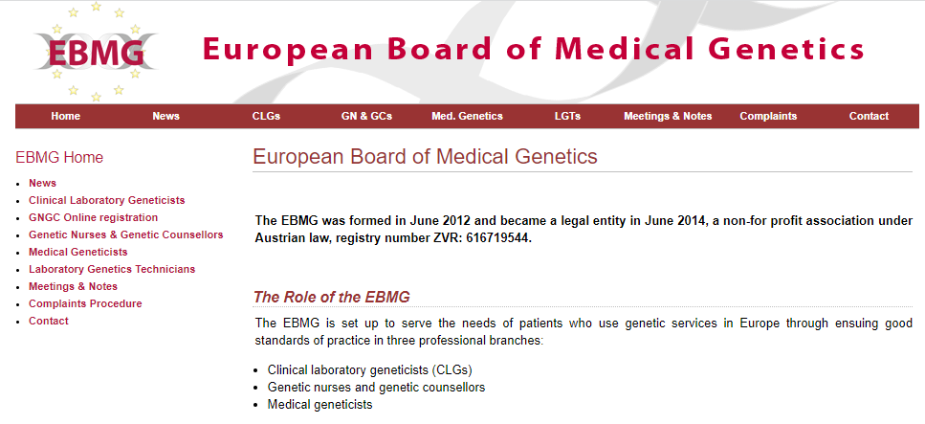
Recommendations at international level:
The European Board of Medical Genetics’ Code
The European Board of Medical Genetics (EBMG) is a legal entity that ensures the good standards of practice in medical genetics in Europe.
Its subdivision, the Genetic Counsellors and Genetic Nurses branch board (GCGN board) is in charge of three main activities:
Assessment of MSc in Genetic Counselling curricula;
Registration of genetic counsellors via an assessment of a body of work (portfolio)
5-yearly assessment of renewal of registration via CPD log for registered genetic counsellors
Fig. 1. EBMG website.

Slide 9
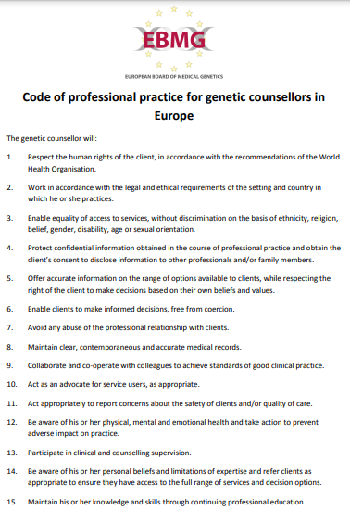
Recommendations at international level:
The European Board of Medical Genetics’ Code
The board has produced, among other documents, the Code of professional practice for genetic counselors in Europe , which summarizes the main considerations to apply on a daily practice.
Fig. 2. EBMG Code of professional practice for genetic counsellors in Europe .
European Board of Medical Genetics. 2013

Slide 10
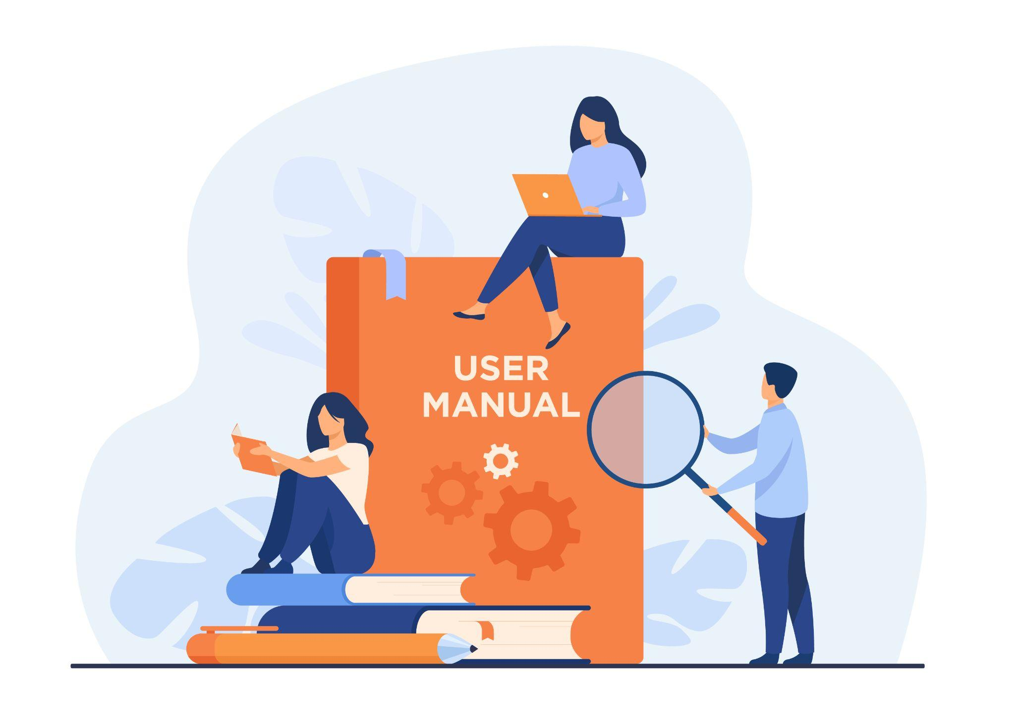
Recommendations at international level:
The European Society of Human Genetics
The European Society of Human Genetics (ESHG) is focused on quality, professional guidelines, training and its dissemination in the area of genetic testing.
They provide interesting documents regarding GT and GC, as well as recommendations for professionals of the field and educational resources on their website.

Slide 11
2
CHAPTER
GECONEU+ Transnational Implementation Guidelines

Slide 12
GECONEU+ Transnational Implementation Guidelines
The main aim of this Guide was to research and combine similar European protocols about genetic counseling in ND. The resulting protocol aims to be used as the standard procedure for conducting GC in ND.
Therefore, these guidelines are based on existing official guidelines, written statements, recommendations, and reports that address issues related to GC. All with the objective of setting the framework of GC intervention as a routine care service in European institutions and establishing the integration of a standardized GC service across Europe.
It is crucial to highlight that this Guide cannot replace the extended Guides that focus on GC in practice. This Guide is just an overview of other best practices and summarizes the main results.

Slide 13
GECONEU+ Suggested Steps for GC in ND
1
2
3
Pre-consultation contact
Preparation for consultation
The consultation

Slide 14
GECONEU+ Suggested Steps for GC in ND
The genetic counselor should contact the clients before the appointment in order to:
Confirm consultation details (location, time, etc.).
Explain the purpose, process, and aims of said appointment.
Address unrealistic expectations.
Assess client/family needs and expectations, including special requirements.
Gather necessary documentation.
Provide emotional support to reduce pre-clinic anxiety.
Self-directed learning materials may be given or sent, covering consultation content, genetic conditions, risk genes, and implications for participants and family members.
1
Pre-consultation contact

Slide 15
GECONEU+ Suggested Steps for GC in ND
Verify that all necessary information has been obtained.
Review previous health and clinical genetics records.
Consult relevant medical literature.
Seek supervisor or colleague input if needed.
Set an agenda based on client/family needs and expectations
Include educational information on disease and genetic tests
Prepare for possible personal questions/concerns.
2
Preparation for consultation

Slide 16
GECONEU+ Suggested Steps for GC in ND
Pre-testing consultation:
Before conducting any sessions or tests, make sure to obtain signed consent forms from the client or other relatives.
Psychological and cognitive readiness assessment
Review of the personal and familial medical history
Providing information about the testing
Disclosure consultation:
Providing information about the results
Estimation of the risk
Establishing follow-up sessions.
3
The consultation

Slide 17
GECONEU+ Suggested Steps for GC in ND
Consent form
Before conducting any sessions or tests, make sure to obtain signed consent forms from the client or other relatives.
Inform clients about the purpose, benefits, risks, and limitations of counseling and genetic testing to allow a voluntary decision-making.
Clients have the right to access their information and it may only be shared with other medical practitioners with explicit consent.
Client and family history information may be stored in a password-protected state-wide database.
Parents or legal representatives must provide authorization for testing in the best interest of children or individuals unable to provide consent.

Slide 18
3
CHAPTER
Assessment of the patient’s and family’s psychological state

Slide 19
Psychological and Cognitive Readiness Assessment
Genetic information often has a profound impact on an individual and their family. To reduce the risk of negative psychological reactions to disclosure of genetic results, measures to assess psychological readiness to receive results need to be administered.

Slide 20
The most common assessment tools
Psychological scales
Depression
15-Item geriatric depression Scale (GDS)
21-Item Beck Depression Inventory (BDI)
Hamilton Depression Rating Scale (HAM-D)
20-ITEM Center for Epidemiological Studies-Depression Scale (CES-D)
Anxiety
21-item Beck Anxiety Inventory (BAI)
Hamilton Anxiety Rating Scale (HAM-A)
Six-Item Subset of the State-Trait Anxiety Inventory for Adults (STAI-AD)
Suicidal ideation and behaviors
Columbia Suicide Severity Rating Scale (C-SSRS)
Cognitive scales
Montreal Cognitive Assessment (MoCa)
Mini-Mental State (MMS)
Notes:
CSSRS 🡪 Free training on the website (youtube videos and certificate)
MoCa 🡪 certificate

Slide 21
4
CHAPTER
Recording the patient and family history

Slide 22
Creating families’ pedigree
Review personal and family history:
Access the existing medical history (medical records, previous tests) with the proper consent from the patient.
Ask for new information:
Express the importance of this task and how this information is going to be used and stored.
A family tree of at least 3 generations should be obtained.
Collect in detail all the people’s name, age, physical and mental conditions. In case of death, it is important to record the cause and age of death. Specially in cases of unaffected relatives.
Record any health problems, such as the ND, age of symptoms onset, pathological conditions and any medical findings.
It is important to establish if all children/siblings share the same biological progenitors.
London Health Sciences Center. n.d.

Slide 23
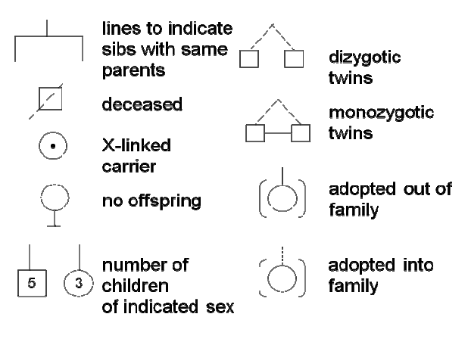
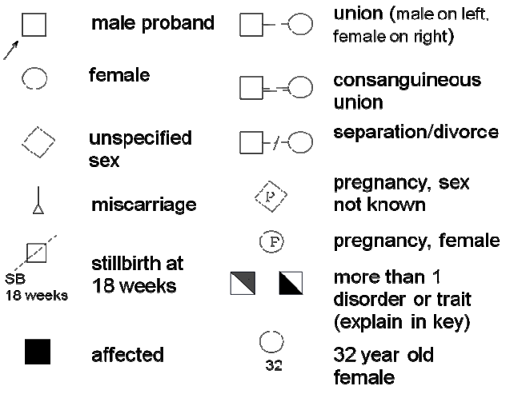
Creating families’ pedigree
Drawing the family pedigree
There are internationally accepted rules to create a pedigree.
Fig. 3. Symbols for Pedigree drawing.
London Health Sciences Center. n.d.

Slide 24
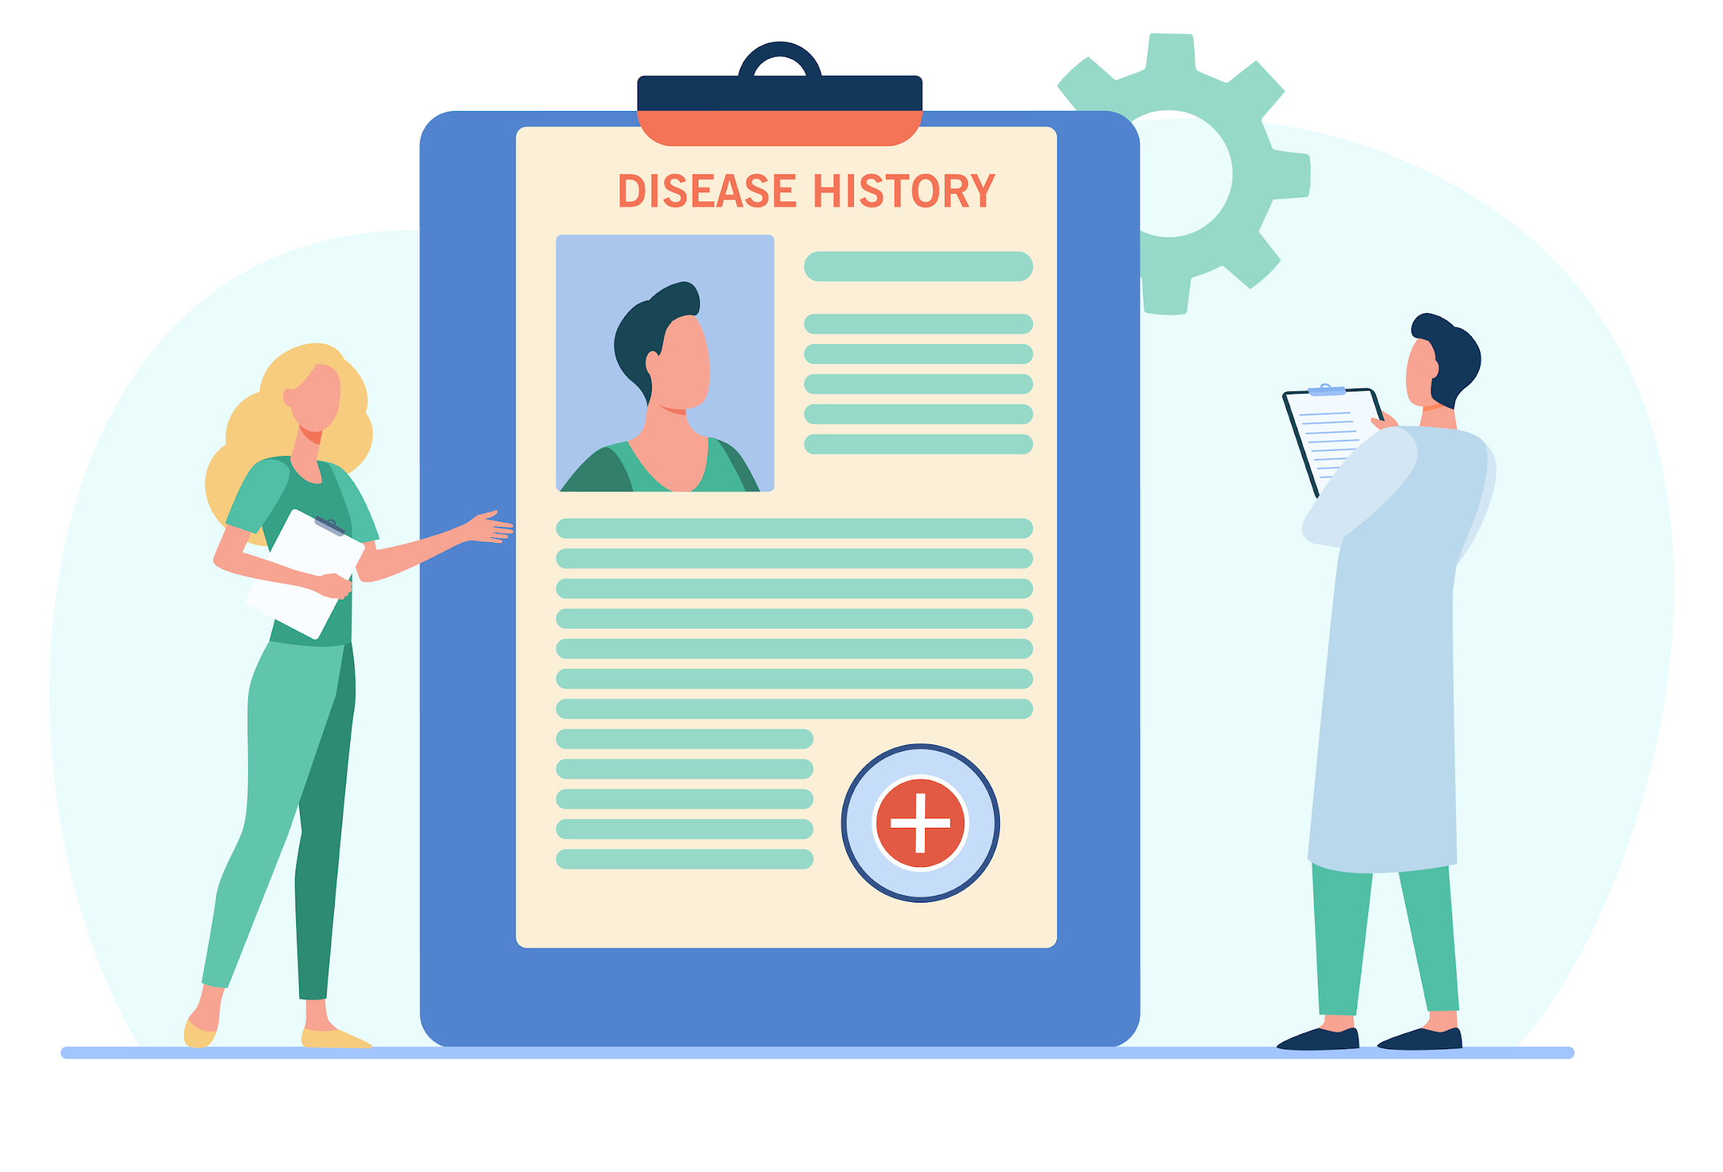
Creating families’ pedigree
In order to create the pedigree, the counselor should follow this steps (I):
Start by drawing the person seeking advice and indicate their name and age below their symbol.
Include client's parents, siblings (from left –oldest– to right –youngest–), spouse, and offspring, always in this order and indicating their ages. Indicate each generation with a number (I, II, II, etc.).
All affected individuals should be included and as many unaffected individuals as possible. When depicting couples, draw the male on the left side and the female on the right to facilitate interpretation.
Spouse of a sibling may not need to be drawn if there is no pertinent information.
Expand to at least 3 generations. If any deaths occurred, inquire about the cause and indicate the age at the time of death.

Slide 25
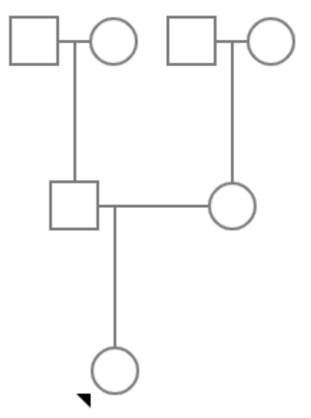
Creating families’ pedigree
In order to create the pedigree, the counselor should follow this steps (II):
Indicate the proband or index case with an arrow. This is the family member with the genetic disorder that induced the seeking of GC. It is important to indicate the age of onset of symptoms, if any, or age of diagnosis
Indicate the ethnic origin on top of the first-generation individuals.
Inquire about consanguinity (blood relationship) or common relatives.
Create a key to denote features of interest in affected individuals.
Identify any relatives with identical or similar features to the index case.
Note any other health concerns.
Inquire about any disorders that "run in the family.“
Ask about any history of miscarriages, stillbirths, or infant deaths in the family
Identify relatives with developmental delay, learning problems, birth defects.
South Asian Caucasian
Fig. 4. Example Pedigree drawing.

Slide 26
Creating families’ pedigree
Drawing the family pedigree – Practical exercise
Your patient, Albert, is a 34 y/o Spanish man that comes to the consult after his father (who is 59 y/o) has been diagnosed with early onset Alzheimer (EOAD), caused by a mutation in the presenilin 1 protein gene (PSEN1). In this case, the EOAD has an autosomal dominant inheritance pattern.
Albert’s mother (57 y/o) is healthy. Moreover, Albert has an older sister (37 y/o) who is married and has identical twin girls (10 y/o). Albert’s grandmother (82 y/o) is still alive, and lives with his parents. She has no signs of dementia and no memory problems. Albert’s grandfather died at age 67 from lung cancer.
Albert has a child who is 6 y/o with Marie, a healthy 35 y/o French woman who is an only child. Marie’s father is 60 y/o and healthy. However, Marie’s mother died at age 50 from a heart-attack.
Draw the family pedigree using all the information provided.
Indicate all the information that is missing and that should be asked to our patient during the pre-test consultation.
You will find the answer to this exercise at the end of this presentation

Slide 27
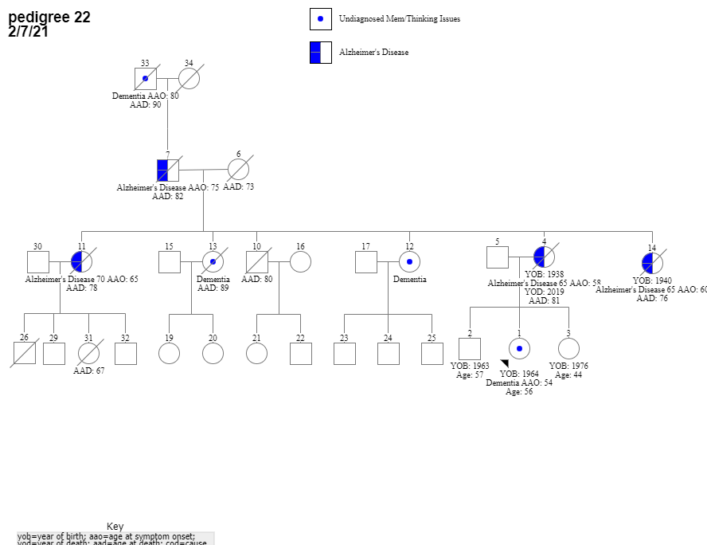
Creating families’ pedigree
Drawing the family pedigree
In the annex of this presentation, you will find literature with more information about the methods of designing pedigrees as well as practical exercises from different websites.
The family pedigree should be designed simultaneously while taking the family history.
Fig. 5. An example of a pedigree with Alzheimer disease history
REFERENCE?

Slide 28
Creating families’ pedigree
Educational discussion:
The counselor must inform the patient about the genetic conditions in a non-biased way, using understandable language and concepts. The counselor can produce materials (videos or some slides) that can be sent to the patient before the main counseling session.
The patient and/or their companions should receive:
Theoretical background of the disease; genetic mechanisms, limitations of the current knowledge about the condition, as well as possibilities of treatment and status of research and DNA banking.
Risk factors and their prevalence in the general population.
The process of genetic testing and possible outcomes of the study.
Assist with informed decision making and result sharing, emphasizing the importance of discretion in genetic testing discussions.
Discuss impact of test results on insurance and genetic discrimination legislation.
Offer a follow-up plan to check in and determine the need for additional counseling.

Slide 29
Creating families’ pedigree
Motives and considerations
The counselor should assess patient's understanding, beliefs, and needs and explore family dynamics and fears about the disease in order to address their concerns.
Consider patient's motivations and support system for testing by asking the following questions:
What do you anticipate your immediate reaction to a positive and a negative test result may be?
Over the long term, talk me through how you imagine you will manage living with knowing your risk status and coping with the stress.
What, if anything, about your future life plans may change?
With whom will you share your results? Have you discussed your testing decision with these people?
How are these results likely to affect these people?
What are your resources and who makes up your primary support system?
If your siblings are testing, how do you anticipate feeling if their results differ from yours?
The genetic counselor may make the recommendation to delay testing until unresolved issues between a couple are addressed and/or may refer them for longer-term counseling.

Slide 30
Creating families’ pedigree
Special considerations for symptomatic patients
Consider potential conflicts of interest when is a relative who requests genetic testing for a symptomatic patient, such as disinterest from said patient or other at-risk relatives.
Explore alternatives like DNA banking if the patient is averse to testing.
Encourage a family meeting to address disagreements and respect individual preferences.
Ensure client's understanding and autonomy in decision-making throughout the consultation.
Present options without bias and discuss advantages, disadvantages, and values.
Allow sufficient time for deliberation and seeking additional input.

Slide 31
5
CHAPTER
Risk determination and population genetics

Slide 32
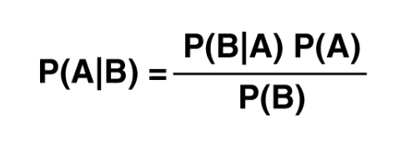
Risk determination
Individual risk estimation involves using empirical data, inheritance patterns, pedigree information, clinical expertise, and genetic test results. Only accredited and formed professionals should calculate and deliver risk calculations to patients.
It is essential to prepare the session before meeting with the patient, in order to use appropriate and specific methods tailored to each case.
The Bayesian analysis integrates pedigree data and genetic testing results to produce personalized risk assessment. In order to use the Bayes theorem, the counselor needs to be aware of the initial risk and conditional modifying factors:
Sensitivity and specificity of the test used
Presence of other unaffected individuals in a family
Likelihood of onset age of the disease
Fig. 6. Bayes theorem
Ogino et al., 2004

Slide 33
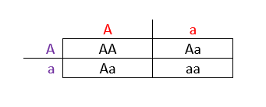
Risk determination
Mendelian conditions
Multifactorial traits and polygenic inheritance
In diseases influenced by multiple genetic and environmental factors, determining the exact level of risk becomes more complex. Genetic counselors need to provide accurate risk estimates combining population-level studies and targeted genetic tests. It is essential to determine the relevance of every genetic alteration to comprehensively assess each patient's profile.
Single-gene alterations usually present a more predictable inheritance patterns.
The use of a Punnett square, shown in the picture, can be a useful visual aid for understanding inheritance probabilities.
Fig. 7. Punnet square
Dixon et al., 2020

Slide 34
Risk determination
Factors Impacting Bayesian Risk Interpretation
Conservatism: The patient does not consider new evidence about their situation (for example the results of a genetic test) and therefore only take into consideration their base rate risk.
Base Rate Neglect: The patient only focuses on new evidence (like the results of a genetic test) without taking into account the base rate risk.
Inverse Fallacy: The patient mistakes the sensibility of a genetic/biochemical test with the probability of having the disease that they were tested for in case of receiving a positive result.
Dixon et al., 2020

Slide 35
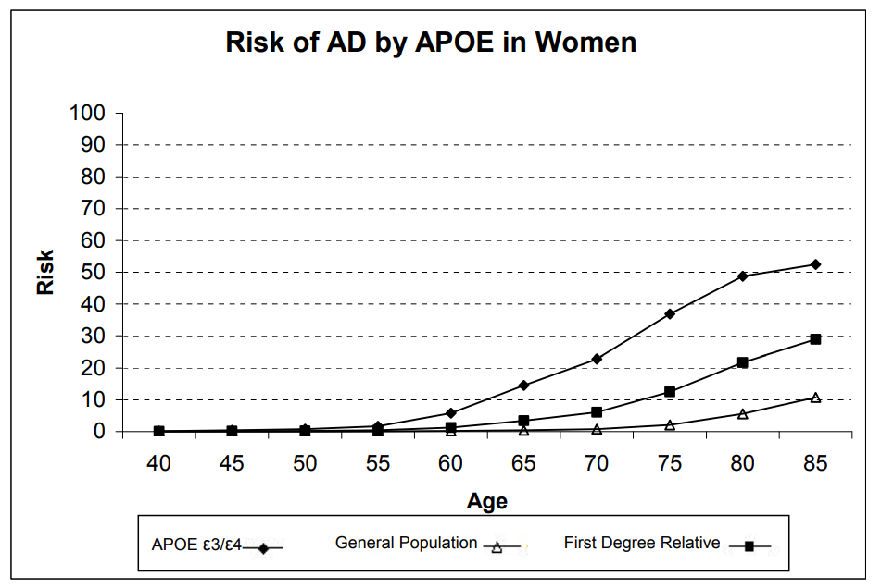
Risk determination
The counselor should discuss with the patient the limitations of risk calculation and interpretation, emphasizing the variability of risk rates presented between studies.
Studies show that patients may have a preference for receiving the risk information in a numerical form. However, a lot of patients can show difficulty in understanding numbers, especially probabilities. Presentation methods, such as frequencies, percentages, odds ratios, and population comparisons, alongside visual aids, impact patient understanding and might be crucial when delivering such sensitive information.
Further information about how to estimate risks can be found in the book “Introduction to Risk Calculation in Genetic Counseling” developed by Ian D. Young (2007).
Fig. 8.

Slide 36
6
CHAPTER
Communicating risk and how to facilitate decision-making.

Slide 37
Communicating risks: Disclosure session
Ideally, only healthcare professionals experienced in communicating sensitive health risk information should divulge results, with telephone and videoconferencing as acceptable alternatives to in-person disclosure.
The counselor will have to adapt the information to each individual. Thus, communication and counseling skills are some of the critical skills that a counselor must cultivate to effectively influence change in a patient. Some of the communication skills presented by Fagerlin et. al (2011) are:
Use plain language instead of medical jargon.
Present numerical and other complex information as simple as possible.
Use pictographs.
Be aware that the order in which information is presented can change the perception of the patient, specially regarding risks and benefits.
Include summaries and conclusions about the content.

Slide 38
Communicating risks: Disclosure session
Before disclosure of any results, the counselor must confirm the participant’s desire to learn about their genetic results. Only after that the following points are discussed:
Disclose results and discuss inheritance implications, risk comparisons and potential risk modifiers such as lifestyle changes.
Provide a Risk Estimate Summary Sheet to the participant with their genetic results.
Revisit plans for sharing results with relatives.
Discuss treatment options, disease research, and DNA banking, even though the most appropriate option is to refer the patient to a treating professional if necessary.
Provide resources for more information and assist with informed decision making.
Offer brochure with prevention strategies, emphasizing the need to consult a healthcare professional before making major lifestyle changes.

Slide 39
Communicating risks: Disclosure session
Talking points with individuals receiving first-time disclosure of their APOE results
Introduction to session
Review the purpose of the session and confirm the individual’s interest in participation
Review family history, with a focus on AD/dementia
Basic clinical description of AD, MCI, and dementia
Impact of APOE on AD risk
Cannot definitively predict or rule out the development of AD
No medical management currently available based on APOE status
Review three possible results and associated AD/MCI risk [Zero copies (ε3/ε3, ε2/ε3, ε2/ε2); one copy (ε3/ε4, ε2/ε4); two copies (ε4/ε4)]

Slide 40
Communicating risks: Disclosure session
Inheritance of APOE gene; address possible implications for children and siblings
Considerations for learning APOE results
Psychological impact
Familial impact
Clinical research impact
Review potential Genetic Information Nondiscrimination Acts (different in each country, this pertains to the United States only)
Address specific concerns or considerations about learning APOE result
State option to either proceed with disclosure of APOE genetic testing results, postpone disclosure to a later date, or decline disclosure of APOE results

Slide 41
Communicating risks: Disclosure session
If proceeding with disclosure, talking points 11–15 would follow
Disclosure of APOE results
Disclosure of AD risk information. Provide comparison for other APOE genotypes to provide context
Allow participants to ask questions and/or discuss issues of concern or interest that are of most importance to them after learning the result
Address the participant’s emotional response to the result (if any)
Review the plan for follow-up phone calls by the counselor
If postponing disclosure, address remaining questions and concerns before ending the session and review plans for recontact when ready for disclosure.
If declining disclosure, participants would be given time to address their questions or concerns before ending the session.

Slide 42
Communicating risks: Disclosure session
It is recommended to use learning material to facilitate the understanding of the disclosure session contents.
Pre-disclosure genetic education material
It is advisable to prepare some materials like pre-disclosure videos or informational brochures providing a summary of the specific gene and disease, as well as the implications for the patients and their relatives.
Genetic counseling and disclosure session materials
The counselor uses the Handout as a visual aid during the sessions and participants are provided with a copy for note taking and to keep.
Fig. 9. (The Alzheimer's Prevention Initiative 2017)

Slide 43
Communicating risks: Disclosure session
Genetic disclosure should be accompanied by recommendations for reducing disease risk.
The World Health Organization (WHO) presented some approaches in its recently issued guidelines for risk reduction, which include health behaviors and interventions that show promise in lowering the risk of the disease; regular physical activity and management of hypertension.
Individuals should also be made aware of substantive education resources such as the Alzheimer’s Association and the US National Institute on Aging. In addition, encouragement to participate in clinical research may be appropriate in some cases.
All key information disclosed to individuals should be concisely summarized in a take-home document for future reference.

Slide 44
Communicating risks: Follow-up session
It is the responsibility of the health professional to offer re-contact from the client after a clinic appointment
Importance of Follow-up:
To assess the impact of genetic results on the participants.
Ensures client understanding and allows to address further questions.
Provides ongoing support and guidance.
Methods of Follow-up:
Telephone or in-person follow-up sessions.
Specific assessment batteries:
At various time points: 2-7 days, 6 weeks, 6 months, and 12 months post-disclosure.
With different objectives: to measure psychological well-being, understanding, and retention of information.
And to assess perceived risk, general impact of testing, and satisfaction with service.

Slide 45
Communicating risks: Follow-up session
Additional Evaluation Measures:
Impact of Event Scale (IES)
Impact of Genetic Testing for Alzheimer's disease instrument (IGT-AD distress)
Genetic Counseling Outcome Scale (GCOS-24)
Self-reported questionnaires for behavioral changes (diet, exercise, medications)
Open-ended risk recall for lifetime risk estimates
Further scales for psychological impact assessment appear in Chapter 3 of this Unit.

Slide 46
Communicating risks: Important issues
Some important aspects about GC that should be taken into account, apart form the ethical issues and recommendations that are revised in other Units of this course, are:
The patient’s right not-to-know about the genetic results, even after the test has been performed.
Discrimination. Genetic information has the potential to result in discrimination and stigmatization if given to external parties. The participants should be are aware of the implications.
Common information. Genetic information is common to the whole family, which can cause conflicts. The counselor should address how the different at-risk family members are contacted and offer counseling for those interested. Disclosure should be agreed between the client and the physician.

Slide 47
Communicating risks: Important issues
Some important aspects about GC that should be taken into account, apart form the ethical issues and recommendations that are revised in other Units of this course, are:
Cultural issues. Family’s cultural and ethnic background should be considered.
Referrals. The counselor can refer the participant to other professionals when necessary.
Periods. Test results should be disclosed as soon as possible. However, there should be enough time between counseling and disclosure to allow the patient to make unrushed decisions.
The chosen venue needs to ensure privacy, absence of distractions, and to be quiet and comfortable.

Slide 48
Communicating risks: Important issues
Finally, some of the most common questions that could be asked to a genetic counselor, and therefore questions which should be prepared beforehand, are the following:
Does this disease run in my family?
If my family member has this disease, might I get it? If yes, should I get tested?
If I have this disease, are my family members at risk of getting it?
Is GT available for this disease? If yes, what are the benefits and limitations of testing? How will I pay for it?
What kind of information could GT for this disease give me?
What does the GT process involve?
How could knowing more about genetic risk help me?
Could I be exposing myself or my family to discrimination based on genetic information?
Could GT results affect my health care coverage?

Slide 49
Check your understanding!

Slide 50
Check your understanding!
During the Pre-consultation contact of genetic counselling, and following the GECONEU+ guidelines, the counsellor should:
Address the patient’s agenda and address unrealistic expectations
Provide emotional support to reduce pre-clinic anxiety
Provide self-directed learning materials
All of the above
The proband in a family pedigree is the member that:
Accompanies the patient
The youngest person of the whole family
The person who seeks genetic counselling
The person whose diagnostic induced the counselling seeking.

Slide 51
Check your understanding!
Three of the possible factor affecting Bayesian risk interpretation from Dixon et al. criteria are:
Confirmation bias, Base rate Neglect and Inverse Fallacy
Conservatism, Base rate Neglect and Inverse Fallacy
Confirmation bias, Base rate Neglect and Overconfidence
Conservatism, Survivor bias and Inverse Fallacy
Identify the false statement about follow-up sessions:
Telephone or videoconference are a valid methods to conduct follow-up sessions
They are only performed if the patient specifically asks for them.
They are a way to provide ongoing support to the patient
They can be performed at various points such as 7 days, 6 weeks, 6 months or even 12 month after the disclosure session.

Slide 52
Lesson overview What’s next?

Slide 53
Lesson Overview - What is next?
After going through the contents of this lesson regarding the process of genetic counseling and disclosure of results, about the importance of recording the family history and pedigree of the patient and the ways of assessing their psychological state regarding this whole process, in the next lesson you will learn about the concept of Telegenetics and its many uses and applications.

Slide 54
References
Additional resources

Slide 55
References
Code of professional practice for genetic counsellors in Europe, European Board of Medical Genetics. (2013). https://www.ebmg.eu/897.0.html
Dixon, S. D., Campion, M. A. W., & Singletary, C. N. (2020). Risk Assessment and Communication. In Genetic Counseling Practice: Advanced Concepts and Skills (pp. 53–78).
Hamilton, M. (1960). A rating scale for depression. Journal of neurology, neurosurgery, and psychiatry, 23(1), 56–62. https://doi.org/10.1136/jnnp.23.1.56
Huntington's Disease Society of America. (2016). Genetic Testing Protocol for Huntington's Disease. Retrieved from http://hdsa.org/wp-content/uploads/2015/02/HDSA-Gen-Testing-Protocol-for-HD.pdf
Jerome A. Yesavage MD & Javaid I. Sheikh MD (1986). Geriatric Depression Scale (GDS). Clinical Gerontologist, 5(1-2), 165-173. DOI: 10.1300/J018v05n01_09
London Health Sciences Center. (n.d.). Drawing a Family Pedigree: Independent Learning Module. Retrieved from https://www.lhsc.on.ca/media/2449

Slide 56
References
Mega, A., Galluzzi, S., Bonvicini, C., Fostinelli, S., Gennarelli, M., Geroldi, C., Zanetti, O., Benussi, L., Di Maria, E., & Frisoni, G. B. (2020). Genetic counselling and testing for inherited dementia: single-centre evaluation of the consensus Italian DIAfN protocol. Alzheimer’s Research & Therapy, 12(1).
Ogino, S., & Wilson, R. B. (2004). Bayesian analysis and risk assessment in genetic counseling and testing. The Journal of Molecular Diagnostics.
The Alzheimer's Prevention Initiative. (2017). APOE Gene Test Results & Risk Information [Handout Sheet]. Retrieved from https://alzheimerspreventioninitiative.com.

Slide 57
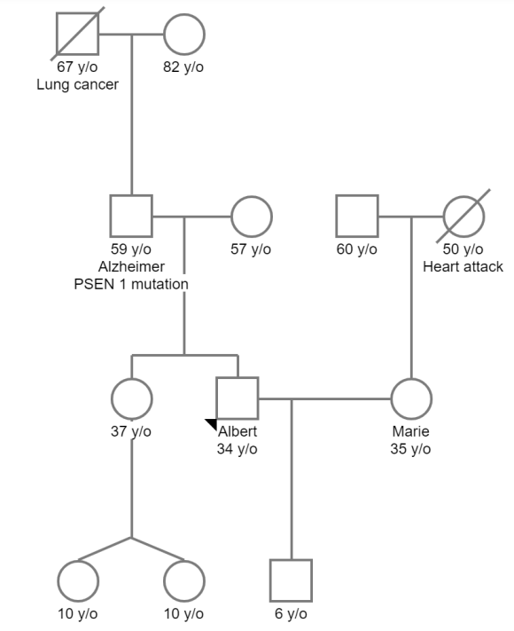
Creating families’ pedigree
Spanish
Spanish
Drawing the family pedigree – Practical exercise
French
French
Your pedigree should look like this

Slide 58
Additional Resources
Books and papers:
Final version of the guidelines
Iowa Institute of Human Genetics: How to Draw a Pedigree
Drawing A Family Pedigree: Independent Learning module
Websites:
Huntington's Disease Society of America.
Alzheimer’s prevention initiative
National Society of Genetic Counselors.
Oxford University Press, Online resource centres: Constructing a Family Tree

Slide 59
Videos for self-learning
Here you will find some videos that might help amplify the materials presented on this lesson:
GeneDx provides a series of videos to explain to clients some of the basic concepts of genetic testing and genetic counseling:
There are some interesting videos on the Internet that can help you practice drawing family pedigrees or to learn more about risk calculation.

Slide 60
Thank you
Visit our website
http://www.genecounsel.eu/
This project has been funded with support from the European Commission. This presentation reflects the views only of the author, and the Commission cannot be held responsible for any use which may be made of the information contained therein.

